Slide 1

011 Linked List
Peter H. Chen

Slide 2
011 Linked List
https://www.tutorialspoint.com/data_structures_algorithms/linked_list_algorithms.htm
Linked List
A linked list is a sequence of data structures, which are connected together via links.
Linked List is a sequence of links which contains items.
Each link contains a connection to another link. Linked list is the second most-used data structure after array.
Following are the important terms to understand the concept of Linked List.
Link − Each link of a linked list can store a data called an element.
Next − Each link of a linked list contains a link to the next link called Next.
LinkedList − A Linked List contains the connection link to the first link called First.

Slide 3
011.1 Linked List Representation

Slide 4
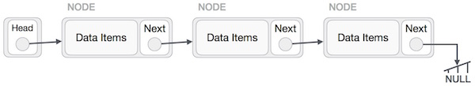
011.1 Linked List Representation
https://www.tutorialspoint.com/data_structures_algorithms/linked_list_algorithms.htm
Linked List Representation
Linked list can be visualized as a chain of nodes, where every node points to the next node.
As per the above illustration, following are the important points to be considered.
Linked List contains a link element called first.
Each link carries a data field(s) and a link field called next.
Each link is linked with its next link using its next link.
Last link carries a link as null to mark the end of the list.

Slide 5
011.2 Types of Linked List

Slide 6
011.2 Types of Linked List
https://www.tutorialspoint.com/data_structures_algorithms/linked_list_algorithms.htm
Types of Linked List
Following are the various types of linked list.
Simple Linked List − Item navigation is forward only.
Doubly Linked List − Items can be navigated forward and backward.
Circular Linked List − Last item contains link of the first element as next and the first element has a link to the last element as previous.

Slide 7
011.3 Insertion Operation

Slide 8
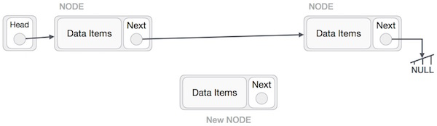
011.3 Insertion Operation
https://www.tutorialspoint.com/data_structures_algorithms/linked_list_algorithms.htm
Insertion Operation
Adding a new node in linked list is a more than one step activity.
We shall learn this with diagrams here.
First, create a node using the same structure and find the location where it has to be inserted.

Slide 9
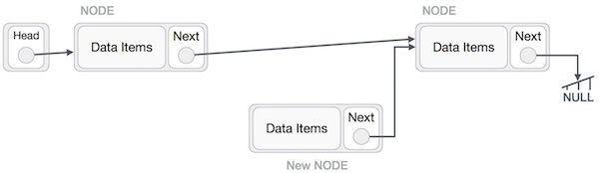
011.3 Insertion Operation
https://www.tutorialspoint.com/data_structures_algorithms/linked_list_algorithms.htm
Insertion Operation
Imagine that we are inserting a node B (NewNode), between A (LeftNode) and C (RightNode).
Then point B.next to C:
> NewNode.next −> RightNode;
It should look like this

Slide 10
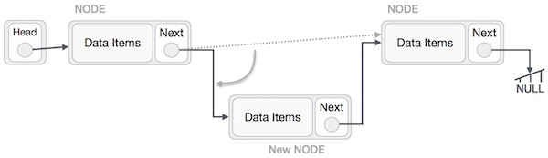
011.3 Insertion Operation
https://www.tutorialspoint.com/data_structures_algorithms/linked_list_algorithms.htm
Insertion Operation
Now, the next node at the left should point to the new node.
> LeftNode.next −> NewNode;

Slide 11
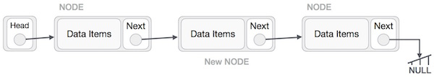
011.3 Insertion Operation
https://www.tutorialspoint.com/data_structures_algorithms/linked_list_algorithms.htm
Insertion Operation
This will put the new node in the middle of the two. The new list should look like this.
Similar steps should be taken if the node is being inserted at the beginning of the list.
While inserting it at the end, the second last node of the list should point to the new node and the new node will point to NULL.

Slide 12
011.4 Deletion Operation

Slide 13
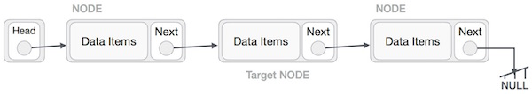
011.4 Deletion Operation
https://www.tutorialspoint.com/data_structures_algorithms/linked_list_algorithms.htm
Deletion Operation
Deletion is also a more than one step process.
We shall learn with pictorial representation.
First, locate the target node to be removed, by using searching algorithms.

Slide 14
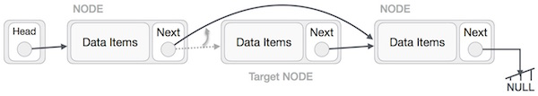
011.4 Deletion Operation
https://www.tutorialspoint.com/data_structures_algorithms/linked_list_algorithms.htm
Deletion Operation
The left (previous) node of the target node now should point to the next node of the target node −
> LeftNode.next −> TargetNode.next;
This will remove the link that was pointing to the target node.

Slide 15
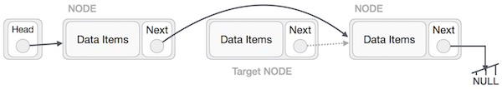
011.4 Deletion Operation
https://www.tutorialspoint.com/data_structures_algorithms/linked_list_algorithms.htm
Deletion Operation
Now, using the following code, we will remove what the target node is pointing at.
> TargetNode.next −> NULL;

Slide 16
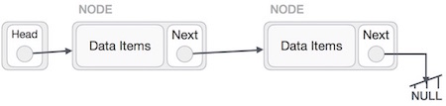
011.4 Deletion Operation
https://www.tutorialspoint.com/data_structures_algorithms/linked_list_algorithms.htm
Deletion Operation
We need to use the deleted node.
We can keep that in memory, otherwise, we can simply deallocate memory and wipe off the target node completely.

Slide 17
011.5 Reverse Operation

Slide 18
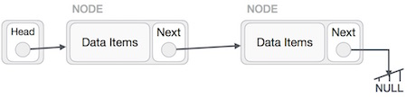
011.5 Reverse Operation
https://www.tutorialspoint.com/data_structures_algorithms/linked_list_algorithms.htm
Reverse Operation
This operation is a thorough one.
We need to make the last node to be pointed by the head node and reverse the whole linked list.

Slide 19
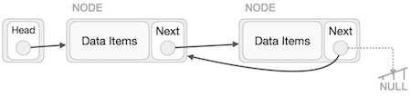
011.5 Reverse Operation
https://www.tutorialspoint.com/data_structures_algorithms/linked_list_algorithms.htm
Reverse Operation
First, we traverse to the end of the list.
It should be pointing to NULL.
Now, we shall make it point to its previous node −

Slide 20
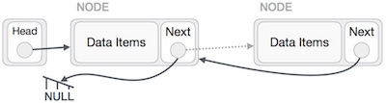
011.5 Reverse Operation
https://www.tutorialspoint.com/data_structures_algorithms/linked_list_algorithms.htm
Reverse Operation
We must make sure that the last node is not the last node.
So, we'll have some temp node, which looks like the head node pointing to the last node.
Now, we shall make all left side nodes point to their previous nodes one by one.

Slide 21
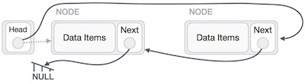
011.5 Reverse Operation
https://www.tutorialspoint.com/data_structures_algorithms/linked_list_algorithms.htm
Reverse Operation
Except the node (first node) pointed by the head node, all nodes should point to their predecessor, making them their new successor.
The first node will point to NULL.

Slide 22

011.5 Reverse Operation
https://www.tutorialspoint.com/data_structures_algorithms/linked_list_algorithms.htm
Reverse Operation
We'll make the head node point to the new first node by using the temp node.
The linked list is now reversed.

Slide 23
011.6 Linked List C Implementation

Slide 24
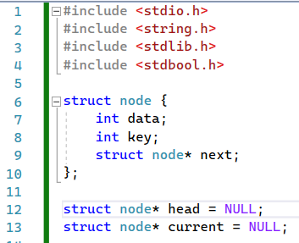
011.6 Linked List C Implementation
https://www.tutorialspoint.com/data_structures_algorithms/linked_list_program_in_c.htm
Linked List C Implementation
A linked list is a sequence of data structures, which are connected together via links.
Linked List is a sequence of links which contains items.
Each link contains a connection to another link.
Linked list is the second most-used data structure after array.

Slide 25
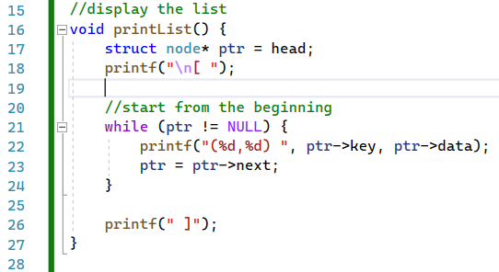
011.6 Linked List C Implementation
https://www.tutorialspoint.com/data_structures_algorithms/linked_list_program_in_c.htm
Linked List C Implementation
printList():

Slide 26
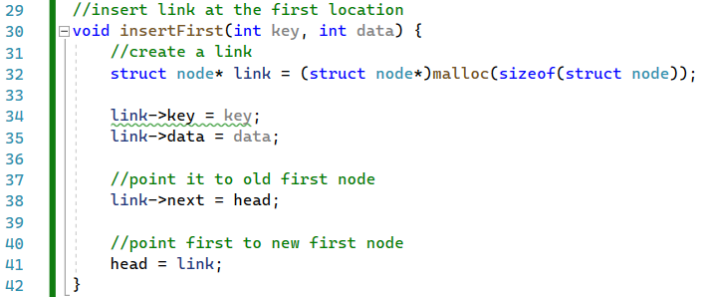
011.6 Linked List C Implementation
https://www.tutorialspoint.com/data_structures_algorithms/linked_list_program_in_c.htm
Linked List C Implementation
insertFirst():
head = null; at very beginning

Slide 27
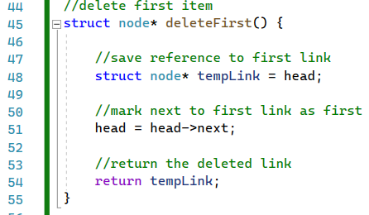
011.6 Linked List C Implementation
https://www.tutorialspoint.com/data_structures_algorithms/linked_list_program_in_c.htm
Linked List C Implementation
deletFirst():
free (tempLink)???
tempLink = NULL????

Slide 28
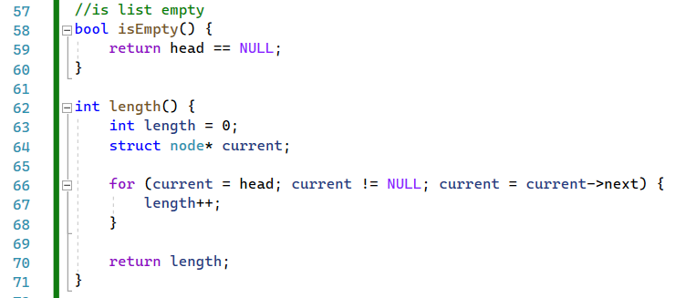
011.6 Linked List C Implementation
https://www.tutorialspoint.com/data_structures_algorithms/linked_list_program_in_c.htm
Linked List C Implementation
isEmpty() and length():
Check if head == NULL, then True
If head != null, the False.

Slide 29
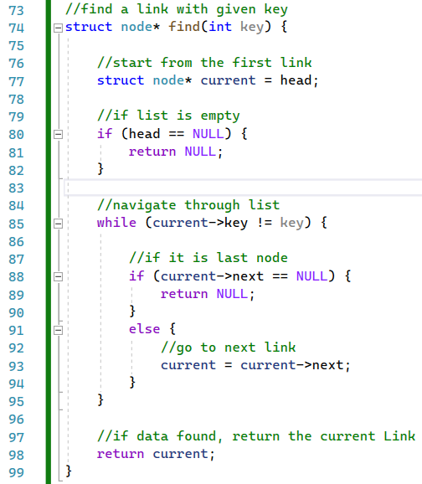
011.6 Linked List C Implementation
https://www.tutorialspoint.com/data_structures_algorithms/linked_list_program_in_c.htm
Linked List C Implementation
find()

Slide 30
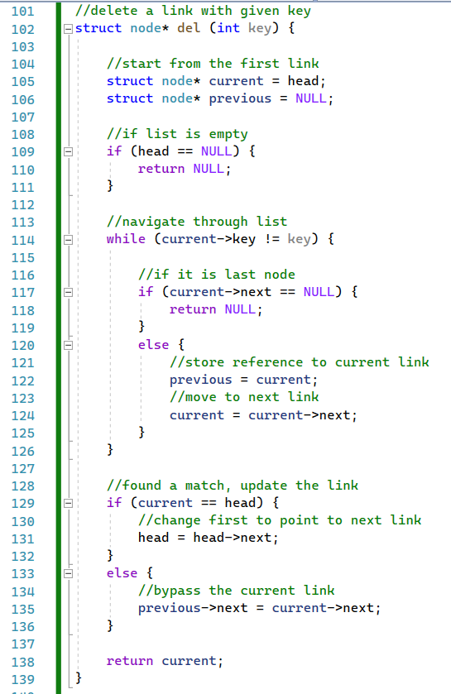
011.6 Linked List C Implementation
https://www.tutorialspoint.com/data_structures_algorithms/linked_list_program_in_c.htm
Linked List C Implementation
del()

Slide 31
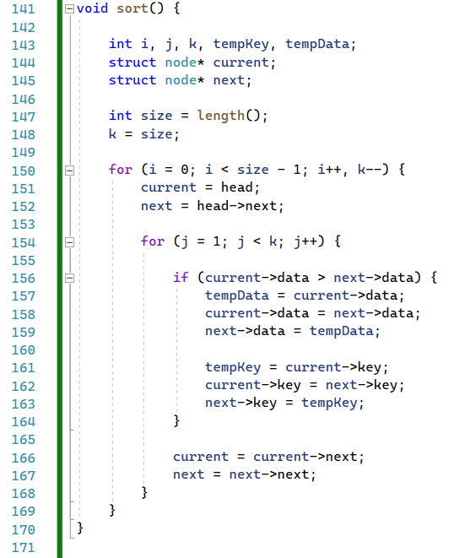
011.6 Linked List C Implementation
https://www.tutorialspoint.com/data_structures_algorithms/linked_list_program_in_c.htm
Linked List C Implementation
sort()

Slide 32
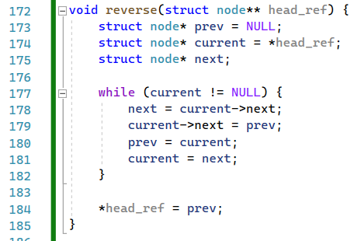
011.6 Linked List C Implementation
https://www.tutorialspoint.com/data_structures_algorithms/linked_list_program_in_c.htm
Linked List C Implementation
reverse()

Slide 33
011.8 Linked List C: main()

Slide 34
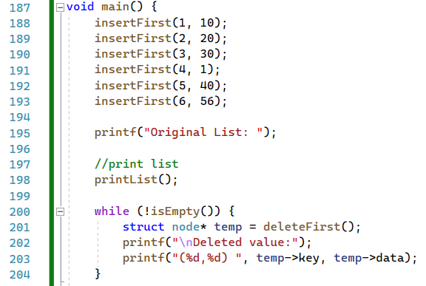
011.6 Linked List C: main()
https://www.tutorialspoint.com/data_structures_algorithms/linked_list_program_in_c.htm
Linked List C: main()
insertFirst(), printList(), isEmpty()

Slide 35
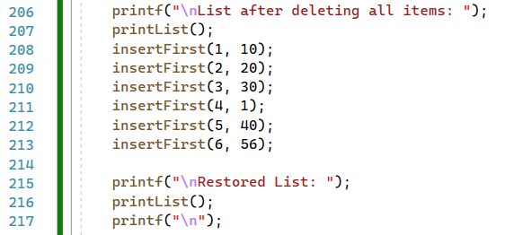
011.6 Linked List C: main()
https://www.tutorialspoint.com/data_structures_algorithms/linked_list_program_in_c.htm
Linked List C: main()
insertFirst() and printList()

Slide 36
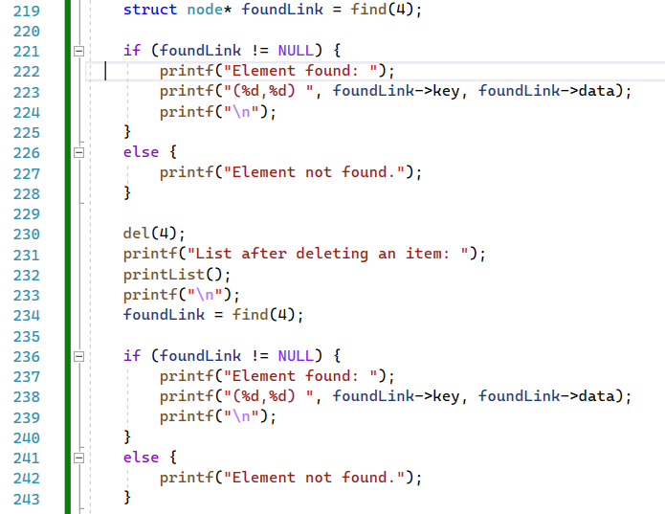
011.6 Linked List C: main()
https://www.tutorialspoint.com/data_structures_algorithms/linked_list_program_in_c.htm
Linked List C: main()
find() and del()

Slide 37
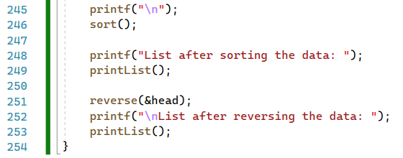
011.6 Linked List C: main()
https://www.tutorialspoint.com/data_structures_algorithms/linked_list_program_in_c.htm
Linked List C: main()
sort() and reverse()

Slide 38
011.7 Linked List C: Result

Slide 39
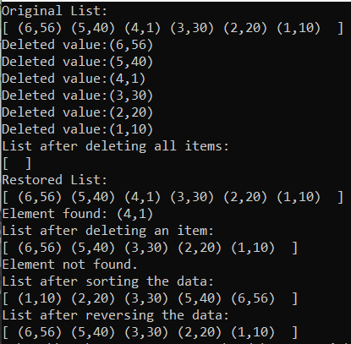
011.7 Linked List C: Result
https://www.tutorialspoint.com/data_structures_algorithms/linked_list_algorithms.htm
Linked List C: Result

Slide 40
End

