Slide 1

012_01 Double Linked List: C
Peter H. Chen

Slide 2
012 Double Linked List: C
https://www.tutorialspoint.com/data_structures_algorithms/doubly_linked_list_algorithm.htm
Double Linked List: C
Doubly Linked List is a variation of Linked list in which navigation is possible in both ways, either forward and backward easily as compared to Single Linked List.
Following are the important terms to understand the concept of doubly linked list.
Link − Each link of a linked list can store a data called an element.
Next − Each link of a linked list contains a link to the next link called Next.
Prev − Each link of a linked list contains a link to the previous link called Prev.
LinkedList − A Linked List contains the connection link to the first link called First and to the last link called Last.

Slide 3
012_01.1 Double Linked List Representation

Slide 4
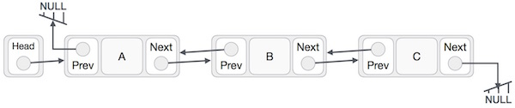
012_01.1 Double Linked List Representation
https://www.tutorialspoint.com/data_structures_algorithms/doubly_linked_list_algorithm.htm
Double Linked List Representation
Below are the important points for double linked List.
Doubly Linked List contains a link element called first and last.
Each link carries a data field(s) and two link fields called next and prev.
Each link is linked with its next link using its next link.
Each link is linked with its previous link using its previous link.
The last link carries a link as null to mark the end of the list.

Slide 5
012_01.2 Basic Operations

Slide 6
012_01.2 Basic Operations
https://www.tutorialspoint.com/data_structures_algorithms/doubly_linked_list_algorithm.htm
Basic Operations
Following are the basic operations supported by a list.
Insertion − Adds an element at the beginning of the list.
Deletion − Deletes an element at the beginning of the list.
Insert Last − Adds an element at the end of the list.
Delete Last − Deletes an element from the end of the list.
Insert After − Adds an element after an item of the list.
Delete − Deletes an element from the list using the key.
Display forward − Displays the complete list in a forward manner.
Display backward − Displays the complete list in a backward manner.

Slide 7
012_01.3 Insert at First Operation

Slide 8
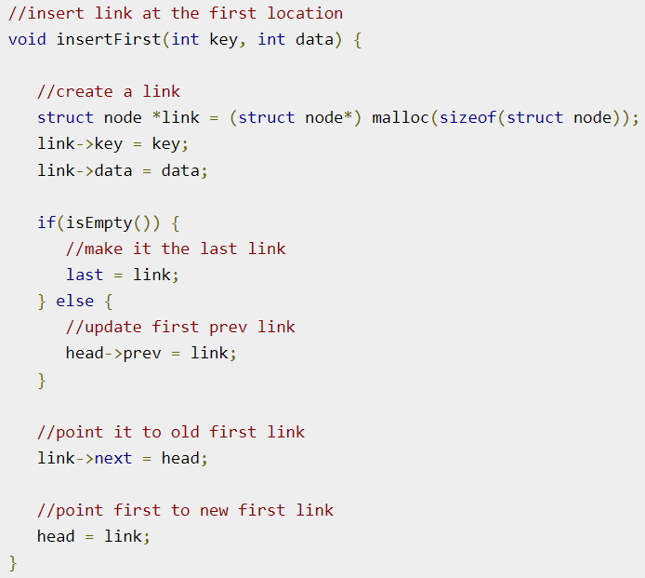
012_01.3 Insert at First Operation
https://www.tutorialspoint.com/data_structures_algorithms/doubly_linked_list_algorithm.htm
Insert at First Operation
Code as below.

Slide 9
012_01.4 Delete Operation

Slide 10
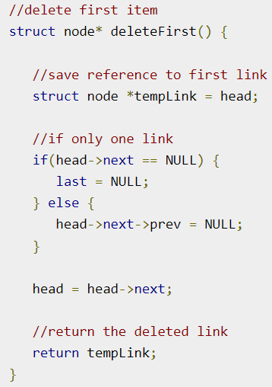
012_01.4 Delete Operation
https://www.tutorialspoint.com/data_structures_algorithms/doubly_linked_list_algorithm.htm
Delete Operation
Code as below.

Slide 11
012_01.4 Insert at End Operation

Slide 12
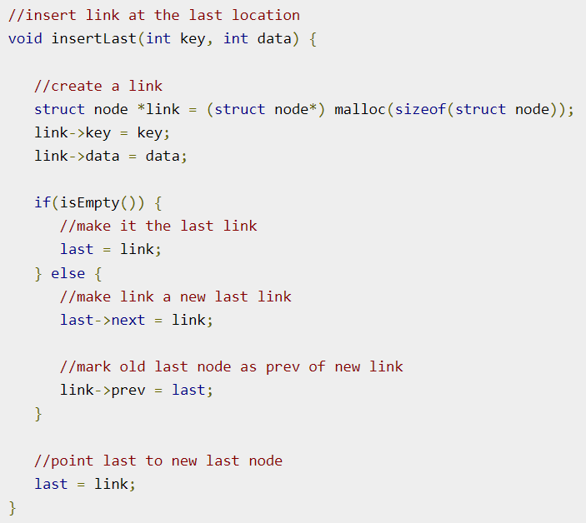
012_01.4 Insert at End Operation
https://www.tutorialspoint.com/data_structures_algorithms/doubly_linked_list_algorithm.htm
Insert at End Operation
Code as below.

Slide 13
012_01.4 Insert at End Operation

Slide 14
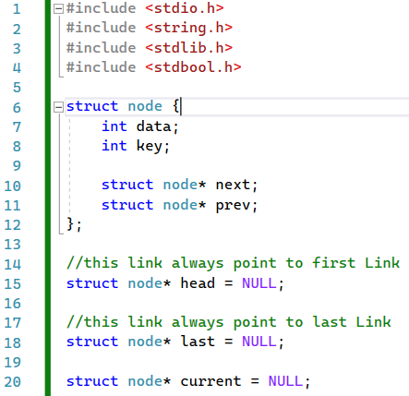
012_01.5 Double Linked List: Code
https://www.tutorialspoint.com/data_structures_algorithms/doubly_linked_list_program_in_c.htm
Double Linked List: Code
Data structure

Slide 15
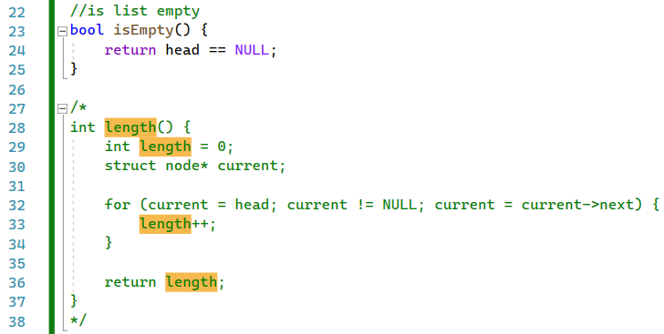
012_01.5 Double Linked List: Code
https://www.tutorialspoint.com/data_structures_algorithms/doubly_linked_list_program_in_c.htm
Double Linked List: Code
isEmpty()

Slide 16
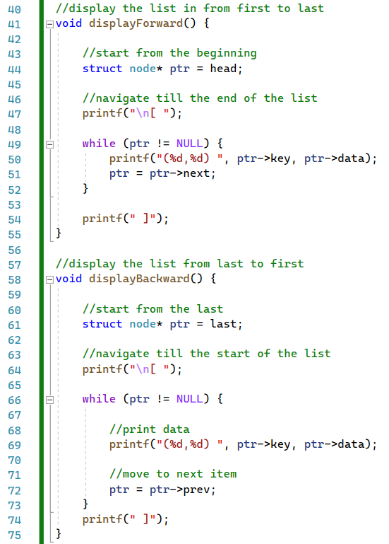
012_01.5 Double Linked List: Code
https://www.tutorialspoint.com/data_structures_algorithms/doubly_linked_list_program_in_c.htm
Double Linked List: Code
isEmpty()

Slide 17
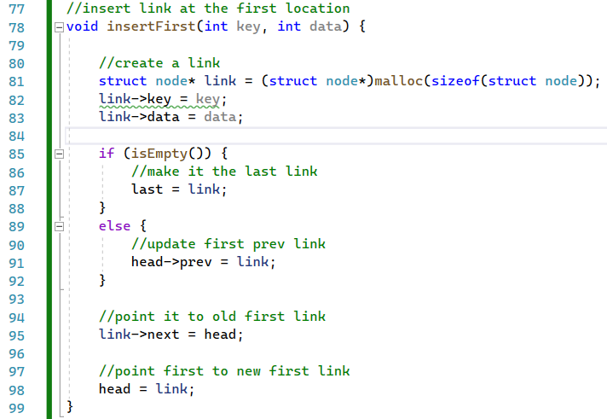
012_01.5 Double Linked List: Code
https://www.tutorialspoint.com/data_structures_algorithms/doubly_linked_list_program_in_c.htm
Double Linked List: Code
insertFirst()
2
Link
1
head
1
2
3
head
3

Slide 18
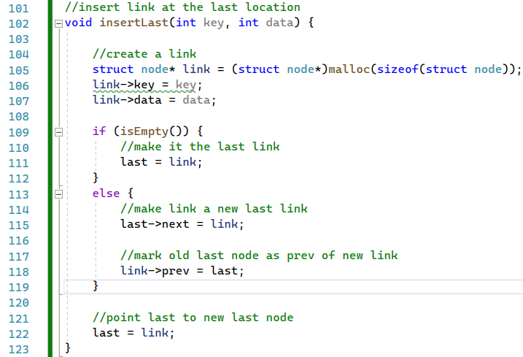
012_01.5 Double Linked List: Code
https://www.tutorialspoint.com/data_structures_algorithms/doubly_linked_list_program_in_c.htm
Double Linked List: Code
insertLast()
2
Link
1
1
last
2
3
3
last

Slide 19
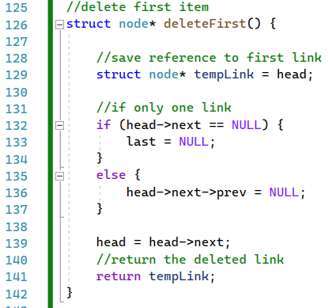
012_01.5 Double Linked List: Code
https://www.tutorialspoint.com/data_structures_algorithms/doubly_linked_list_program_in_c.htm
Double Linked List: Code
deleteFirst()
1
1
tmpLink
2
head
node
2
3
3
head

Slide 20
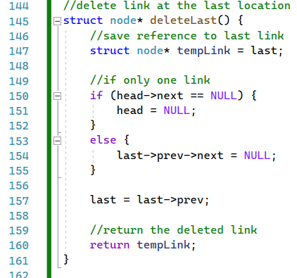
012_01.5 Double Linked List: Code
https://www.tutorialspoint.com/data_structures_algorithms/doubly_linked_list_program_in_c.htm
Double Linked List: Code
insertLast()
1
tmpLink
1
2
last
node
2
3
last
3

Slide 21
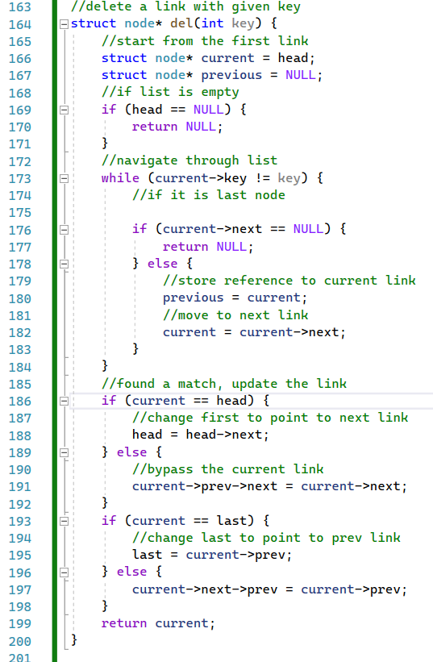
012_01.5 Double Linked List: Code
https://www.tutorialspoint.com/data_structures_algorithms/doubly_linked_list_program_in_c.htm
Double Linked List: Code
del()

Slide 22
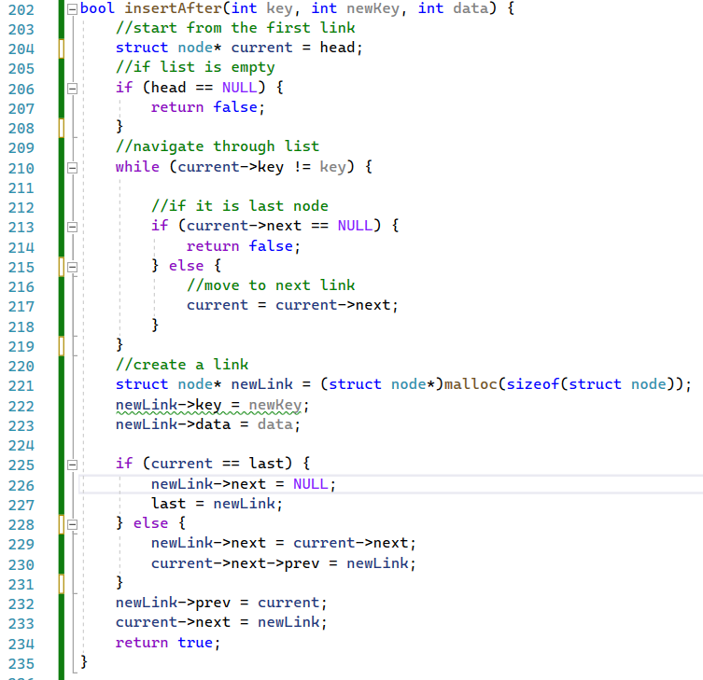
012_01.5 Double Linked List: Code
https://www.tutorialspoint.com/data_structures_algorithms/doubly_linked_list_program_in_c.htm
Double Linked List: Code
insertAfter()

Slide 23
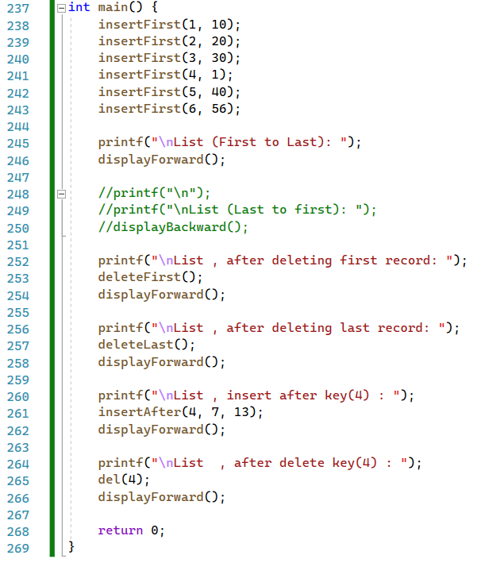
012_01.5 Double Linked List: Code
https://www.tutorialspoint.com/data_structures_algorithms/doubly_linked_list_program_in_c.htm
Double Linked List: Code
main()

Slide 24
End

