Slide 1

012_01 Double Linked List: STL
Peter H. Chen

Slide 2
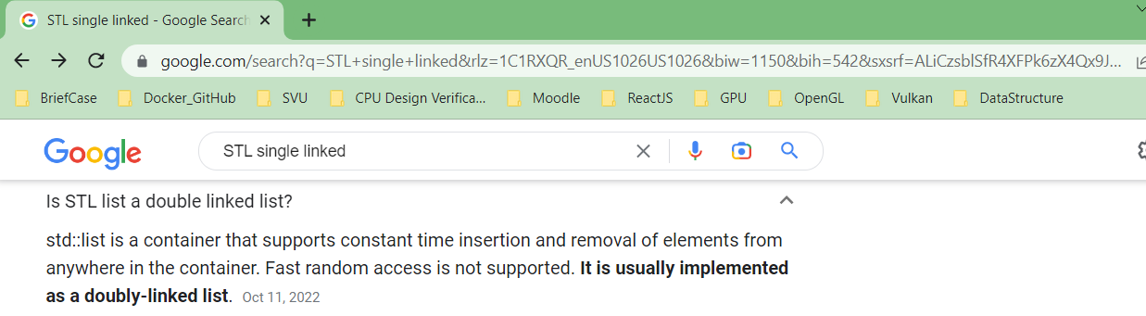
012_01 Double Linked List: STL
https://en.cppreference.com/w/cpp/container/list
Double Linked List: STL
STL was single linked list. Now, STL only keep the double linked list.
The code example here is same as 011_02 Linked List: STL

Slide 3
012_02.1 Double Linked List: STL

Slide 4
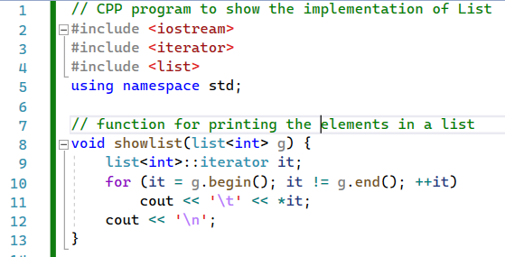
012_02.1 Double Linked List: STL
https://www.geeksforgeeks.org/list-cpp-stl/
Double Linked List: STL
showList().

Slide 5
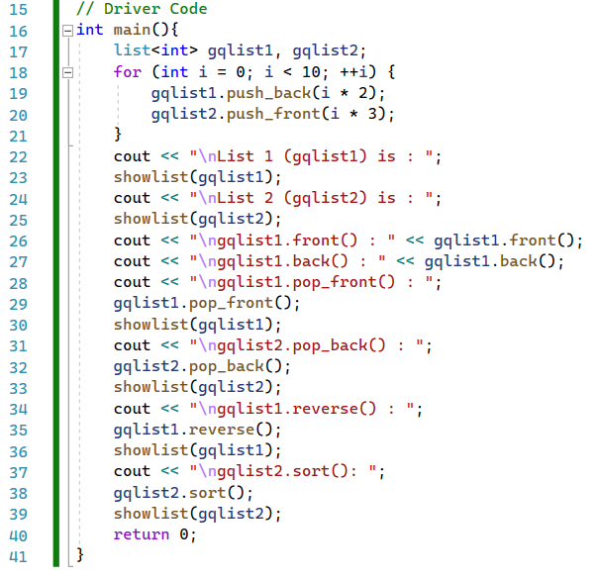
012_02.1 Double Linked List: STL
https://www.geeksforgeeks.org/list-cpp-stl/
Double Linked List: STL
main()

Slide 6
End

