Slide 1

013_01 Circular Linked List: C
Peter H. Chen

Slide 2
013_01 Circular Linked List: C
https://www.tutorialspoint.com/data_structures_algorithms/circular_linked_list_algorithm.htm
Circular Linked List: C
Circular Linked List is a variation of Linked list in which the first element points to the last element and the last element points to the first element.
Both Singly Linked List and Doubly Linked List can be made into a circular linked list.

Slide 3
013_01.1 Singly Linked List as Circular: C

Slide 4

013_01.1 Singly Linked List as Circular: C
https://www.tutorialspoint.com/data_structures_algorithms/circular_linked_list_algorithm.htm
Singly Linked List as Circular: C
In singly linked list, the next pointer of the last node points to the first node.

Slide 5
013_01.2 Double Linked List as Circular: C

Slide 6

013_01.2 Double Linked List as Circular: C
https://www.tutorialspoint.com/data_structures_algorithms/circular_linked_list_algorithm.htm
Double Linked List as Circular: C
In doubly linked list, the next pointer of the last node points to the first node and the previous pointer of the first node points to the last node making the circular in both directions.
As per the above illustration, following are the important points to be considered.
The last link's next points to the first link of the list in both cases of singly as well as doubly linked list.
The first link's previous points to the last of the list in case of doubly linked list.

Slide 7
013_01.3 Basic Operation: C

Slide 8
013_01.3 Basic Operation: C
https://www.tutorialspoint.com/data_structures_algorithms/circular_linked_list_algorithm.htm
Basic Operation: C
Following are the important operations supported by a circular list.
insert − Inserts an element at the start of the list.
delete − Deletes an element from the start of the list.
display − Displays the list.

Slide 9
013_01.4 Insertion Operation

Slide 10
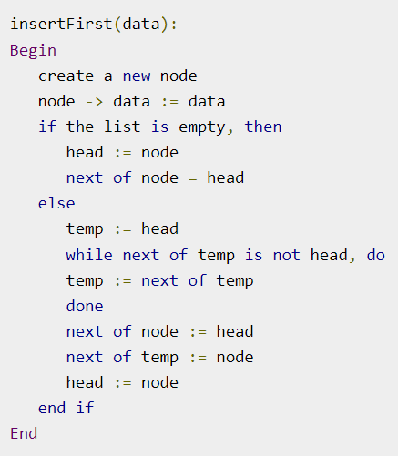
013_01.4 Insertion Operation
https://www.tutorialspoint.com/data_structures_algorithms/circular_linked_list_algorithm.htm
Insertion Operation
Following code demonstrates the insertion operation in a circular linked list based on single linked list.

Slide 11
013_01.5 Deletion Operation

Slide 12
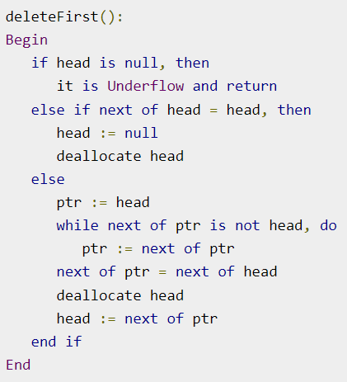
013_01.5 Deletion Operation
https://www.tutorialspoint.com/data_structures_algorithms/circular_linked_list_algorithm.htm
Deletion Operation:
Following code demonstrates the deletion operation in a circular linked list based on single linked list.

Slide 13
013_01.6 Display List Operation

Slide 14
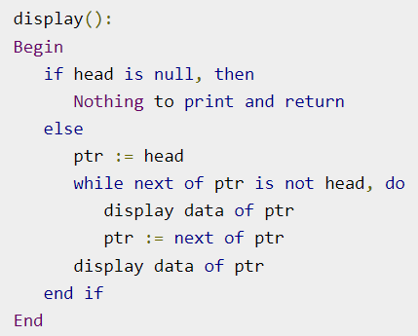
013_01.6 Display List Operation
https://www.tutorialspoint.com/data_structures_algorithms/circular_linked_list_algorithm.htm
Display List Operation:
Following code demonstrates the display list operation in a circular linked list.

Slide 15
013_01.7 Circular Single Linked List: C

Slide 16
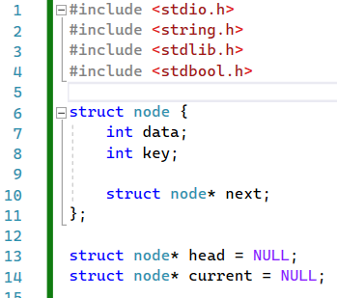
013_01.7 Circular Single Linked List: C
https://www.tutorialspoint.com/data_structures_algorithms/circular_linked_list_algorithm.htm
Circular Linked List: C
Defined structure.

Slide 17
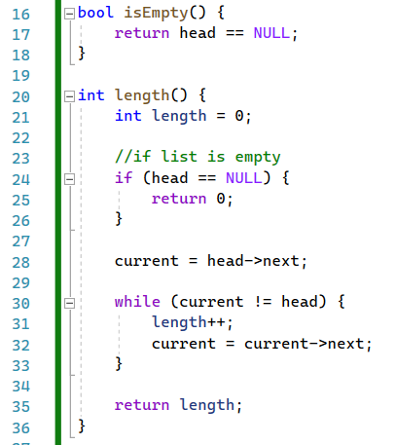
013_01.7 Circular Single Linked List: C
https://www.tutorialspoint.com/data_structures_algorithms/circular_linked_list_algorithm.htm
Circular Linked List: C
isEmpty() and length()

Slide 18
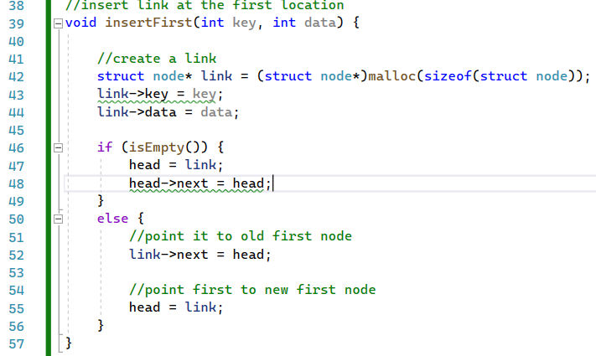
013_01.7 Circular Single Linked List: C
https://www.tutorialspoint.com/data_structures_algorithms/circular_linked_list_algorithm.htm
Circular Linked List: C
insertFirst()

Slide 19
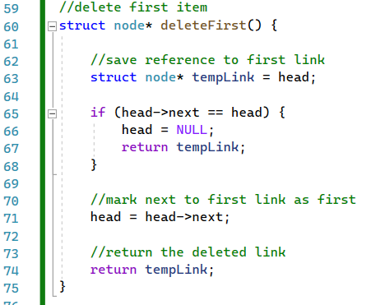
013_01.7 Circular Single Linked List: C
https://www.tutorialspoint.com/data_structures_algorithms/circular_linked_list_algorithm.htm
Circular Linked List: C
insertFirst()

Slide 20
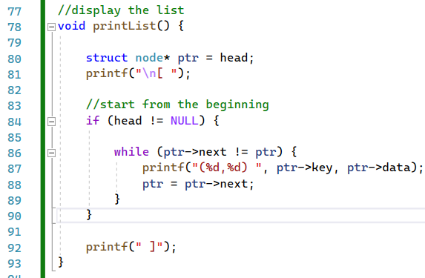
013_01.7 Circular Single Linked List: C
https://www.tutorialspoint.com/data_structures_algorithms/circular_linked_list_algorithm.htm
Circular Linked List: C
printList()

Slide 21
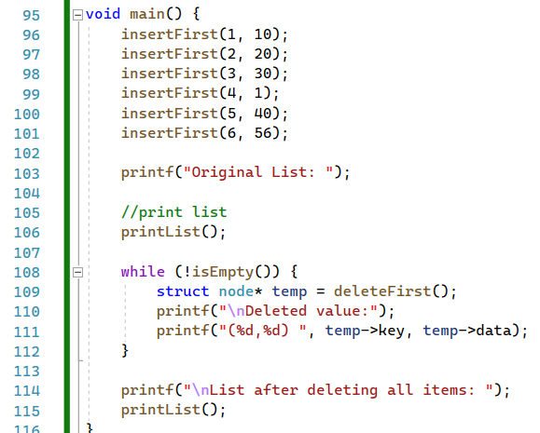
013_01.7 Circular Single Linked List: C
https://www.tutorialspoint.com/data_structures_algorithms/circular_linked_list_algorithm.htm
Circular Linked List: C
main()

Slide 22
End

