Slide 1

013_02 Circular Linked List: CPP
Peter H. Chen

Slide 2
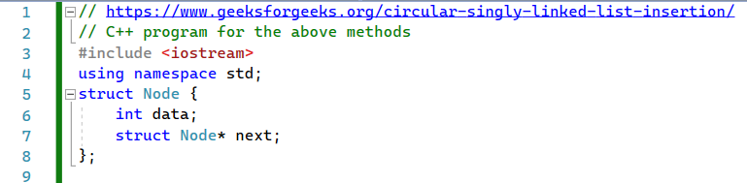
013_02 Circular Linked List: CPP
https://www.geeksforgeeks.org/circular-singly-linked-list-insertion/
Circular Linked List: CPP
Define structure.

Slide 3
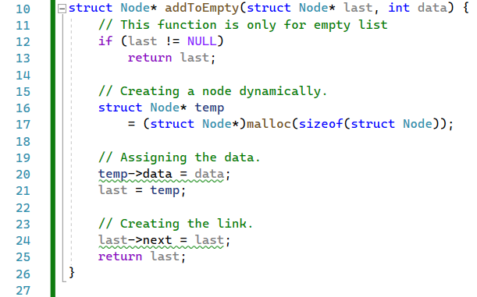
013_02 Circular Linked List: CPP
https://www.geeksforgeeks.org/circular-singly-linked-list-insertion/
Circular Linked List: CPP
addToEmpty().

Slide 4
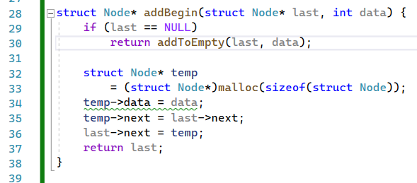
013_02 Circular Linked List: CPP
https://www.geeksforgeeks.org/circular-singly-linked-list-insertion/
Circular Linked List: CPP
addToBegin().

Slide 5
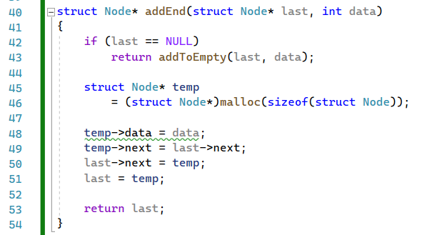
013_02 Circular Linked List: CPP
https://www.geeksforgeeks.org/circular-singly-linked-list-insertion/
Circular Linked List: CPP
addToEnd().

Slide 6
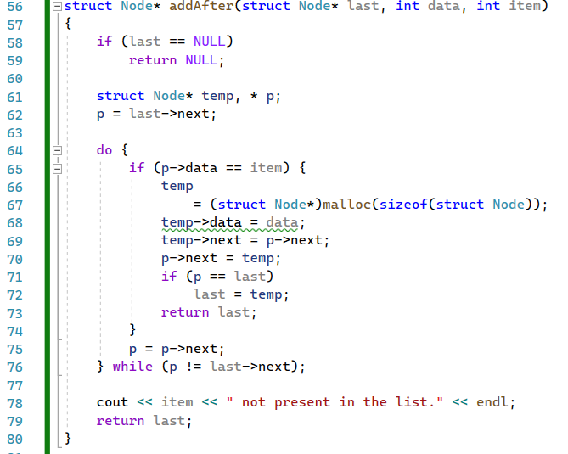
013_02 Circular Linked List: CPP
https://www.geeksforgeeks.org/circular-singly-linked-list-insertion/
Circular Linked List: CPP
addToAfter().

Slide 7
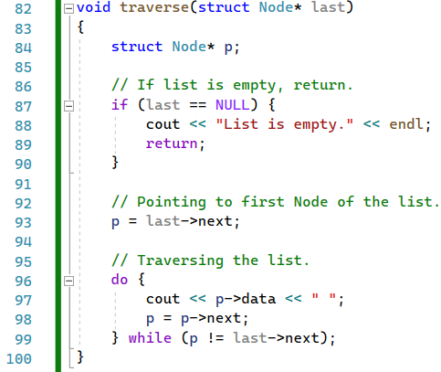
013_02 Circular Linked List: CPP
https://www.geeksforgeeks.org/circular-singly-linked-list-insertion/
Circular Linked List: CPP
traverse().

Slide 8
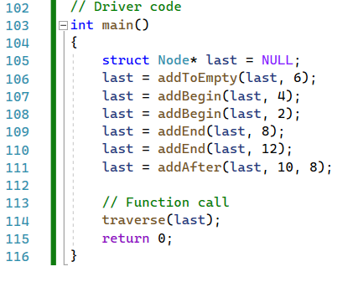
013_02 Circular Linked List: CPP
https://www.geeksforgeeks.org/circular-singly-linked-list-insertion/
Circular Linked List: CPP
main().

Slide 9

013_02 Circular Linked List: CPP
https://www.geeksforgeeks.org/circular-singly-linked-list-insertion/
Circular Linked List: CPP
Result

Slide 10
End

