Slide 1

030_01 Breath First Traverse: C
Peter H. Chen

Slide 2
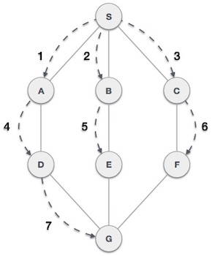
030_01 Breath First Traverse: C
https://www.tutorialspoint.com/data_structures_algorithms/depth_first_traversal.htm
Breath First Traverse: C
Breadth First Search (BFS) algorithm traverses a graph in a breadthward motion and uses a queue to remember to get the next vertex to start a search, when a dead end occurs in any iteration.

Slide 3
030_01 Breath First Traverse: CPP
https://www.tutorialspoint.com/data_structures_algorithms/depth_first_traversal.htm
Breath First Traverse: C
As in the example below, BFS algorithm traverses from S to A, B, and C first; then to D, E, and F; lastly to G.
It employs the following rules.
Rule 1 − Visit the adjacent unvisited vertex. Mark it as visited. Display it. Insert it in a queue.
Rule 2 − If no adjacent vertex is found, remove the first vertex from the queue.
Rule 3 − Repeat Rule 1 and Rule 2 until the queue is empty.

Slide 4
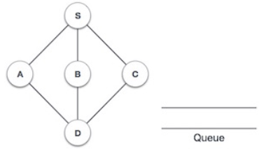
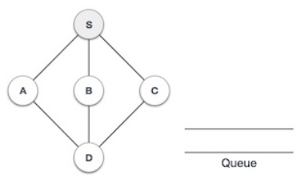
030_01 Breath First Traverse: CPP
https://www.tutorialspoint.com/data_structures_algorithms/depth_first_traversal.htm
Breath First Traverse: C
Step | Traversal | Description
1 |  | Initialize the queue.
2 |  | We start from visiting S (starting node), and mark it as visited.

Slide 5
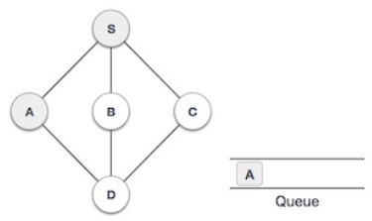
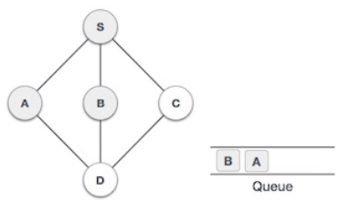
030_01 Breath First Traverse: CPP
https://www.tutorialspoint.com/data_structures_algorithms/depth_first_traversal.htm
Breath First Traverse: C
Step | Traversal | Description
3 |  | We then see an unvisited adjacent node from S. In this example, we have three nodes but alphabetically we choose A, mark it as visited and enqueue it.
4 |  | Next, the unvisited adjacent node from S is B. We mark it as visited and enqueue it.

Slide 6
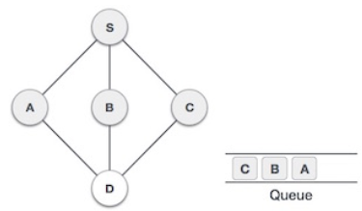
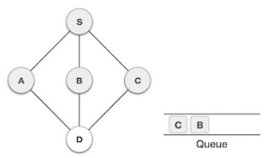
030_01 Breath First Traverse: CPP
https://www.tutorialspoint.com/data_structures_algorithms/depth_first_traversal.htm
Breath First Traverse: C
Step | Traversal | Description
5 |  | Next, the unvisited adjacent node from S is C. We mark it as visited and enqueue it.
6 |  | Now, S is left with no unvisited adjacent nodes. So, we dequeue and find A.

Slide 7
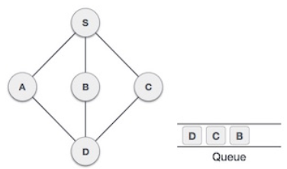
030_01 Breath First Traverse: CPP
https://www.tutorialspoint.com/data_structures_algorithms/depth_first_traversal.htm
Breath First Traverse: C
Step | Traversal | Description
7 |  | From A we have D as unvisited adjacent node. We mark it as visited and enqueue it.
At this stage, we are left with no unmarked (unvisited) nodes.
But as per the algorithm we keep on dequeuing in order to get all unvisited nodes.
When the queue gets emptied, the program is over.

Slide 8
030_01.2 Breath First Traverse: C Code

Slide 9
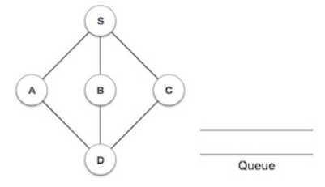
030_01.2 Breath First Traverse: C Code
https://www.tutorialspoint.com/data_structures_algorithms/breadth_first_traversal_in_c.htm
Breath First Traverse: C Code
We will see the implementation of Breadth First Traversal (or Breadth First Search) in C programming language.

Slide 10
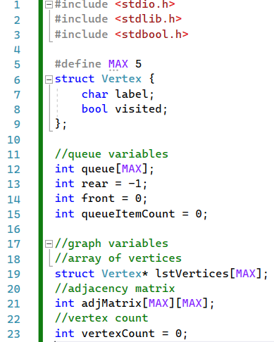
030_01.2 Breath First Traverse: C Code
https://www.tutorialspoint.com/data_structures_algorithms/breadth_first_traversal_in_c.htm
Breath First Traverse: C Code
Define Data

Slide 11
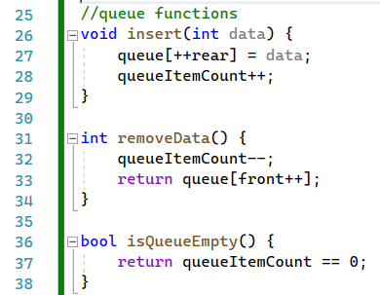
030_01.2 Breath First Traverse: C Code
https://www.tutorialspoint.com/data_structures_algorithms/breadth_first_traversal_in_c.htm
Breath First Traverse: C Code
Queue function:
insert(), remove(), isQueueEmpty()

Slide 12
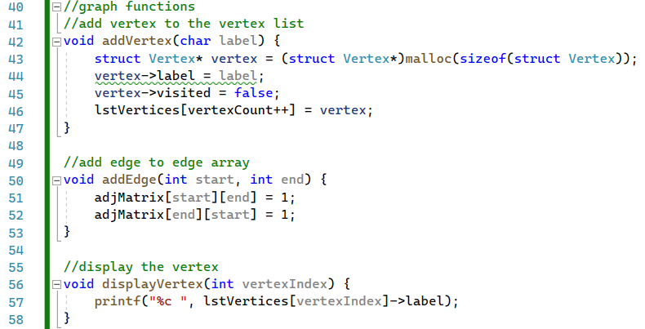
030_01.2 Breath First Traverse: C Code
https://www.tutorialspoint.com/data_structures_algorithms/breadth_first_traversal_in_c.htm
Breath First Traverse: C Code
Graph function:
addVertex(), addEdge(), displayVertex()

Slide 13
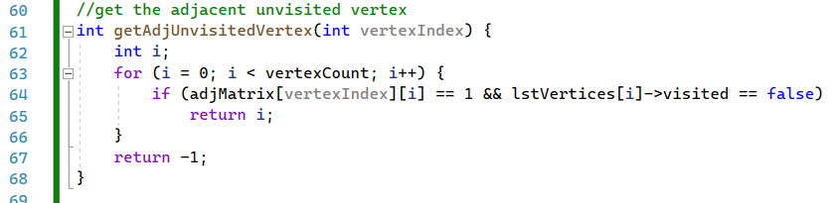
030_01.2 Breath First Traverse: C Code
https://www.tutorialspoint.com/data_structures_algorithms/breadth_first_traversal_in_c.htm
Breath First Traverse: C Code
Graph function:
getAdjUniverseVertex()

Slide 14
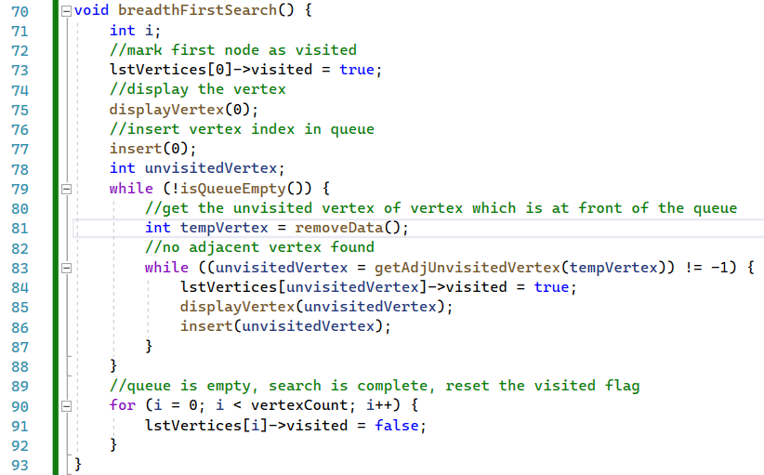
030_01.2 Breath First Traverse: C Code
https://www.tutorialspoint.com/data_structures_algorithms/breadth_first_traversal_in_c.htm
Breath First Traverse: C Code
Graph function:
breathFirstSearch()

Slide 15
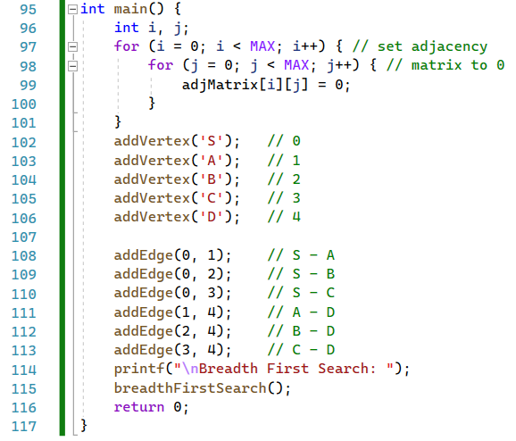
030_01.2 Breath First Traverse: C Code
https://www.tutorialspoint.com/data_structures_algorithms/breadth_first_traversal_in_c.htm
Breath First Traverse: C Code
main().

Slide 16

030_01.2 Breath First Traverse: C Code
https://www.tutorialspoint.com/data_structures_algorithms/breadth_first_traversal_in_c.htm
Breath First Traverse: C Code
Result

Slide 17
End

