Slide 1

030_02 Breath First Traverse: STL
Peter H. Chen

Slide 2
030_02 Breath First Traverse: STL
https://www.geeksforgeeks.org/breadth-first-search-or-bfs-for-a-graph/
Breath First Traverse: STL
Breadth-First Traversal (or Search) for a graph is similar to Breadth-First Traversal of a tree (See method 2 of this post).
The only catch here is, that, unlike trees, graphs may contain cycles, so we may come to the same node again. To avoid processing a node more than once, we divide the vertices into two categories:
Visited and
Not visited.
A boolean visited array is used to mark the visited vertices. For simplicity, it is assumed that all vertices are reachable from the starting vertex. BFS uses a queue data structure for traversal.

Slide 3
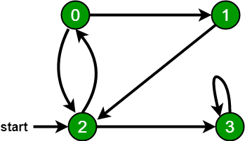
030_02 Breath First Traverse: STL
https://www.geeksforgeeks.org/breadth-first-search-or-bfs-for-a-graph/
Breath First Traverse: STL
In the following graph, we start traversal from vertex 2.
When we come to vertex 0, we look for all adjacent vertices of it.
2 is also an adjacent vertex of 0.
If we don’t mark visited vertices, then 2 will be processed again and it will become a non-terminating process.
There can be multiple BFS traversals for a graph.
Different BFS traversals for the above graph:
2, 3, 0, 1
2, 0, 3, 1

Slide 4
030_02.1 Breath First Traverse: STL

Slide 5
030_02.1 Breath First Traverse: STL
https://www.geeksforgeeks.org/breadth-first-search-or-bfs-for-a-graph/
Breath First Traverse: STL
Follow the below method to implement BFS traversal.
1. Declare a queue and insert the starting vertex.
2. Initialize a visited array and mark the starting vertex as visited.
3. Follow the below process till the queue becomes empty:
Remove the first vertex of the queue.
Mark that vertex as visited.
Insert all the unvisited neighbors of the vertex into the queue.

Slide 6
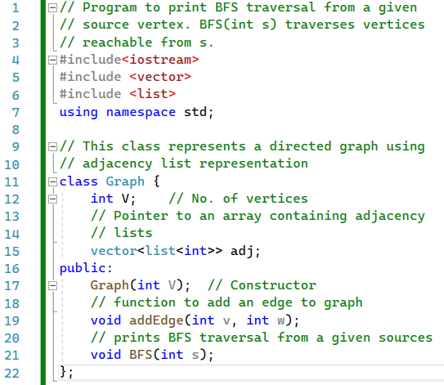
030_02.1 Breath First Traverse: STL
https://www.geeksforgeeks.org/breadth-first-search-or-bfs-for-a-graph/
Breath First Traverse: STL
Define Data.

Slide 7
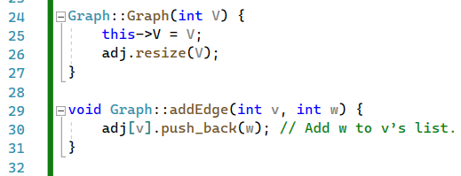
030_02.1 Breath First Traverse: STL
https://www.geeksforgeeks.org/breadth-first-search-or-bfs-for-a-graph/
Breath First Traverse: STL
Graph () and addEdge().

Slide 8
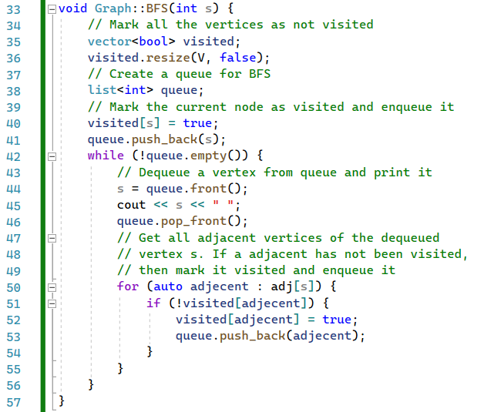
030_02.1 Breath First Traverse: STL
https://www.geeksforgeeks.org/breadth-first-search-or-bfs-for-a-graph/
Breath First Traverse: STL
BFS()

Slide 9
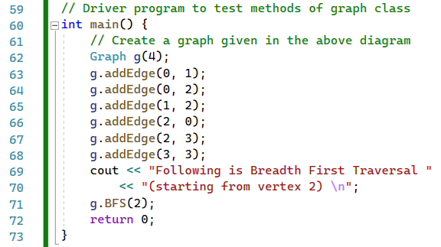
030_02.1 Breath First Traverse: STL
https://www.geeksforgeeks.org/breadth-first-search-or-bfs-for-a-graph/
Breath First Traverse: STL
main().

Slide 10

030_02.1 Breath First Traverse: STL
https://www.geeksforgeeks.org/breadth-first-search-or-bfs-for-a-graph/
Breath First Traverse: STL
Result

Slide 11
End

