Slide 1

010 Array Data Structure
Peter H. Chen

Slide 2
010 Array Data Structure
https://www.tutorialspoint.com/data_structures_algorithms/array_data_structure.htm
Array Data Structure
Array is a container which can hold a fix number of items and these items should be of the same type.
Most of the data structures make use of arrays to implement their algorithms. Following are the important terms to understand the concept of Array.
Element − Each item stored in an array is called an element.
Index − Each location of an element in an array has a numerical index, which is used to identify the element.

Slide 3
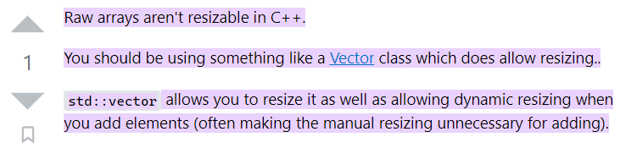
010 Array Data Structure
https://www.tutorialspoint.com/data_structures_algorithms/array_data_structure.htm
Array Data Structure
Note that array cannot be resize in C/C++.
We use C/C++ STL vector instead of C/C++ only.
https://stackoverflow.com/questions/3749660/how-to-resize-array-in-c#:~:text=Raw%20arrays%20aren't%20resizable,manual%20resizing%20unnecessary%20for%20adding).

Slide 4
010.1 Array Representation

Slide 5
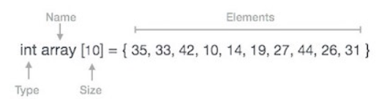
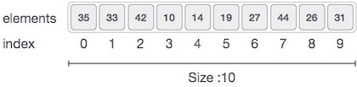
010.1 Array Representation
https://www.tutorialspoint.com/data_structures_algorithms/array_data_structure.htm
Array Representation
Arrays can be declared in various ways in different languages.
For illustration, let's take C array declaration.
Arrays can be declared in various ways in different languages.
For illustration, let's take C array declaration.

Slide 6
010.1 Array Representation
https://www.tutorialspoint.com/data_structures_algorithms/array_data_structure.htm
Array Representation
As per the above illustration, following are the important points to be considered.
Index starts with 0.
Array length is 10 which means it can store 10 elements.
Each element can be accessed via its index. For example, we can fetch an element at index 6 as 27.

Slide 7
010.2 Basic Operation

Slide 8
010.2 Basic Operation
https://www.tutorialspoint.com/data_structures_algorithms/array_data_structure.htm
Basic Operation
Following are the basic operations supported by an array.
Traverse − print all the array elements one by one.
Insertion − Adds an element at the given index.
Deletion − Deletes an element at the given index.
Search − Searches an element using the given index or by the value.
Update − Updates an element at the given index.

Slide 9
010.2 Basic Operation
https://www.tutorialspoint.com/data_structures_algorithms/array_data_structure.htm
Basic Operation
In C, when an array is initialized with size, then it assigns defaults values to its elements in following order.
Data Type | Default Value
bool | false
char | 0
int | 0
float | 0.0
double | 0.0f
void
wchar_t | 0

Slide 10
010.3 Traverse Operation

Slide 11
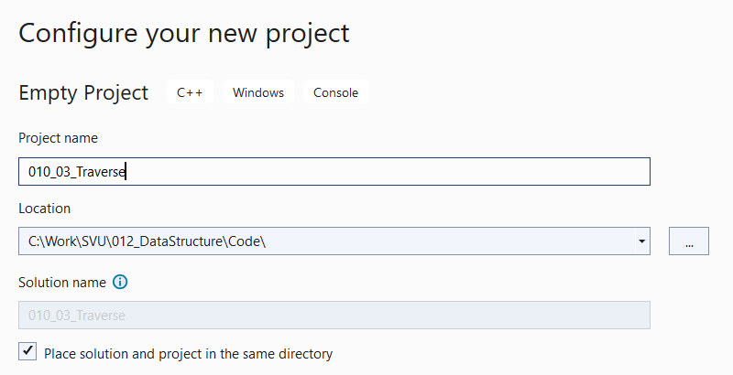
010.3 Traverse Operation
https://www.tutorialspoint.com/data_structures_algorithms/array_data_structure.htm
Create Empty Project
Start Visual Studio
Create Empty Project: 010_03_traverse

Slide 12
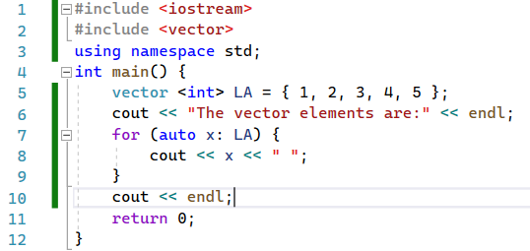

010.3 Traverse Operation
https://www.tutorialspoint.com/data_structures_algorithms/array_data_structure.htm
Traverse Operation
This operation is to traverse through the elements of an array.
Traverse Operation Example
Following program traverses and prints the elements of an array:

Slide 13
010.4 Insert Operation

Slide 14
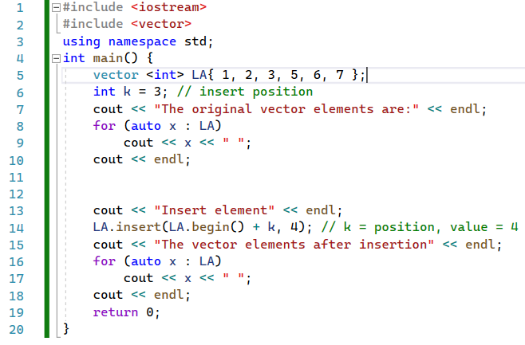
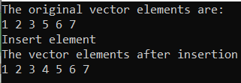
010.4 Insert Operation
https://www.tutorialspoint.com/data_structures_algorithms/array_data_structure.htm
Insert Operation
Insert operation is to insert one or more data elements into an array.
Based on the requirement, a new element can be added at the beginning, end, or any given index of array.

Slide 15
010.5 Delete Operation

Slide 16
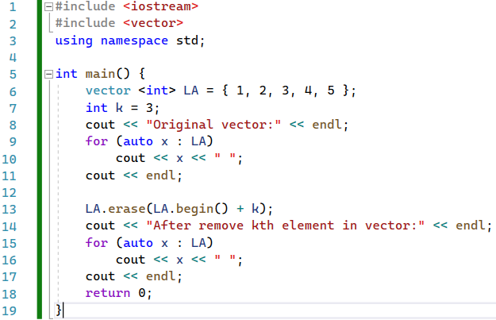

010.5 Delete Operation
https://www.tutorialspoint.com/data_structures_algorithms/array_data_structure.htm
Delete Operation
Deletion refers to removing an existing element from the array and re-organizing all elements of an array.

Slide 17
010.6 Find Operation

Slide 18
010.6 Find Operation
https://www.tutorialspoint.com/data_structures_algorithms/array_data_structure.htm
Find Operation
You can perform a search for an array element based on its value or its index.

Slide 19
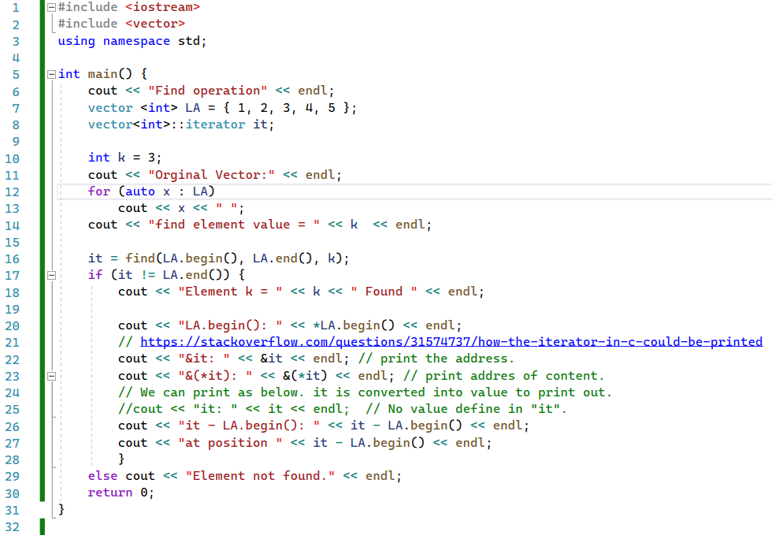
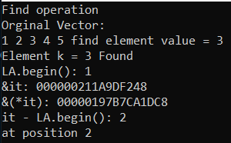
010.6 Find Operation
Note:
We cannot print iterator it. “it” is not defined yet.
We can print “it – LA.begin()”.
We can print address of reference “&it”
We can print address of iterator content “&(*it)”.
https://www.tutorialspoint.com/data_structures_algorithms/array_data_structure.htm

Slide 20
010.7 Index Value Replace at Operation

Slide 21
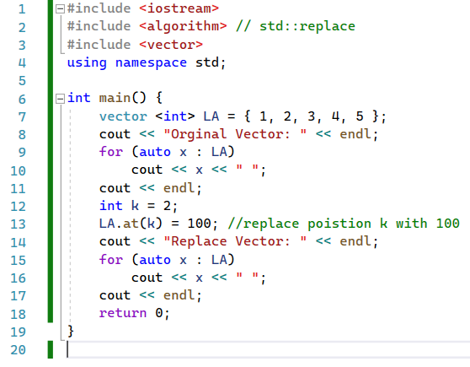

010.7 Index Value Replace at Operation
https://www.tutorialspoint.com/data_structures_algorithms/array_data_structure.htm
Index Vale Replace at Operation
Update operation refers to updating an existing element from the array at a given index.

Slide 22
010.7 Replace Value by Index

Slide 23
010.7 Replace Value by Index: at Operation
https://www.tutorialspoint.com/data_structures_algorithms/array_data_structure.htm
Replace Value by Index: at Operation
Update operation refers to updating an existing element from the array at a given index.

Slide 24
010.8 Update by Matched Value

Slide 25
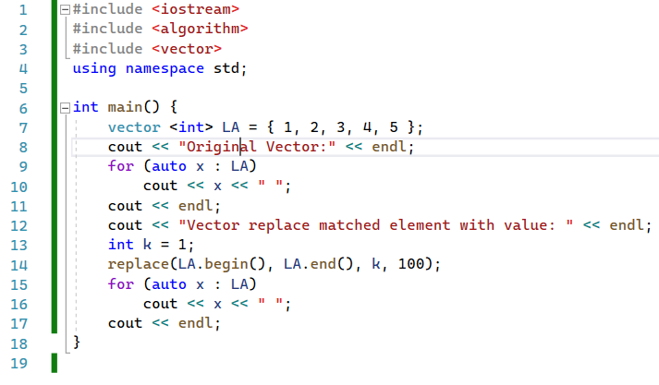

010.8 Update by Matched Value
https://www.tutorialspoint.com/data_structures_algorithms/array_data_structure.htm
Update by Matched Value
Below example is matched by value, not specified by index by (at position).

Slide 26
End

