Slide 1

011_02 Linked List: STL
Peter H. Chen

Slide 2
011_02 Linked List: STL
https://www.geeksforgeeks.org/list-cpp-stl/
Linked List: STL
We discuss Linked List in STL.

Slide 3
011_02.1 Linked List: STL Implementation

Slide 4
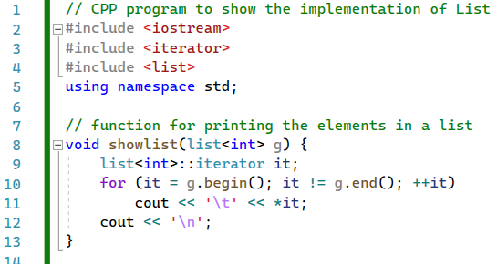
011_02.1 Linked List: STL Implementation
https://www.geeksforgeeks.org/list-cpp-stl/
Linked List: STL Implementation
showList():

Slide 5
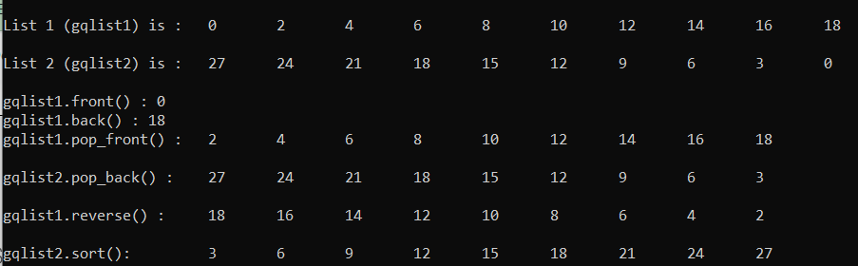
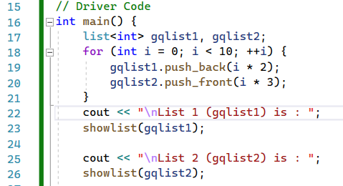
011_02.1 Linked List: STL Implementation
https://www.geeksforgeeks.org/list-cpp-stl/
Linked List: STL Implementation
Declare list<int> gqlist1, gqlist2;
0, 2, 4, 6, …, 18
Push_back: 0, 3, 6, 9, …, 18, 21, 24, 27
Push_front: 27, 24, 21, 18, …, 6, 3, 0

Slide 6
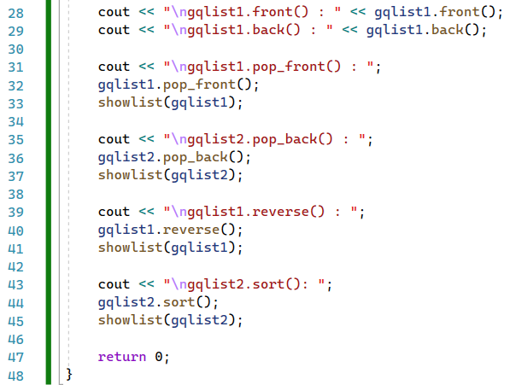
011_02.1 Linked List: STL Implementation
https://www.geeksforgeeks.org/list-cpp-stl/
Linked List: STL Implementation
front(), back(), pop_front(), pop_back(), reverse(), sort()

Slide 7
011_02.1 Linked List: STL Implementation
https://www.geeksforgeeks.org/list-cpp-stl/
Linked List: STL Implementation
front(), back(), pop_front(), pop_back(), reverse(), sort()

Slide 8
011_02.1 Linked List: STL Implementation
https://www.geeksforgeeks.org/list-cpp-stl/
Linked List: STL Implementation
front(), back(), pop_front(), pop_back(), reverse(), sort()

Slide 9
011_02.2 Linked List: STL Result

Slide 10
011_02.2 Linked List: STL Result
https://www.geeksforgeeks.org/list-cpp-stl/
Linked List: STL Result

Slide 11
End

