Slide 1

039_01 Fibonacci: C
Peter H. Chen

Slide 2

039_01 Fibonacci: C
https://www.tutorialspoint.com/data_structures_algorithms/fibonacci_series.htm
Fibonacci: C
Fibonacci series generates the subsequent number by adding two previous numbers.
Fibonacci series starts from two numbers: F₀ and F₁.
The initial values of F₀ and F₁ can be taken 0, 1 or 1, 1, respectively.
Fibonacci series satisfies the following conditions
Hence, a Fibonacci series can look like this −
F₈ = 0 1 1 2 3 5 8 13
or,
F₈ = 1 1 2 3 5 8 13 21

Slide 3
039_01.2 Rule
https://www.tutorialspoint.com/data_structures_algorithms/fibonacci_series.htm
Rule
Fibonacci of F₈ = 1 1 2 3 5 8 13 21 is displayed as

Slide 4
039_01.1 Fibonacci Iterative

Slide 5
039_01.1 Fibonacci Iterative Algorithm
https://quescol.com/interview-preparation/fibonacci-series-in-c-program
Fibonacci Iterative Pseudo Code
int n = 10;
int first = 0, second = 1, result;
for (int i = 0; i < n; i++) {
if (i <= 1) result = i;
else {
result = first + second;
first = second;
second = result;
}
}

Slide 6
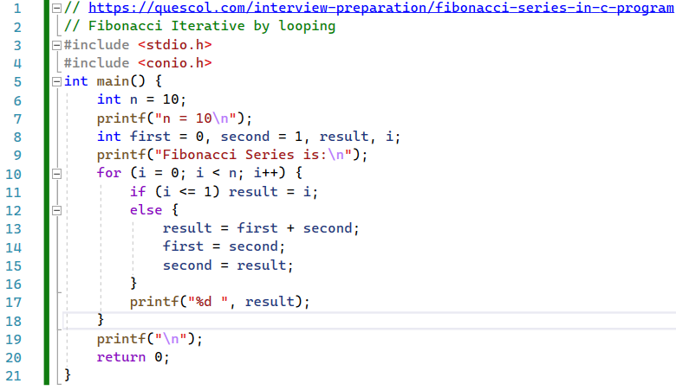
039_01.1 Fibonacci Iterative Algorithm
https://quescol.com/interview-preparation/fibonacci-series-in-c-program
Fibonacci Iterative Code
Iterative Fibonacci series.

Slide 7
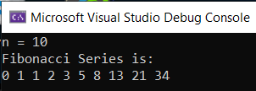
039_01.2 Fibonacci Iterative: C Code
https://quescol.com/interview-preparation/fibonacci-series-in-c-program
Fibonacci Iterative: C Code
Result

Slide 8
039_01.2 Fibonacci Recursive

Slide 9
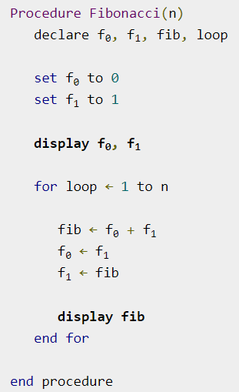
039_01.2 Fibonacci Recursive
https://www.tutorialspoint.com/data_structures_algorithms/fibonacci_series.htm
Fibonacci Recursive Algorithm
Iterative Fibonacci series.

Slide 10
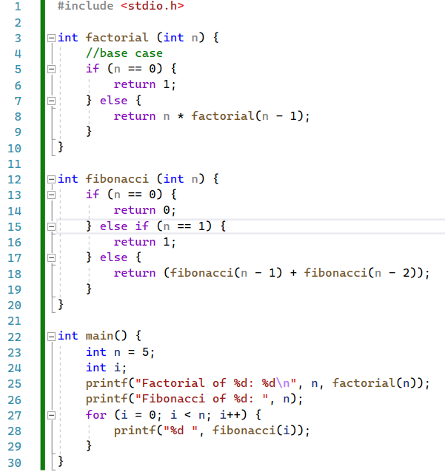
039_01.4 Fibonacci Recursive: C Code
https://www.tutorialspoint.com/data_structures_algorithms/fibonacci_iterative_program_in_c.htm
Fibonacci Recursive: C Code
factorial() and fibonacci ()

Slide 11

039_01.2 Fibonacci Recursive: C Code
https://www.tutorialspoint.com/data_structures_algorithms/fibonacci_iterative_program_in_c.htm
Fibonacci Recursive: C Code
Result

Slide 12
End

