Slide 1

039_03/04 Fibonacci Iterative/Recursive: CPP
Peter H. Chen

Slide 2
039_03 Fibonacci Iterative: CPP

Slide 3
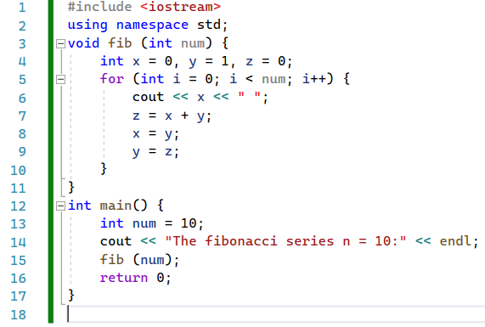
039_03 Fibonacci Iterative: CPP
https://www.tutorialspoint.com/cplusplus-program-to-find-fibonacci-numbers-using-recursion
Fibonacci Iterative: CPP

Slide 4

039_03 Fibonacci Iterative: CPP
https://www.tutorialspoint.com/cplusplus-program-to-find-fibonacci-numbers-using-recursion
Fibonacci Iterative: CPP
Result

Slide 5
039_04 Fibonacci Recursive: CPP

Slide 6
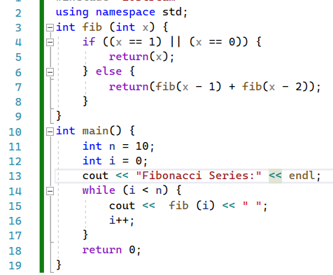
039_04 Fibonacci Iterative/Recursive: CPP
https://www.tutorialspoint.com/cplusplus-program-to-find-fibonacci-numbers-using-recursion
Fibonacci Recursive: CPP

Slide 7
039_04 Fibonacci Iterative/Recursive: CPP
https://www.tutorialspoint.com/cplusplus-program-to-find-fibonacci-numbers-using-recursion
Fibonacci Recursive: CPP
Result

Slide 8
End

