Slide 1

031_01 Tree: C
Peter H. Chen

Slide 2
031_01 Tree: C
https://www.tutorialspoint.com/data_structures_algorithms/tree_data_structure.htm
Tree: C
Tree represents the nodes connected by edges.
We will discuss binary tree or binary search tree specifically.
Binary Tree is a special data structure used for data storage purposes.
A binary tree has a special condition that each node can have a maximum of two children.

Slide 3
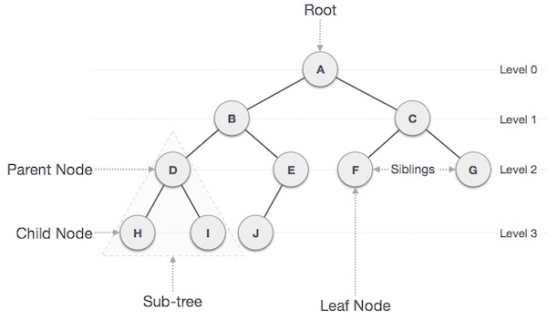
031_01 Tree: C
https://www.tutorialspoint.com/data_structures_algorithms/tree_data_structure.htm
Tree: C
A binary tree has the benefits of both an ordered array and a linked list as search is as quick as in a sorted array and insertion or deletion operation are as fast as in linked list.

Slide 4
031_01.1 Tree Terminology: C

Slide 5
031_01.1 Tree Terminology: C
https://www.tutorialspoint.com/data_structures_algorithms/breadth_first_traversal_in_c.htm
Tree Terminology: C Code
Following are the important terms with respect to tree.
Path − Path refers to the sequence of nodes along the edges of a tree.
Root − The node at the top of the tree is called root. There is only one root per tree and one path from the root node to any node.
Parent − Any node except the root node has one edge upward to a node called parent.
Child − The node below a given node connected by its edge downward is called its child node.
Leaf − The node which does not have any child node is called the leaf node.
Subtree − Subtree represents the descendants of a node.
Visiting − Visiting refers to checking the value of a node when control is on the node.
Traversing − Traversing means passing through nodes in a specific order.
Levels − Level of a node represents the generation of a node. If the root node is at level 0, then its next child node is at level 1, its grandchild is at level 2, and so on.
keys − Key represents a value of a node based on which a search operation is to be carried out for a node.

Slide 6
031_01.2 Binary Search Representation

Slide 7
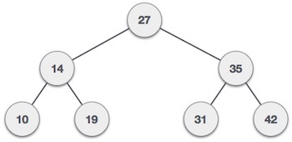
031_01.2 Binary Search Representation
https://www.tutorialspoint.com/data_structures_algorithms/breadth_first_traversal_in_c.htm
Binary Search Representation
Binary Search tree exhibits a special behavior.
A node's left child must have a value less than its parent's value and the node's right child must have a value greater than its parent value.
We're going to implement tree using node object and connecting them through references.

Slide 8
031_01.3 Tree Node

Slide 9
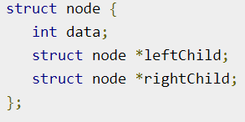
031_01.3 Tree Node
https://www.tutorialspoint.com/data_structures_algorithms/breadth_first_traversal_in_c.htm
Tree Node
The code to write a tree node would be similar to what is given below.
It has a data part and references to its left and right child nodes.
In a tree, all nodes share common construct.

Slide 10
031_01.4 BST Basic Operation

Slide 11
031_01.4 BST Basic Operation
https://www.tutorialspoint.com/data_structures_algorithms/breadth_first_traversal_in_c.htm
BST Basic Operation
The basic operations that can be performed on a binary search tree data structure, are the following −
Insert − Inserts an element in a tree/create a tree.
Search − Searches an element in a tree.
Preorder Traversal − Traverses a tree in a pre-order manner.
Inorder Traversal − Traverses a tree in an in-order manner.
Postorder Traversal − Traverses a tree in a post-order manner.
We shall learn creating (inserting into) a tree structure and searching a data item in a tree in this chapter.
We will discuss about tree traversing methods in the coming discussion.

Slide 12
031_01.5 Insert Operation

Slide 13
031_01.5 Insert Operation
https://www.tutorialspoint.com/data_structures_algorithms/breadth_first_traversal_in_c.htm
Insert Operation
The very first insertion creates the tree.
Afterwards, whenever an element is to be inserted, first locate its proper location.
Start searching from the root node, then if the data is less than the key value, search for the empty location in the left subtree and insert the data.
Otherwise, search for the empty location in the right subtree and insert the data.

Slide 14
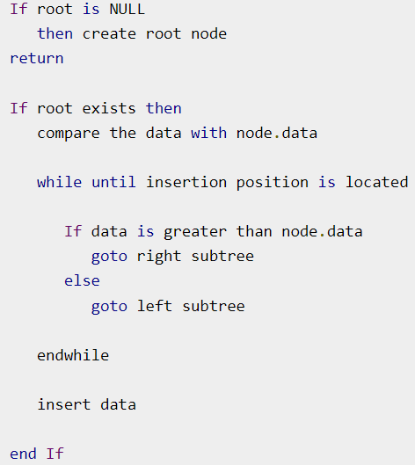
031_01.5 Insert Operation
https://www.tutorialspoint.com/data_structures_algorithms/breadth_first_traversal_in_c.htm
Algorithm

Slide 15
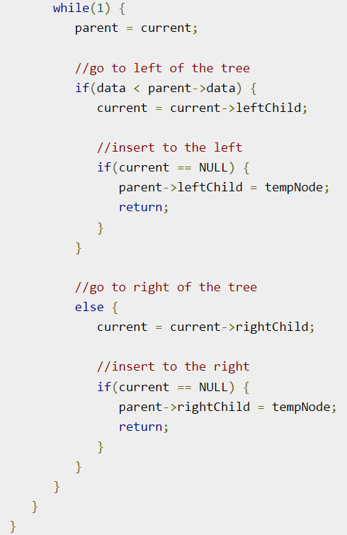
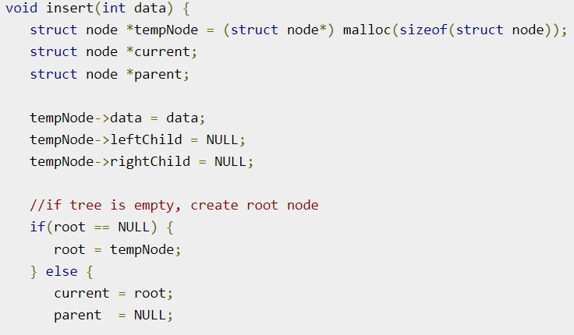
031_01.5 Insert Operation
https://www.tutorialspoint.com/data_structures_algorithms/breadth_first_traversal_in_c.htm
Code

Slide 16
031_01.6 Search Operation

Slide 17
031_01.6 Search Operation
https://www.tutorialspoint.com/data_structures_algorithms/breadth_first_traversal_in_c.htm
Search Operation
Whenever an element is to be searched, start searching from the root node, then if the data is less than the key value, search for the element in the left subtree.
Otherwise, search for the element in the right subtree. Follow the same algorithm for each node.

Slide 18
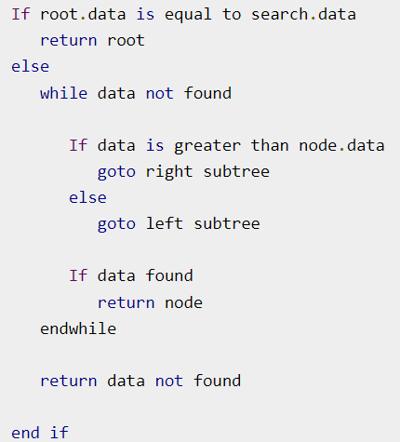
031_01.6 Search Operation
https://www.tutorialspoint.com/data_structures_algorithms/breadth_first_traversal_in_c.htm
Algorithm

Slide 19
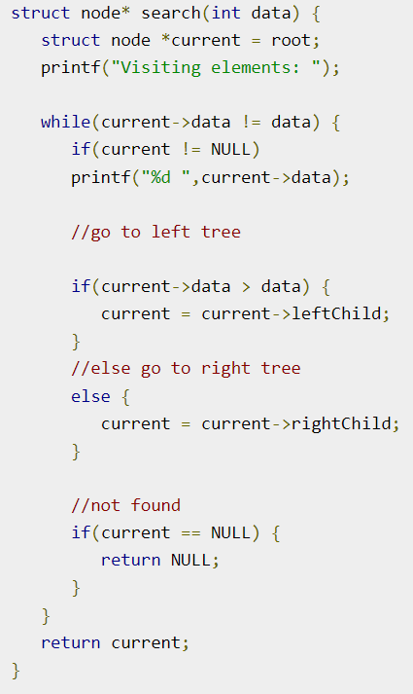
031_01.6 Search Operation
https://www.tutorialspoint.com/data_structures_algorithms/breadth_first_traversal_in_c.htm
Code

Slide 20
031_01.7 Tree: C Code

Slide 21
031_01.7 Tree: C Code
https://www.tutorialspoint.com/data_structures_algorithms/tree_traversal_in_c.htm
Tree: C Code
Traversal is a process to visit all the nodes of a tree and may print their values too.
Because all nodes are connected via edges (links) we always start from the root (head) node.
That is, we cannot random access a node in a tree.
There are three ways which we use to traverse a tree −
In-order Traversal
Pre-order Traversal
Post-order Traversal
We now look at the implementation of tree traversal in C programming language here using the following binary tree

Slide 22
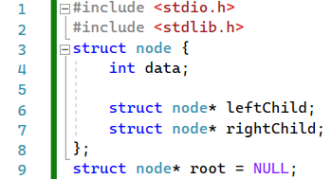
031_01.7 Tree: C Code
https://www.tutorialspoint.com/data_structures_algorithms/tree_traversal_in_c.htm
Tree: C Code
Define data.

Slide 23
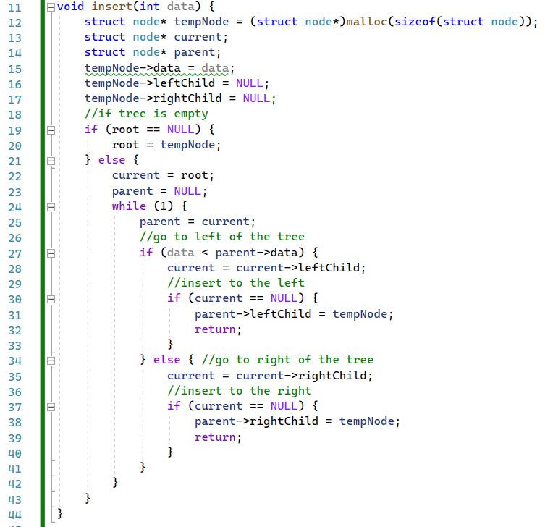
031_01.7 Tree: C Code
https://www.tutorialspoint.com/data_structures_algorithms/tree_traversal_in_c.htm
Tree: C Code
insert()

Slide 24
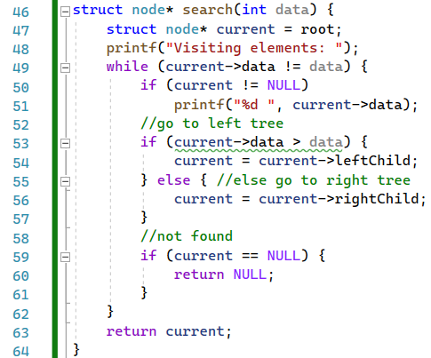
031_01.7 Tree: C Code
https://www.tutorialspoint.com/data_structures_algorithms/tree_traversal_in_c.htm
Tree: C Code
search()

Slide 25
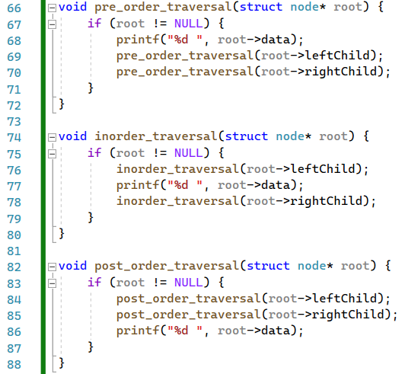
031_01.7 Tree: C Code
https://www.tutorialspoint.com/data_structures_algorithms/tree_traversal_in_c.htm
Tree: C Code
pre_order_traversal(),
inorder_traversal(), and post_order_traversal().

Slide 26
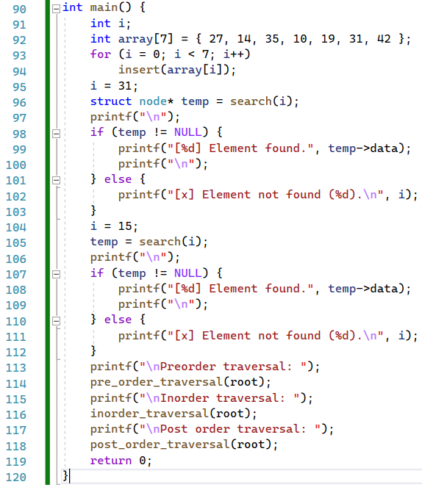
031_01.7 Tree: C Code
https://www.tutorialspoint.com/data_structures_algorithms/tree_traversal_in_c.htm
Tree: C Code
main()

Slide 27
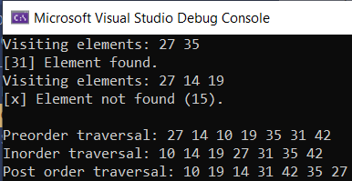
031_01.7 Tree: C Code
https://www.tutorialspoint.com/data_structures_algorithms/tree_traversal_in_c.htm
Tree: C Code
Result

Slide 28
End

