Slide 1

031_02 Tree Creation: CPP
Peter H. Chen

Slide 2
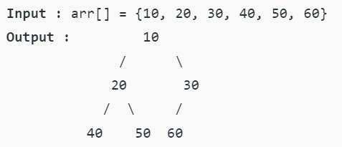
031_02 Tree Creation: CPP
https://www.geeksforgeeks.org/create-a-tree-in-level-order/
Create a Tree with Level Order: CPP
Given an array of elements, the task is to insert these elements in level order and construct a tree.

Slide 3
031_02 Tree Creation: CPP
https://www.geeksforgeeks.org/create-a-tree-in-level-order/
Create a Tree with Level Order: CPP
The task is to construct a whole tree from a given array.
To insert in level order in an already constructed tree, please see Insertion in a Binary Tree in level order (https://www.geeksforgeeks.org/insertion-in-a-binary-tree-in-level-order/)
The task is to store data in a binary tree but in level order.
To do so, we will proceed as follows:
1. Whenever a new Node is added to the binary tree, the address of the node is pushed into a queue.
2. Node addresses will stay in the queue until both its children’s Nodes do not get filled.
3. Once both the children’s Nodes get filled up, the parent Node is popped from the queue.

Slide 4
031_02.1 Tree Traverse: CPP Code

Slide 5
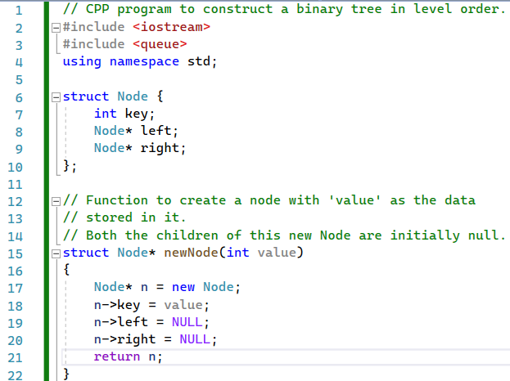
031_02.1 Tree Traverse: CPP Code
https://www.geeksforgeeks.org/create-a-tree-in-level-order/
Tree Traverse: CPP Code
Define Data, newNode.

Slide 6
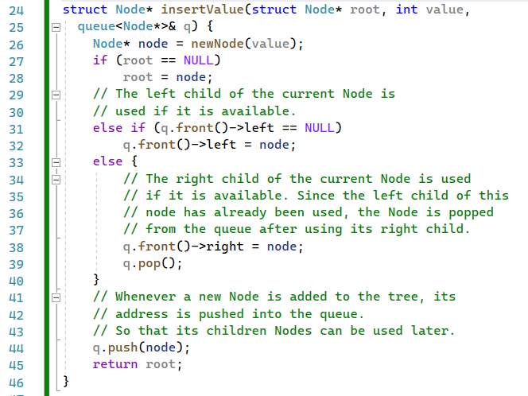
031_02.1 Tree Traverse: CPP Code
https://www.geeksforgeeks.org/create-a-tree-in-level-order/
Tree Traverse: CPP Code
insertValue()

Slide 7
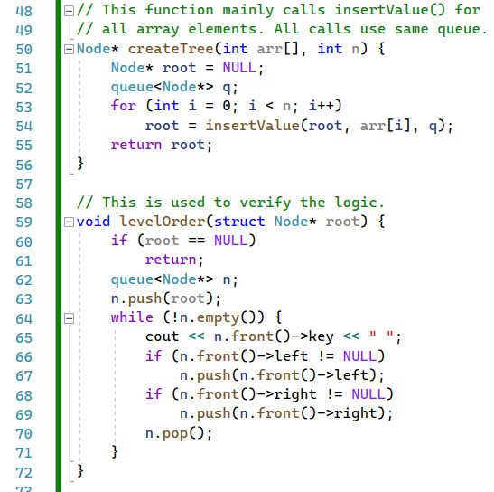
031_02.1 Tree Traverse: CPP Code
https://www.geeksforgeeks.org/create-a-tree-in-level-order/
Tree Traverse: CPP Code
createTree() and levelOrder()

Slide 8
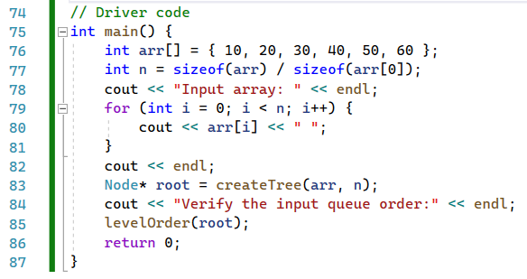
031_02.1 Tree Traverse: CPP Code
https://www.geeksforgeeks.org/create-a-tree-in-level-order/
Tree Traverse: CPP Code
main()

Slide 9
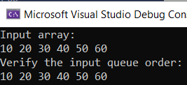
031_02.1 Tree Traverse: CPP Code
https://www.geeksforgeeks.org/create-a-tree-in-level-order/
Tree Traverse: CPP Code
Create Tree

Slide 10
End

