Slide 1

032_01 Tree Traverse: C
Peter H. Chen

Slide 2
032_01 Tree Traverse : C
https://www.tutorialspoint.com/data_structures_algorithms/tree_traversal.htm
Tree Traverse: C
Traversal is a process to visit all the nodes of a tree and may print their values too.
Because all nodes are connected via edges (links) we always start from the root (head) node.
That is, we cannot randomly access a node in a tree. There are three ways which we use to traverse a tree −
In-order Traversal
Pre-order Traversal
Post-order Traversal
Generally, we traverse a tree to search or locate a given item or key in the tree or to print all the values it contains.

Slide 3
032_01.1 In-Order Traversal

Slide 4
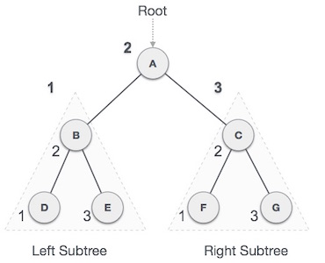
032_01.1 In-Order Traversal
https://www.tutorialspoint.com/data_structures_algorithms/tree_traversal.htm
In-Order Traversal
In this traversal method, the left subtree is visited first, then the root and later the right sub-tree.
We should always remember that every node may represent a subtree itself.
If a binary tree is traversed in-order, the output will produce sorted key values in an ascending order.

Slide 5
032_01.1 In-Order Traversal
https://www.tutorialspoint.com/data_structures_algorithms/tree_traversal.htm
In-Order Traversal
We start from A, and following in-order traversal, we move to its left subtree B.
B is also traversed in-order.
The process goes on until all the nodes are visited. The output of inorder traversal of this tree will be:
D → B → E → A → F → C → G

Slide 6
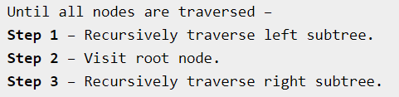
032_01.1 In-Order Traversal
https://www.tutorialspoint.com/data_structures_algorithms/tree_traversal.htm
In-Order Traversal Algorithm

Slide 7
032_01.2 Pre-Order Traversal

Slide 8
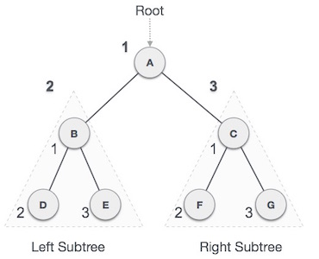
032_01.2 Pre-Order Traversal
https://www.tutorialspoint.com/data_structures_algorithms/tree_traversal.htm
Pre-Order Traversal
In this traversal method, the root node is visited first, then the left subtree and finally the right subtree.
We start from A, and following pre-order traversal, we first visit A itself and then move to its left subtree B.
B is also traversed pre-order.
The process goes on until all the nodes are visited.
The output of pre-order traversal of this tree will be −
A → B → D → E → C → F → G

Slide 9
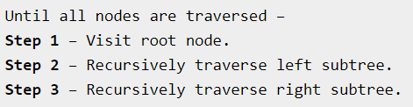
032_01.2 Pre-Order Traversal
https://www.tutorialspoint.com/data_structures_algorithms/tree_traversal.htm
Pre-Order Traversal Algorithm

Slide 10
032_01.3 Post-Order Traversal

Slide 11
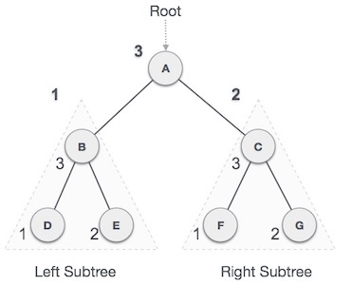
032_01.3 Post-Order Traversal
https://www.tutorialspoint.com/data_structures_algorithms/tree_traversal.htm
Post-Order Traversal
In this traversal method, the root node is visited last, hence the name.
First, we traverse the left subtree, then the right subtree and finally the root node.
We start from A, and following Post-order traversal, we first visit the left subtree B.
B is also traversed post-order.
The process goes on until all the nodes are visited.
The output of post-order traversal of this tree will be −
D → E → B → F → G → C → A

Slide 12
032_01.4 Tree Traversal: C Code

Slide 13
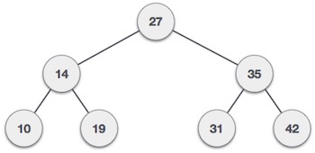
032_01.4 Tree Traversal: C Code
https://www.tutorialspoint.com/data_structures_algorithms/tree_traversal_in_c.htm
Tree Traversal: C Code
Traversal is a process to visit all the nodes of a tree and may print their values too.
Because all nodes are connected via edges (links) we always start from the root (head) node. That is, we cannot random access a node in a tree. There are three ways which we use to traverse a tree −
In-order Traversal
Pre-order Traversal
Post-order Traversal
We now look at the implementation of tree traversal in C programming language.

Slide 14
032_01.4 Tree Traversal: C Code
https://www.tutorialspoint.com/data_structures_algorithms/tree_traversal_in_c.htm
Tree Traversal: C Code
Traversal is a process to visit all the nodes of a tree and may print their values too.
Because all nodes are connected via edges (links) we always start from the root (head) node. That is, we cannot random access a node in a tree. There are three ways which we use to traverse a tree −
In-order Traversal
Pre-order Traversal
Post-order Traversal
We now look at the implementation of tree traversal in C programming language.

Slide 15
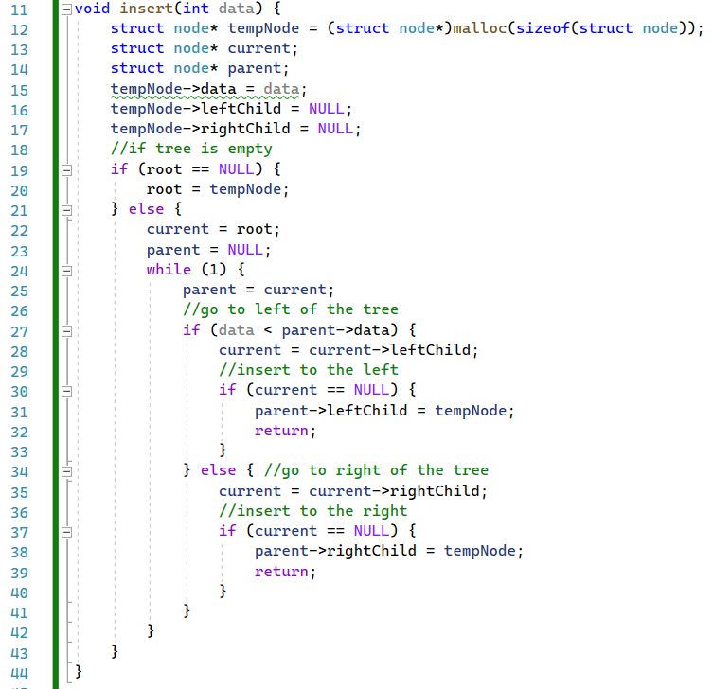
032_01.4 Tree Traversal: C Code
https://www.tutorialspoint.com/data_structures_algorithms/tree_traversal_in_c.htm
Tree: C Code
insert()

Slide 16
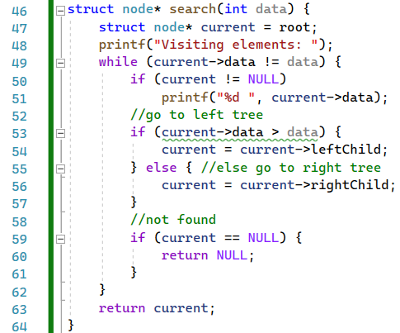
032_01.4 Tree Traversal: C Code
https://www.tutorialspoint.com/data_structures_algorithms/tree_traversal_in_c.htm
Tree: C Code
search()

Slide 17
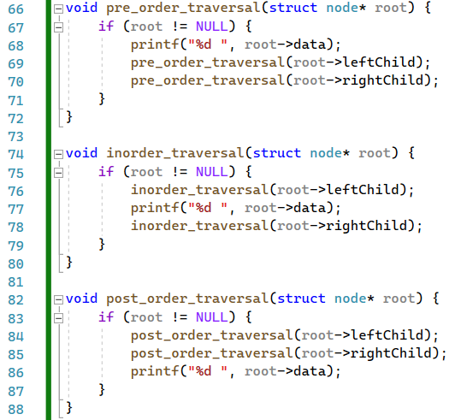
032_01.4 Tree Traversal: C Code
https://www.tutorialspoint.com/data_structures_algorithms/tree_traversal_in_c.htm
Tree: C Code
pre_order_traversal(),
inorder_traversal(), and post_order_traversal().

Slide 18
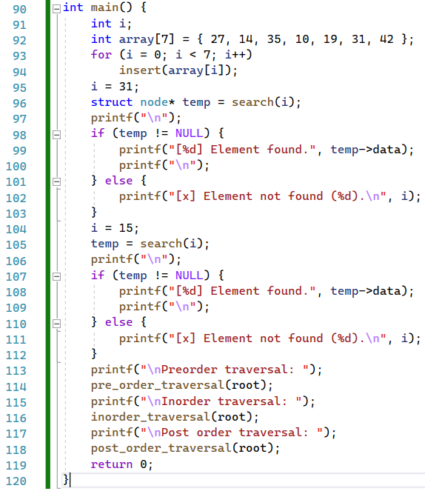
032_01.4 Tree Traversal: C Code
https://www.tutorialspoint.com/data_structures_algorithms/tree_traversal_in_c.htm
Tree: C Code
main()

Slide 19
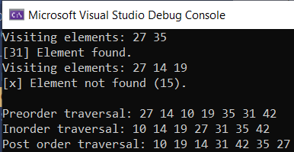
032_01.4 Tree Traversal: C Code
https://www.tutorialspoint.com/data_structures_algorithms/tree_traversal_in_c.htm
Tree: C Code
Result

Slide 20
032_01.5 Summary

Slide 21
032_01.5 Summary
https://www.tutorialspoint.com/data_structures_algorithms/tree_traversal_in_c.htm
Summary
The Tree Traverse has three ways:
In-order Traversal
Pre-order Traversal
Post-order Traversal
The code in 032_01 (Traverse) is reused from 031_01m (creation).

Slide 22
End

