Slide 1

032_02 Tree Traverse: CPP
Peter H. Chen

Slide 2
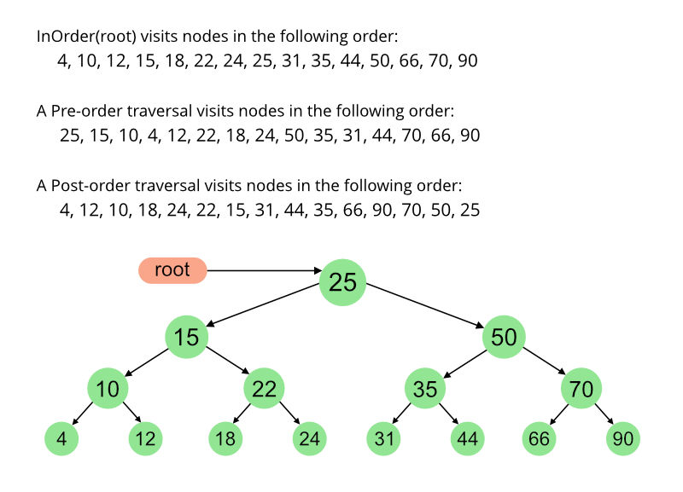
032_02 Tree Traverse: CPP
https://www.geeksforgeeks.org/tree-traversals-inorder-preorder-and-postorder/
Tree Traversals (Inorder, Preorder and Postorder): CPP
Unlike linear data structures (Array, Linked List, Queues, Stacks, etc.) which have only one logical way to traverse them, trees can be traversed in different ways.
On the right are the generally used methods for traversing trees:

Slide 3
032_02.1 Tree Traverse: CPP Code

Slide 4
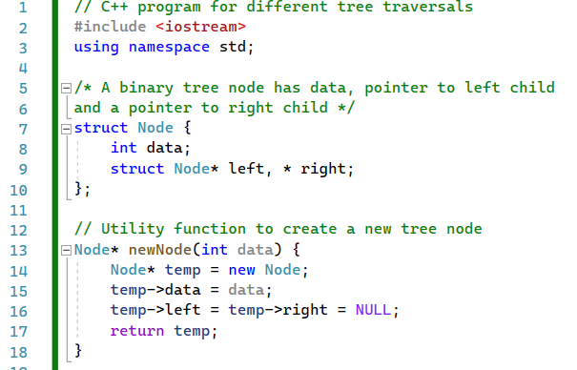
032_02.1 Tree Traverse: CPP Code
https://www.geeksforgeeks.org/tree-traversals-inorder-preorder-and-postorder/
Tree Traverse: CPP Code
Note: The code below is manually creating the tree node one-by-one.

Slide 5
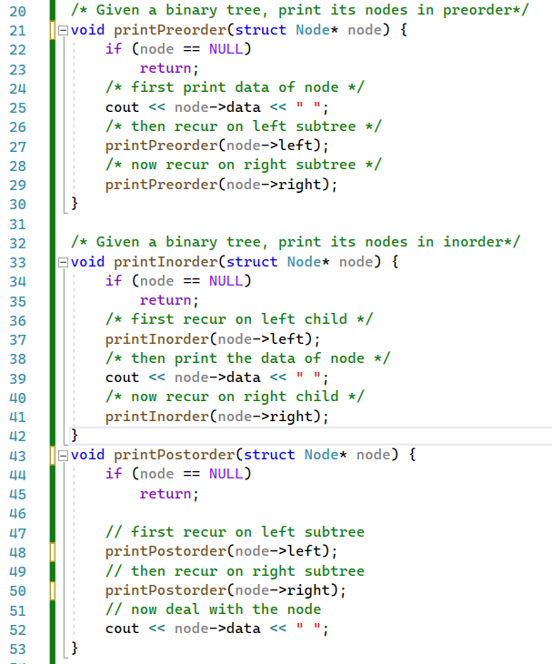
032_02.1 Tree Traverse: CPP Code
https://www.geeksforgeeks.org/tree-traversals-inorder-preorder-and-postorder/
Tree Traverse: CPP Code
printPreorder(), printInorder(), printPostorder()

Slide 6
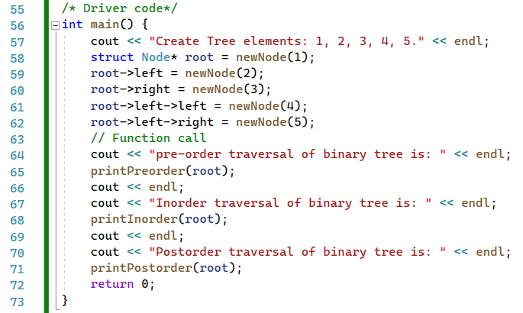
032_02.1 Tree Traverse: CPP Code
https://www.geeksforgeeks.org/tree-traversals-inorder-preorder-and-postorder/
Tree Traverse: CPP Code

Slide 7
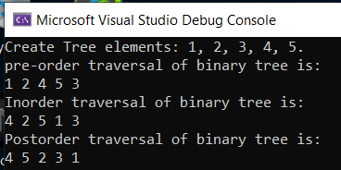
032_02.1 Tree Traverse: CPP Code
https://www.geeksforgeeks.org/tree-traversals-inorder-preorder-and-postorder/
Tree Traverse: CPP Code

Slide 8
End

