Slide 1

035_01 Spanning Tree
Peter H. Chen

Slide 2
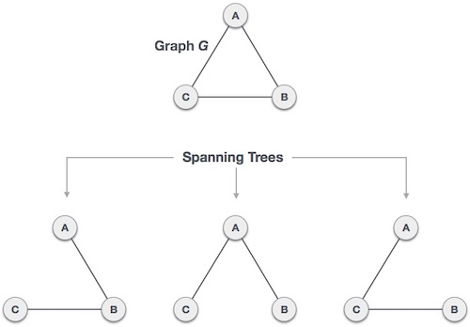
035_01 Spanning Tree
https://www.tutorialspoint.com/data_structures_algorithms/spanning_tree.htm
Spanning Tree
A spanning tree is a subset of Graph G, which has all the vertices covered with minimum possible number of edges.
Hence, a spanning tree does not have cycles and it cannot be disconnected.

Slide 3
035_01 Spanning Tree
https://www.tutorialspoint.com/data_structures_algorithms/spanning_tree.htm
Spanning Tree
By this definition, we can draw a conclusion that every connected and undirected Graph G has at least one spanning tree.
A disconnected graph does not have any spanning tree, as it cannot be spanned to all its vertices.

Slide 4
035_01 Spanning Tree
https://www.tutorialspoint.com/data_structures_algorithms/spanning_tree.htm
Spanning Tree
We found three spanning trees off one complete graph.
A complete undirected graph can have maximum n^{n-2} number of spanning trees, where n is the number of nodes.
In the above addressed example, n is 3, hence 3³⁻² = 3 spanning trees are possible.

Slide 5
035_01.1 General Properties of Spanning Tree

Slide 6
035_01.1 General Properties of Spanning Tree
https://www.tutorialspoint.com/data_structures_algorithms/spanning_tree.htm
General Properties of Spanning Tree
We now understand that one graph can have more than one spanning tree.
Following are a few properties of the spanning tree connected to graph G −
A connected graph G can have more than one spanning tree.
All possible spanning trees of graph G, have the same number of edges and vertices.
The spanning tree does not have any cycle (loops).
Removing one edge from the spanning tree will make the graph disconnected, i.e., the spanning tree is minimally connected.
Adding one edge to the spanning tree will create a circuit or loop, i.e., the spanning tree is maximally acyclic.

Slide 7
035_01.2 Math Properties of Spanning Tree

Slide 8
035_01.2 Math Properties of Spanning Tree
https://www.tutorialspoint.com/data_structures_algorithms/spanning_tree.htm
Mathematical Properties of Spanning Tree
Below are the mathematical properties of Spanning Tree:
Spanning tree has n - 1 edges, where n is the number of nodes (vertices).
From a complete graph, by removing maximum e - n + 1 edges, we can construct a spanning tree.
A complete graph can have maximum n^{n-2} number of spanning trees.
Thus, we can conclude that spanning trees are a subset of connected Graph G and disconnected graphs do not have spanning tree.

Slide 9
035_01.3 Application of Spanning Tree

Slide 10
035_01.3 Application of Spanning Tree
https://www.tutorialspoint.com/data_structures_algorithms/spanning_tree.htm
Application of Spanning Tree
Spanning tree is basically used to find a minimum path to connect all nodes in a graph.
Common application of spanning trees are −
Civil Network Planning
Computer Network Routing Protocol
Cluster Analysis
Let us understand this through a small example.
Consider, city network as a huge graph and now plans to deploy telephone lines in such a way that in minimum lines we can connect to all city nodes.
This is where the spanning tree comes into picture.

Slide 11
035_01.4 MST (Minimum Spanning Tree)

Slide 12
035_01.4 MST (Minimum Spanning Tree)
https://www.tutorialspoint.com/data_structures_algorithms/spanning_tree.htm
MST (Minimum Spanning Tree)
In a weighted graph, a minimum spanning tree is a spanning tree that has minimum weight than all other spanning trees of the same graph.
In real-world situations, this weight can be measured as distance, congestion, traffic load or any arbitrary value denoted to the edges.

Slide 13
035_01.5 Minimum Spanning Tree Algorithm

Slide 14
035_01.5 Minimum Spanning Tree Algorithm
https://www.tutorialspoint.com/data_structures_algorithms/spanning_tree.htm
Minimum Spanning Tree Algorithm
We shall learn about two most important spanning tree algorithms here −
Kruskal's Algorithm
Prim's Algorithm
Both are greedy algorithms.

Slide 15
035_01.6 Krushal’s Spanning Tree Algorithm

Slide 16
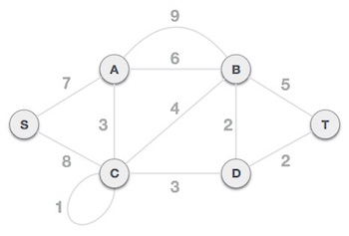
035_01.6 Krushal’s Spanning Tree Algorithm
https://www.tutorialspoint.com/data_structures_algorithms/kruskals_spanning_tree_algorithm.htm
Krushal’s Spanning Tree Algorithm
Kruskal's algorithm finds the minimum cost spanning tree uses the greedy approach.
This algorithm treats the graph as a forest and every node it has as an individual tree.
A tree connects to another only and only if, it has the least cost among all available options and does not violate MST properties.
To understand Kruskal's algorithm let us consider the following example

Slide 17
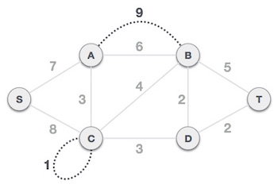
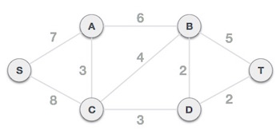
035_01.6 Krushal’s Spanning Tree Algorithm
https://www.tutorialspoint.com/data_structures_algorithms/kruskals_spanning_tree_algorithm.htm
Step 1: Remove all Loops and Parallel Edges
Remove all loops and parallel edges from the given graph.
In case of parallel edges, keep the one which has the least cost associated and remove all others.

Slide 18
035_01.6 Krushal’s Spanning Tree Algorithm
https://www.tutorialspoint.com/data_structures_algorithms/kruskals_spanning_tree_algorithm.htm
Step 2: Arrange All Edges in Their Increasing Order of Weight
The next step is to create a set of edges and weight and arrange them in an ascending order of weightage (cost).
B, D | D, T | A,C | C, D | C, B | B, T | A,B | S, A | S, C
2 | 2 | 3 | 3 | 4 | 5 | 6 | 7 | 8

Slide 19
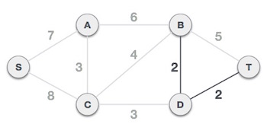
035_01.6 Krushal’s Spanning Tree Algorithm
https://www.tutorialspoint.com/data_structures_algorithms/kruskals_spanning_tree_algorithm.htm
Step 3: Add the Edge Which has the Least Weightage
Now we start adding edges to the graph beginning from the one which has the least weight.
Throughout, we shall keep checking that the spanning properties remain intact.
In case, by adding one edge, the spanning tree property does not hold then we shall consider not to include the edge in the graph.
The least cost is 2 and edges involved are B,D and D,T.
We add them.
Adding them does not violate spanning tree properties, so we continue to our next edge selection.

Slide 20
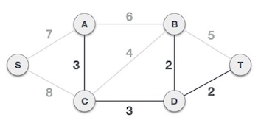
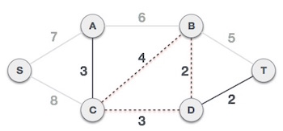
035_01.6 Krushal’s Spanning Tree Algorithm
https://www.tutorialspoint.com/data_structures_algorithms/kruskals_spanning_tree_algorithm.htm
Step 3: Add the Edge Which has the Least Weightage
Next cost is 3, and associated edges are A, C and C, D.
We add them again.
Next cost in the table is 4, and we observe that adding it will create a circuit in the graph.

Slide 21
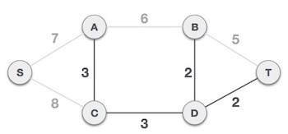
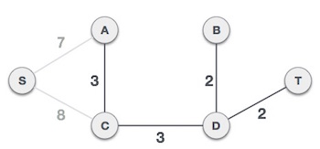
035_01.6 Krushal’s Spanning Tree Algorithm
https://www.tutorialspoint.com/data_structures_algorithms/kruskals_spanning_tree_algorithm.htm
Step 3: Add the Edge Which has the Least Weightage
We ignore it.
In the process we shall ignore/avoid all edges that create a circuit.
We observe that edges with cost 5 and 6 also create circuits.
We ignore them and move on.

Slide 22
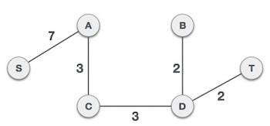
035_01.6 Krushal’s Spanning Tree Algorithm
https://www.tutorialspoint.com/data_structures_algorithms/kruskals_spanning_tree_algorithm.htm
Step 3: Add the Edge Which has the Least Weightage
Now we are left with only one node to be added.
Between the two least cost edges available 7 and 8, we shall add the edge with cost 7.
By adding edge S, A.
We have included all the nodes of the graph and we now have minimum cost spanning tree.

Slide 23
035_01.7 Prim’s Spanning Tree Algorithm

Slide 24
035_01.7 Prim’s Spanning Tree Algorithm
https://www.tutorialspoint.com/data_structures_algorithms/prims_spanning_tree_algorithm.htm
Prim’s Spanning Tree Algorithm
Prim's algorithm to find minimum cost spanning tree (as Kruskal's algorithm) uses the greedy approach.
Prim's algorithm shares a similarity with the shortest path first algorithms.
Prim's algorithm, in contrast with Kruskal's algorithm, treats the nodes as a single tree and keeps on adding new nodes to the spanning tree from the given graph.
To contrast with Kruskal's algorithm and to understand Prim's algorithm better, we shall use the same example

Slide 25
035_01.7 Prim’s Spanning Tree Algorithm
https://www.tutorialspoint.com/data_structures_algorithms/prims_spanning_tree_algorithm.htm
Step 1 - Remove all loops and parallel edges
Remove all loops and parallel edges from the given graph.
In case of parallel edges, keep the one which has the least cost associated and remove all others.

Slide 26
035_01.7 Prim’s Spanning Tree Algorithm
https://www.tutorialspoint.com/data_structures_algorithms/prims_spanning_tree_algorithm.htm
Step 2 - Choose any arbitrary node as root node
In this case, we choose S node as the root node of Prim's spanning tree.
This node is arbitrarily chosen, so any node can be the root node.
One may wonder why any vertex can be a root node.
So, the answer is, in the spanning tree all the nodes of a graph are included and because it is connected then there must be at least one edge, which will join it to the rest of the tree.

Slide 27
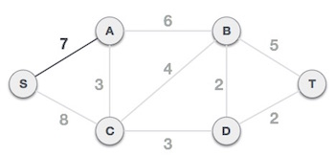
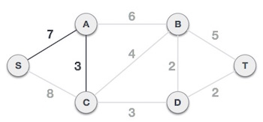
035_01.7 Prim’s Spanning Tree Algorithm
https://www.tutorialspoint.com/data_structures_algorithms/prims_spanning_tree_algorithm.htm
Step 3 - Check outgoing edges and select the one with less cost
After choosing the root node S, we see that S,A and S, C are two edges with weight 7 and 8, respectively.
We choose the edge S, A as it is lesser than the other.
Now, the tree S-7-A is treated as one node, and we check for all edges going out from it.
We select the one which has the lowest cost and include it in the tree.

Slide 28
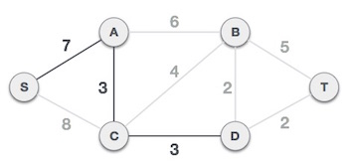
035_01.7 Prim’s Spanning Tree Algorithm
https://www.tutorialspoint.com/data_structures_algorithms/prims_spanning_tree_algorithm.htm
Step 3 - Check outgoing edges and select the one with less cost
After this step, S-7-A-3-C tree is formed. Now we'll again treat it as a node and will check all the edges again. However, we will choose only the least cost edge. In this case, C-3-D is the new edge, which is less than other edges' cost 8, 6, 4, etc.

Slide 29
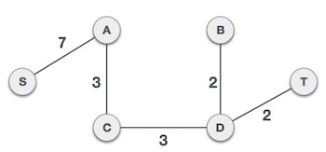
035_01.7 Prim’s Spanning Tree Algorithm
https://www.tutorialspoint.com/data_structures_algorithms/prims_spanning_tree_algorithm.htm
Step 3 - Check outgoing edges and select the one with less cost
After adding node D to the spanning tree, we now have two edges going out of it having the same cost, i.e., D-2-T and D-2-B.
Thus, we can add either one. But the next step will again yield edge 2 as the least cost.
Hence, we are showing a spanning tree with both edges included.
We may find that the output spanning tree of the same graph using two different algorithms is same.

Slide 30
End

