Slide 1

035_02 Spanning Tree: STL
Peter H. Chen

Slide 2
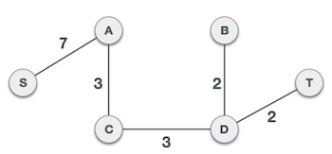
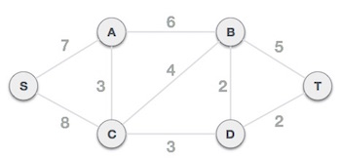
035_02 Kruskal Algorithm
https://www.geeksforgeeks.org/kruskals-minimum-spanning-tree-using-stl-in-c/
Kruskal Algorithm
Given an undirected, connected and weighted graph, find MST (Minimum Spanning Tree) of the graph using Kruskal’s algorithm.
(Minimum Spanning Tree)

Slide 3
035_02 Kruskal Algorithm
https://www.geeksforgeeks.org/kruskals-minimum-spanning-tree-using-stl-in-c/
Kruskal Algorithm
We have discussed below Kruskal’s MST implementations.
Below are the steps for finding MST using Kruskal’s algorithm
1. Sort all the edges in non-decreasing order of their weight.
2. Pick the smallest edge. Check if it forms a cycle with the spanning tree formed so far. If cycle is not formed, include this edge. Else, discard it.
3. Repeat step#2 until there are (V-1) edges in the spanning tree.

Slide 4

035_02 Kruskal Algorithm
https://www.geeksforgeeks.org/kruskals-minimum-spanning-tree-using-stl-in-c/
Kruskal Algorithm
1. Use a vector of edges which consist of all the edges in the graph and each item of a vector will contain 3 parameters: source, destination and the cost of an edge between the source and destination.
Here in the outer pair (i.e., pair<int, pair<int, int> > ) the first element corresponds to the cost of a edge while the second element is itself a pair, and it contains two vertices of edge.
2. Use the inbuilt std::sort to sort the edges in the non-decreasing order; by default, the sort function sort in non-decreasing order.
3. We use the Union Find Algorithm to check if it the current edge forms a cycle if it is added in the current MST. If yes discard it, else include it (union).

Slide 5
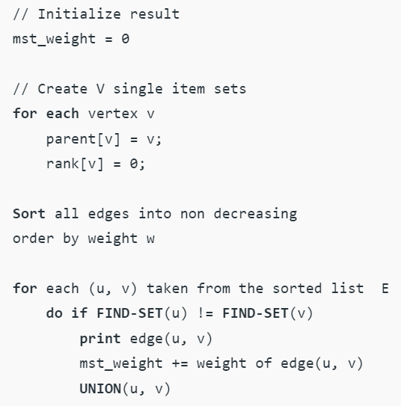
035_02 Kruskal Algorithm
https://www.geeksforgeeks.org/kruskals-minimum-spanning-tree-using-stl-in-c/
Kruskal Pseudo Code

Slide 6
035_02.1 Kruskal Algorithm: STL Code
Peter H. Chen

Slide 7
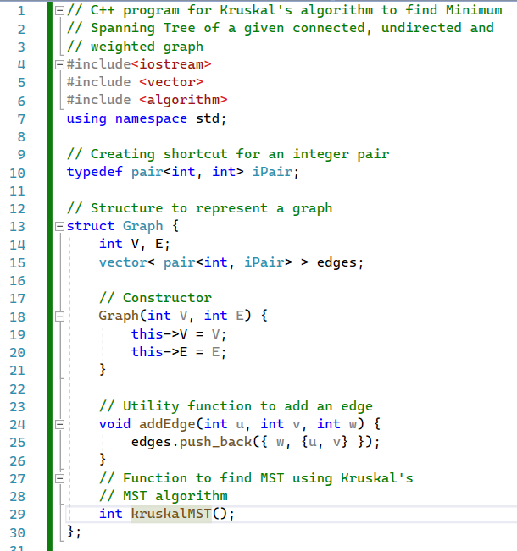
035_02.1 Kruskal Algorithm: STL Code
https://www.geeksforgeeks.org/kruskals-minimum-spanning-tree-using-stl-in-c/
Kruskal STL Code
Class Graph Definition

Slide 8
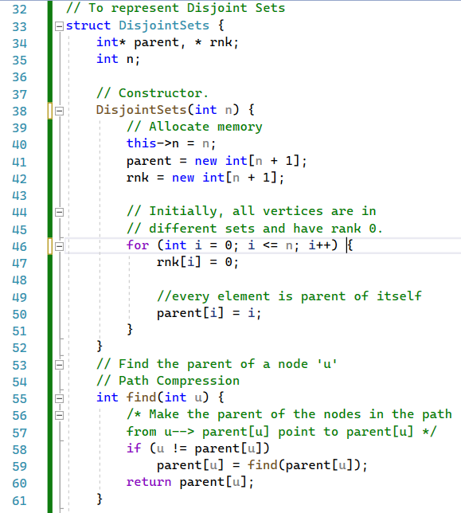
035_02.1 Kruskal Algorithm: STL Code
https://www.geeksforgeeks.org/kruskals-minimum-spanning-tree-using-stl-in-c/
Kruskal STL Code
DisjoinSets(), find()

Slide 9
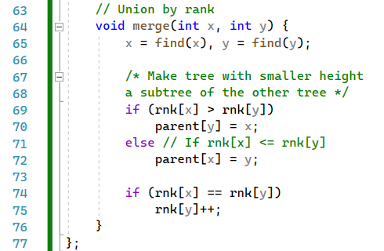
035_02.1 Kruskal Algorithm: STL Code
https://www.geeksforgeeks.org/kruskals-minimum-spanning-tree-using-stl-in-c/
Kruskal STL Code
Union merge()

Slide 10
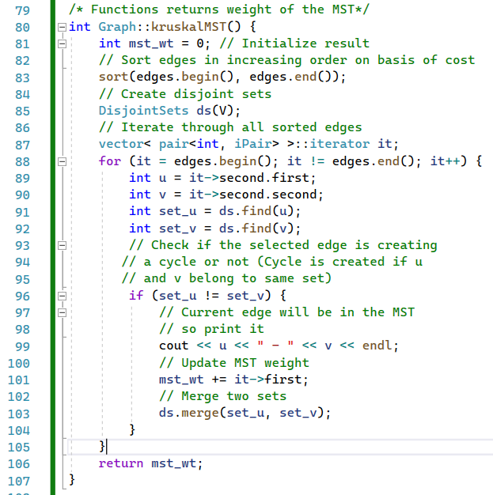
035_02.1 Kruskal Algorithm: STL Code
https://www.geeksforgeeks.org/kruskals-minimum-spanning-tree-using-stl-in-c/
Kruskal STL Code
kruskalMST ()

Slide 11
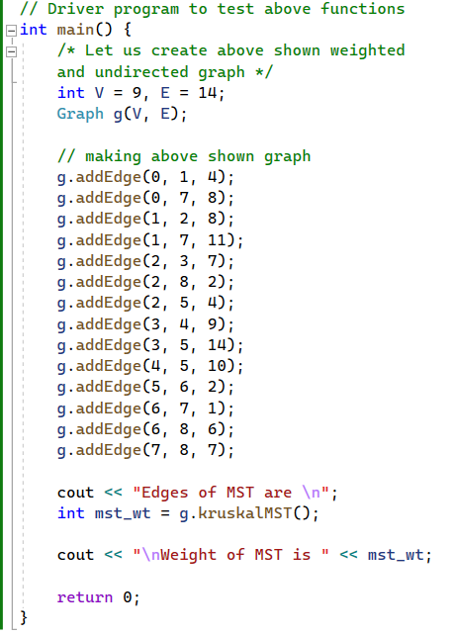
035_02.1 Kruskal Algorithm: STL Code
https://www.geeksforgeeks.org/kruskals-minimum-spanning-tree-using-stl-in-c/
Kruskal STL Code
main ()

Slide 12
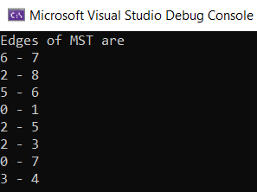
035_02.1 Kruskal Algorithm: STL Code
https://www.geeksforgeeks.org/kruskals-minimum-spanning-tree-using-stl-in-c/
Kruskal STL Code

Slide 13
End

