Slide 1

036_01 Heap
Peter H. Chen

Slide 2

036_01 Heap
https://www.tutorialspoint.com/data_structures_algorithms/heap_data_structure.htm
Heap
Heap is a special case of balanced binary tree data structure where the root-node key is compared with its children and arranged accordingly.
If α has child node β then
If the value of parent is greater than that of child, this property generates Max Heap.
If the value of parent is less than that of child, this property generates Min Heap.
Based on the above criteria, a heap can be of two types

Slide 3
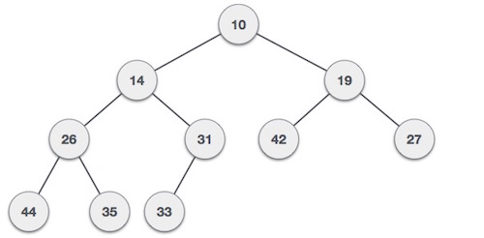
036_01 Heap
https://www.tutorialspoint.com/data_structures_algorithms/heap_data_structure.htm
Min-Heap − Where the value of the root node is less than or equal to either of its children.

Slide 4
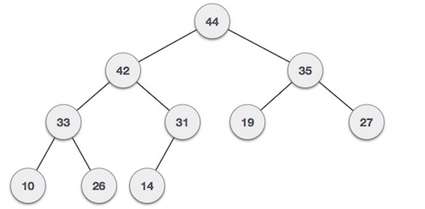
036_01 Heap
https://www.tutorialspoint.com/data_structures_algorithms/heap_data_structure.htm
Max-Heap − Where the value of the root node is greater than or equal to either of its children.
Both trees are constructed using the same input and order of arrival.

Slide 5
036_01.1 Max Heap Construction Algorithm

Slide 6
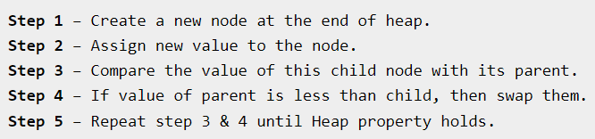
036_01.1 Max Heap Construction Algorithm
https://www.tutorialspoint.com/data_structures_algorithms/heap_data_structure.htm
Max Heap Construction Algorithm
We shall use the same example to demonstrate how a Max Heap is created.
The procedure to create Min Heap is similar but we go for min values instead of max values.
We are going to derive an algorithm for max heap by inserting one element at a time.
At any point of time, heap must maintain its property. While insertion, we also assume that we are inserting a node in an already heapified tree.

Slide 7
036_01.1 Max Heap Construction Algorithm
https://www.tutorialspoint.com/data_structures_algorithms/heap_data_structure.htm
Max Heap Construction Algorithm
Note − In Min Heap construction algorithm, we expect the value of the parent node to be less than that of the child node.
Let's understand Max Heap construction by an animated illustration. We consider the same input sample that we used earlier.

Slide 8
036_01.2 Max Heap Deletion Algorithm

Slide 9
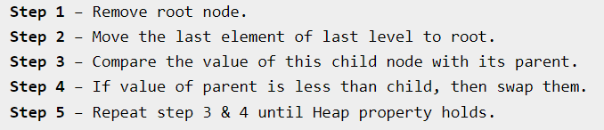
036_01.2 Max Heap Deletion Algorithm
https://www.tutorialspoint.com/data_structures_algorithms/heap_data_structure.htm
Max Heap Deletion Algorithm
Let us derive an algorithm to delete from max heap. Deletion in Max (or Min) Heap always happens at the root to remove the Maximum (or minimum) value.

Slide 10
036_01.1 Max Heap Construction Algorithm
https://www.tutorialspoint.com/data_structures_algorithms/heap_data_structure.htm
Max Heap Construction Algorithm
Note − In Min Heap construction algorithm, we expect the value of the parent node to be less than that of the child node.
Let's understand Max Heap construction by an animated illustration. We consider the same input sample that we used earlier.

Slide 11
End

