Slide 1

036_02 Heap: STL
Peter H. Chen

Slide 2

036_02 Heap
https://www.geeksforgeeks.org/heap-using-stl-c/
Heap
Heap is a special case of balanced binary tree data structure where the root-node key is compared with its children and arranged accordingly.
If α has child node β then
If the value of parent is greater than that of child, this property generates Max Heap.
If the value of parent is less than that of child, this property generates Min Heap.
Based on the above criteria, a heap can be of two types

Slide 3
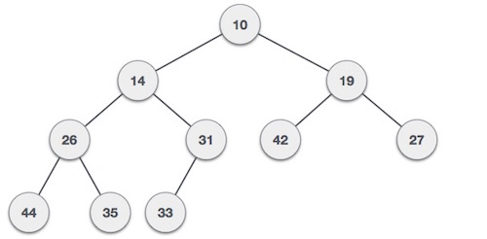
036_02 Heap
https://www.geeksforgeeks.org/heap-using-stl-c/
Min-Heap − Where the value of the root node is less than or equal to either of its children.

Slide 4
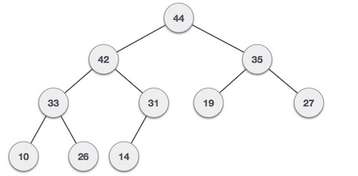
036_02 Heap
https://www.geeksforgeeks.org/heap-using-stl-c/
Max-Heap − Where the value of the root node is greater than or equal to either of its children.
Both trees are constructed using the same input and order of arrival.

Slide 5
036_02.1 Heap: STL Code

Slide 6
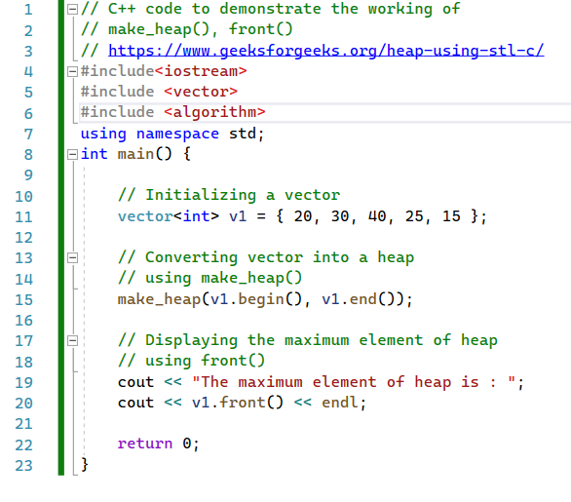
036_02.1 Heap: STL Code
https://www.geeksforgeeks.org/heap-using-stl-c/
Heap: STL

Slide 7

036_02.1 Heap: STL Code
https://www.geeksforgeeks.org/heap-using-stl-c/
Heap: STL Code
Result

Slide 8
End

