Slide 1

003 Setup on Visual Studio
Peter H. Chen

Slide 2
003 Setup on Visual Studio
https://www.youtube.com/watch?v=cuCWbztXk4Y
Cuda Setup on Visual Studio
We use Visual Studio IDE for Data structure, Vulkan, and Cuda Programming. We discussed Data Structure/Cuda Programming on Window-10
1. Check for Cuda-capable GPU.
2. Install Visual Studio 2022.
3. Download Cuda toolkit 11.8
4. Download Cuda Sample program for Cuda version 11.6.
Note: After Cuda 11.6, the sample programs are separated out from the Cuda toolkit.
https://docs.nvidia.com/cuda/cuda-samples/index.html
5. Create New Project. Setup Cuda 11.8 for Cuda Sample 11.6

Slide 3
003.1 Check Cuda-Capable GPU

Slide 4
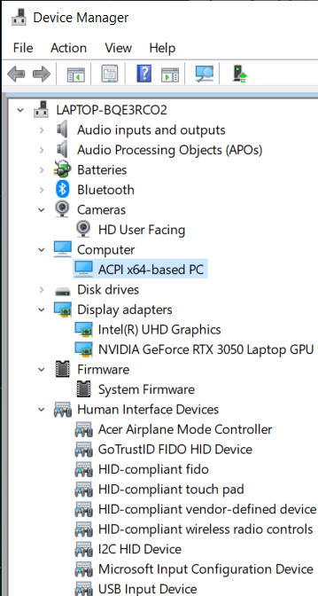
003.1 Check Cuda-Capable GPU
https://www.youtube.com/watch?v=cuCWbztXk4Y
Check Cuda-Capable GPU
1. Control Panel > Hardware and Sound > Device Manager
2. Make sure we have the keywords:
NIVIDA GeForce RTX xxxx GPU:
For example, NIVIDIA GeForce RTX 3050 Laptop GPU

Slide 5

003.2 Install Visual Studio

Slide 6
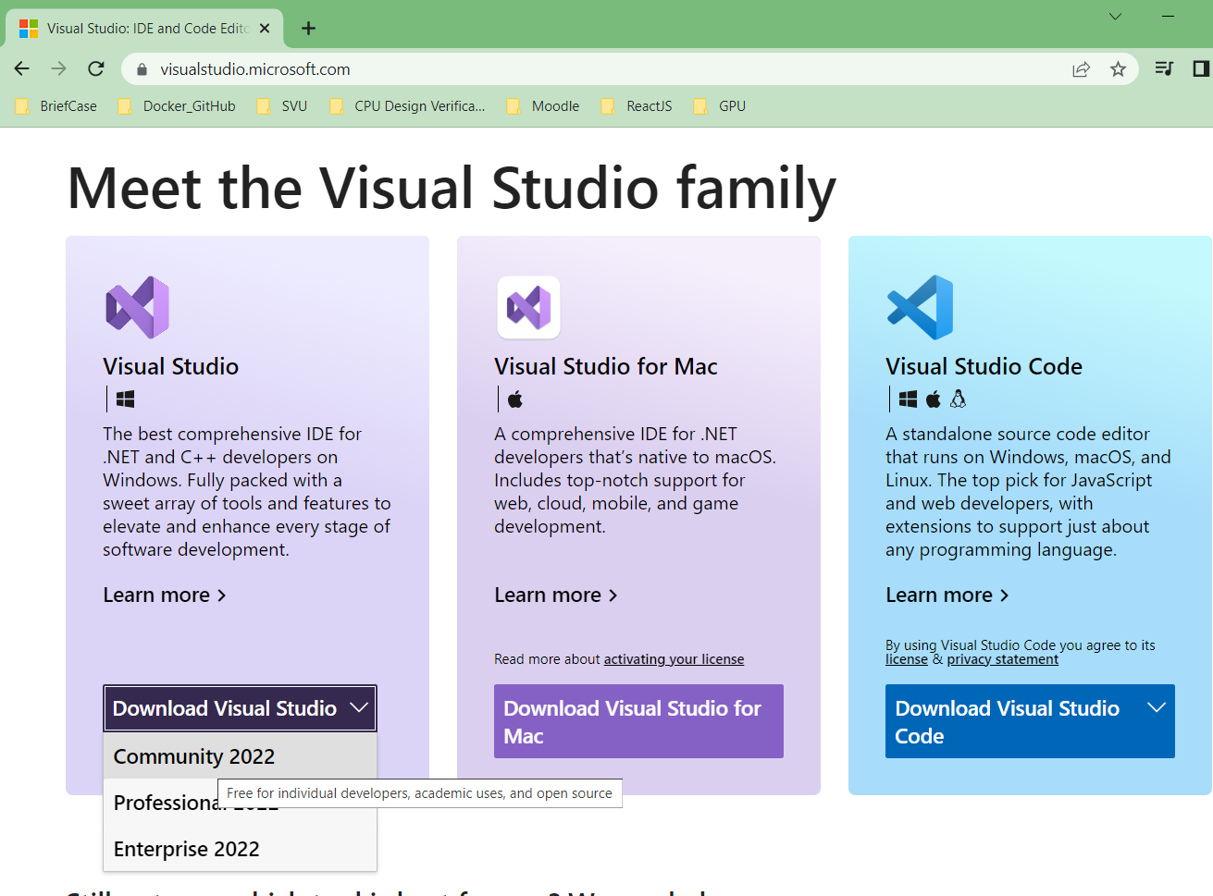
003.2 Install Visual Studio
https://www.youtube.com/watch?v=cuCWbztXk4Y
Install Visual Studio
Go to https://visualstudio.microsfot.com
Download Visual Studio community version for Microsoft Window.

Slide 7
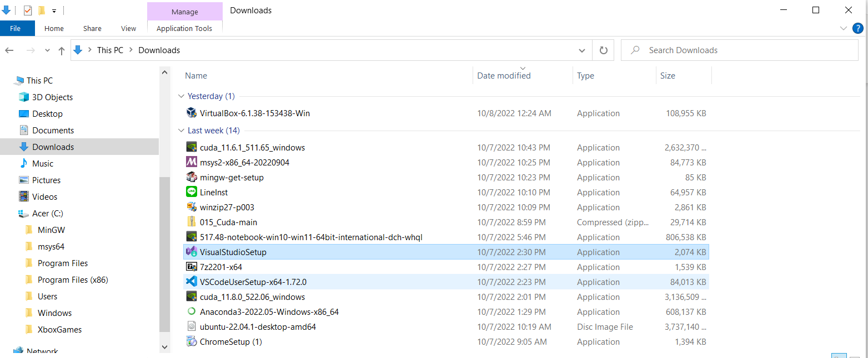
003.2 Install Visual Studio
https://www.youtube.com/watch?v=cuCWbztXk4Y
Install Visual Studio
Double-Click downloaded “VisualStudioSetup”.

Slide 8
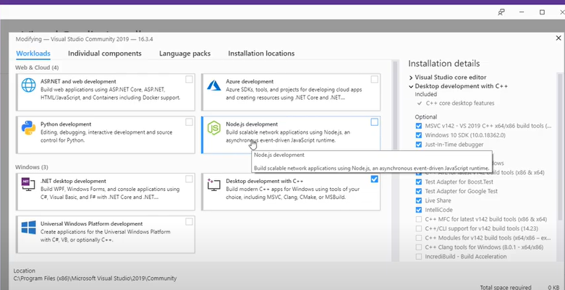
003.2 Install Visual Studio
https://www.youtube.com/watch?v=cuCWbztXk4Y
Install Visual Studio
First time, we have something as below.

Slide 9
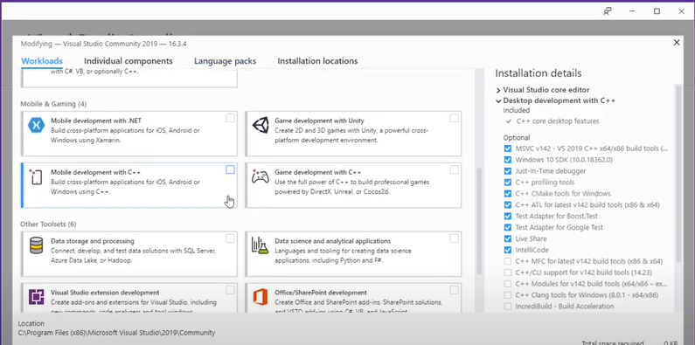
003.2 Install Visual Studio
https://www.youtube.com/watch?v=cuCWbztXk4Y
Install Visual Studio
There are tools for you to install.

Slide 10
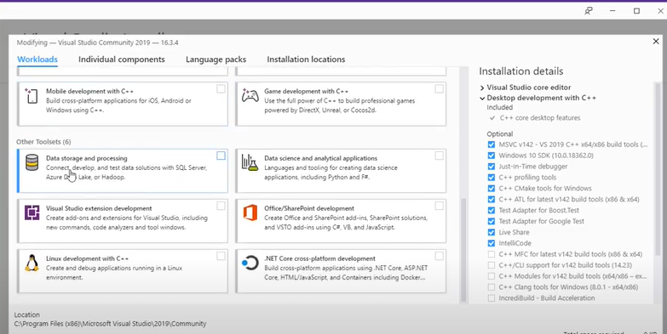
003.2 Install Visual Studio
https://www.youtube.com/watch?v=cuCWbztXk4Y
Install Visual Studio
We have
1. Data Storage and processing and
2. Linux development with C++.
1
2

Slide 11
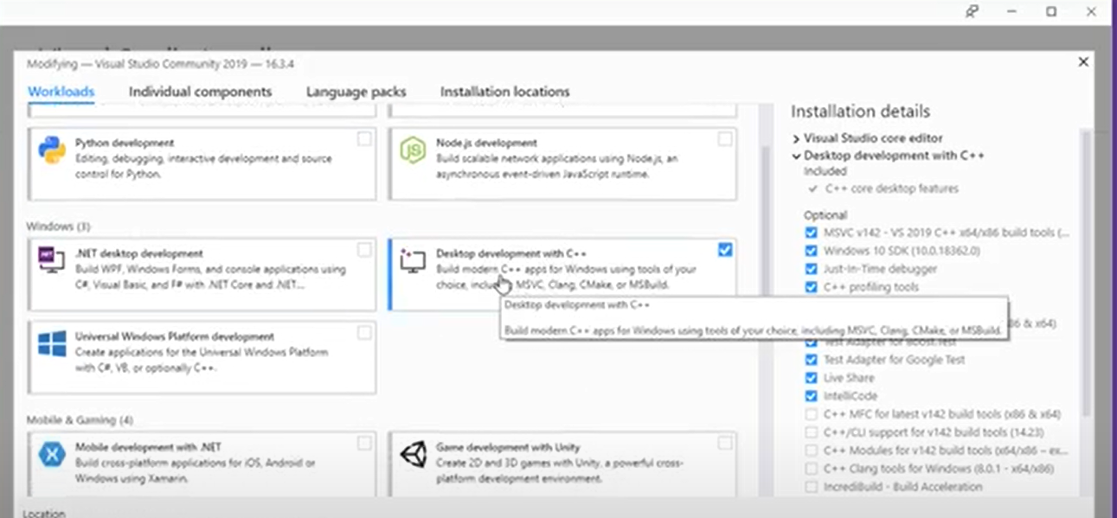
003.2 Install Visual Studio
https://www.youtube.com/watch?v=cuCWbztXk4Y
Install Visual Studio
We also have
1. Python Development
2. Desktop development with C++
1
2

Slide 12
003.3 Download Cuda Toolkit

Slide 13
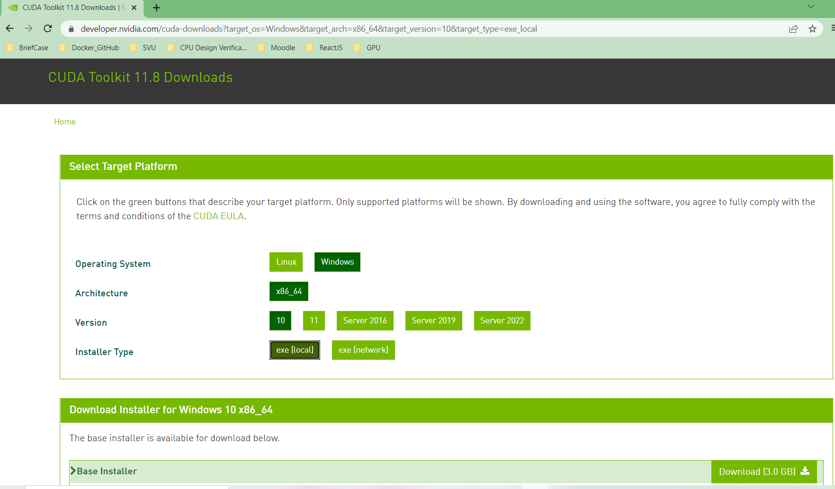
003.3 Download Cuda Toolkit
https://www.youtube.com/watch?v=cuCWbztXk4Y
Download Cuda Toolkit
After we install the Visual Studio, we need to install the Cuda toolkit.
Go to developer.nvidia.com, download Windows, x86_64, Windows version 10, download exe file to local (Installer is 3.0GB).

Slide 14
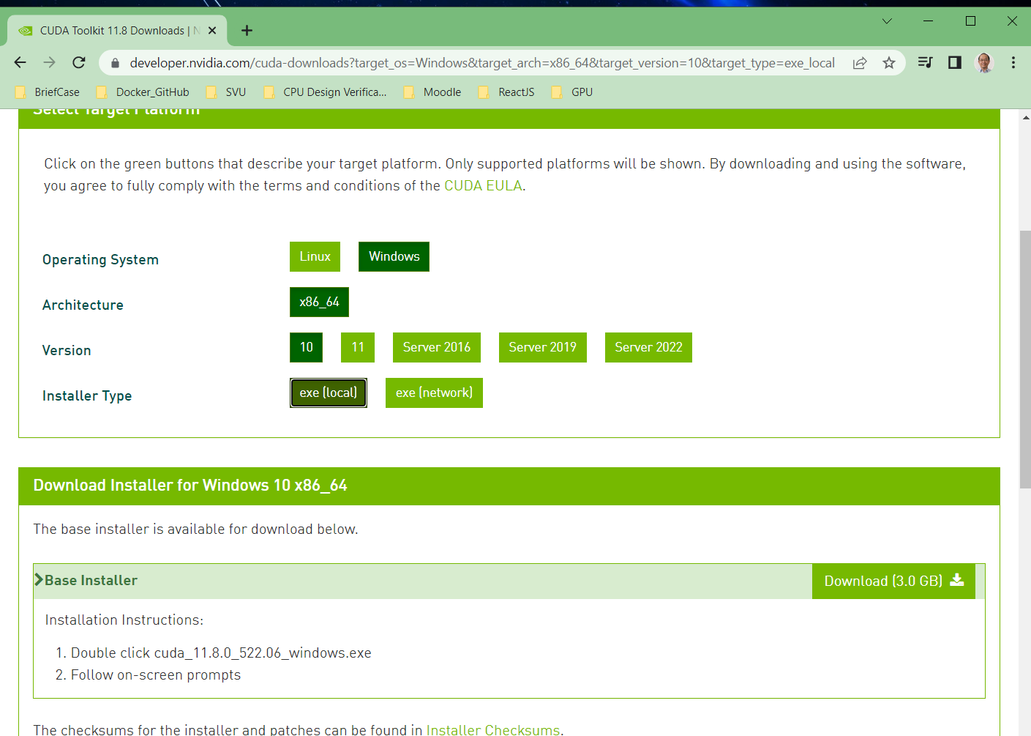
003.3 Download Cuda Toolkit
https://www.youtube.com/watch?v=cuCWbztXk4Y
Download Cuda Toolkit
Double-click the installer to install.

Slide 15
003.4 Download Cuda Sample Program

Slide 16
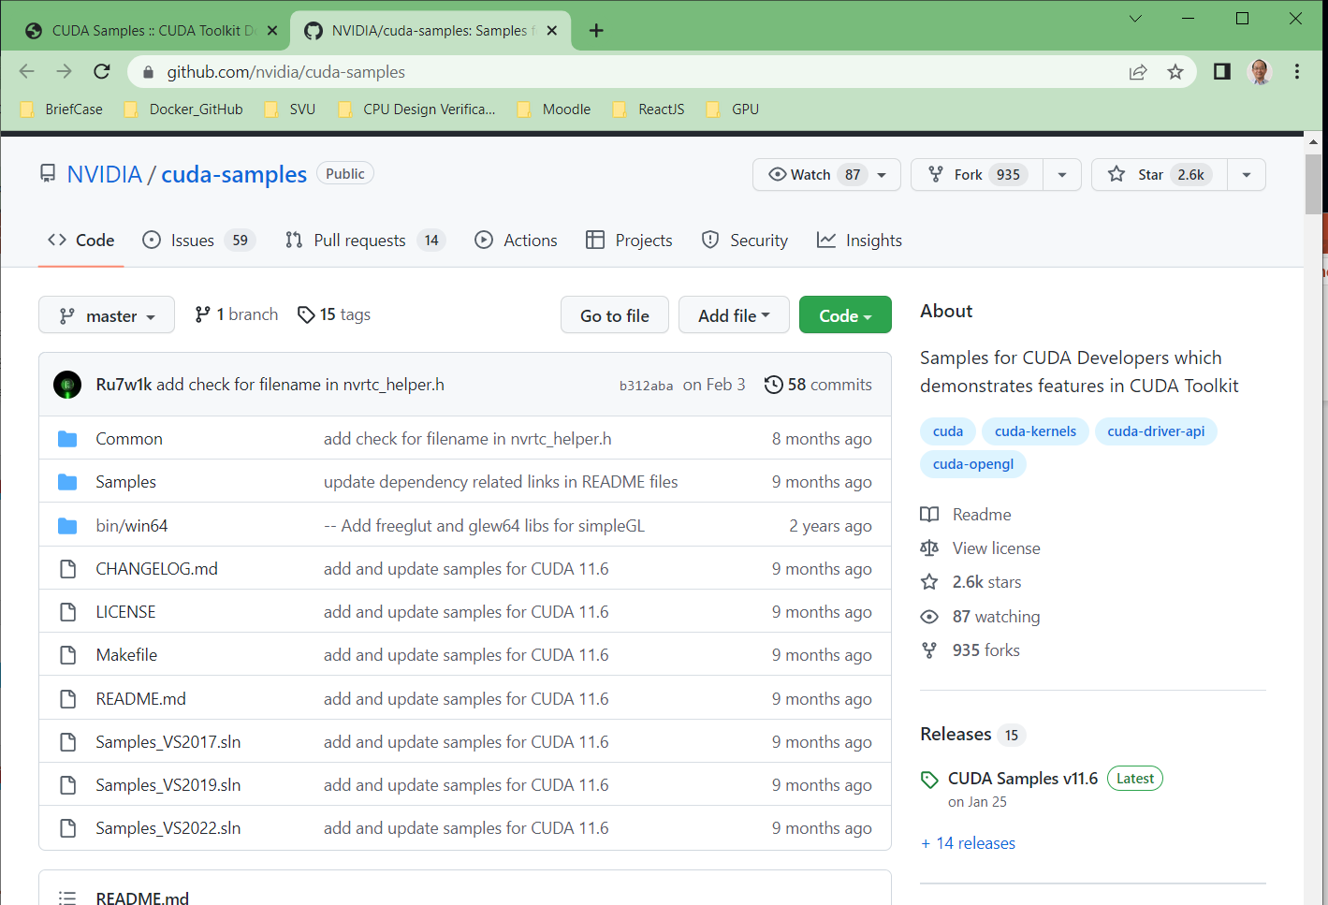
003.4 Download Cuda Sample Program
https://www.youtube.com/watch?v=cuCWbztXk4Y
Download Cuda Sample Program
https://docs.nvidia.com/cuda/cuda-samples/index.html
Download Cuda Sample program for Cuda version 11.6.
Note: After Cuda 11.6, the sample programs are separated out from the Cuda toolkit.
The Cuda sample program download from github:
https://github.com/nvidia/cuda-samples

Slide 17
003.4 Download Cuda Sample Program
https://www.youtube.com/watch?v=cuCWbztXk4Y
Building CUDA Samples Windows
The Windows samples are built using the Visual Studio IDE.
Solution files (.sln) are provided for each supported version of Visual Studio, using the format:
*_vs<version>.sln - for Visual Studio <version>
Complete samples solution files exist at parent directory of the repo.
Each individual sample has its own set of solution files at: <CUDA_SAMPLES_REPO>\Samples\<sample_dir>\
To build/examine all the samples at once, the complete solution files should be used.
To build/examine a single sample, the individual sample solution files should be used.

Slide 18
003.4 Download Cuda Sample Program
https://www.youtube.com/watch?v=cuCWbztXk4Y
Building CUDA Samples Windows
Note:
*.sln is the file extension for Microsoft Solution.
A solution is simply a container Visual Studio uses to organize one or more related projects.
When you open a solution, Visual Studio automatically loads all the projects that the solution contains.

Slide 19
003.5 Create New Project

Slide 20
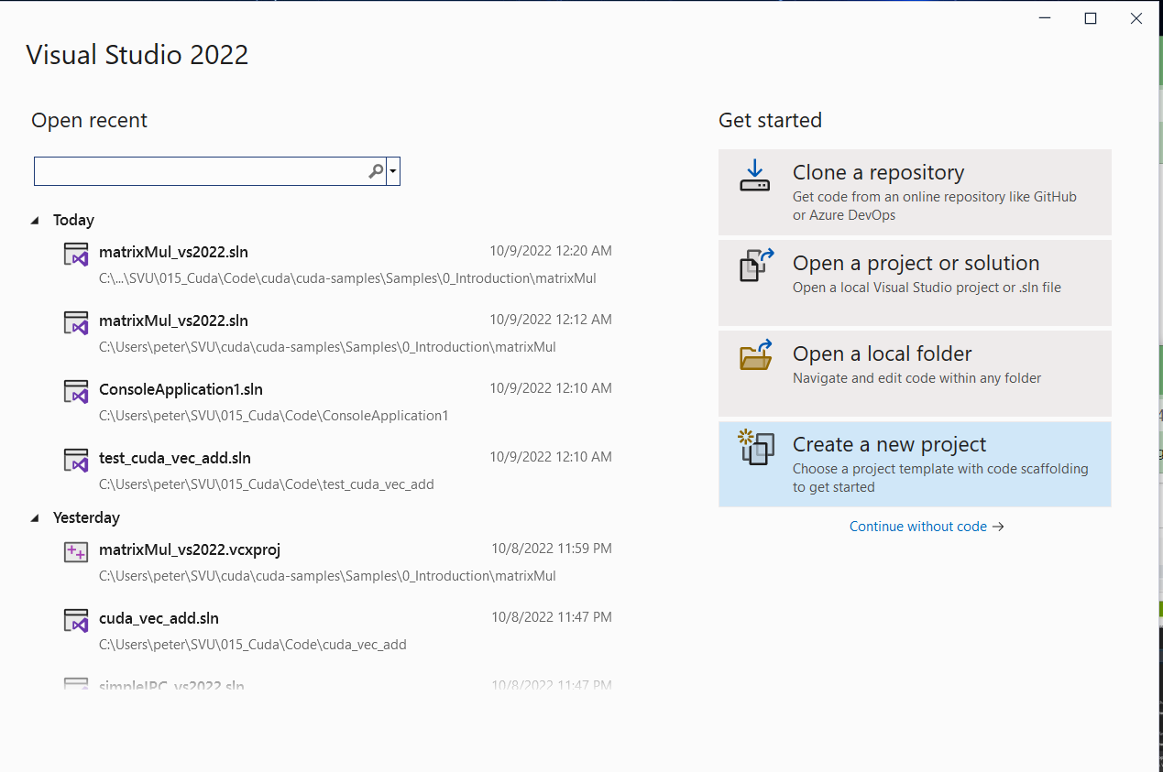
003.5 Create New Project
https://www.youtube.com/watch?v=cuCWbztXk4Y
Create New Project

Slide 21
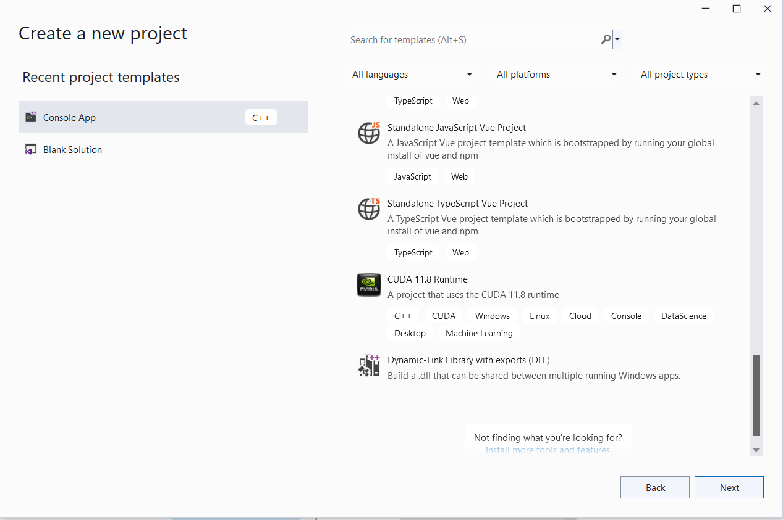
003.5 Create New Project
https://www.youtube.com/watch?v=cuCWbztXk4Y
CUDA 11.8 Runtime
Scroll to bottom to find “CUDA 11.8 Runtime” and click “Next”.

Slide 22
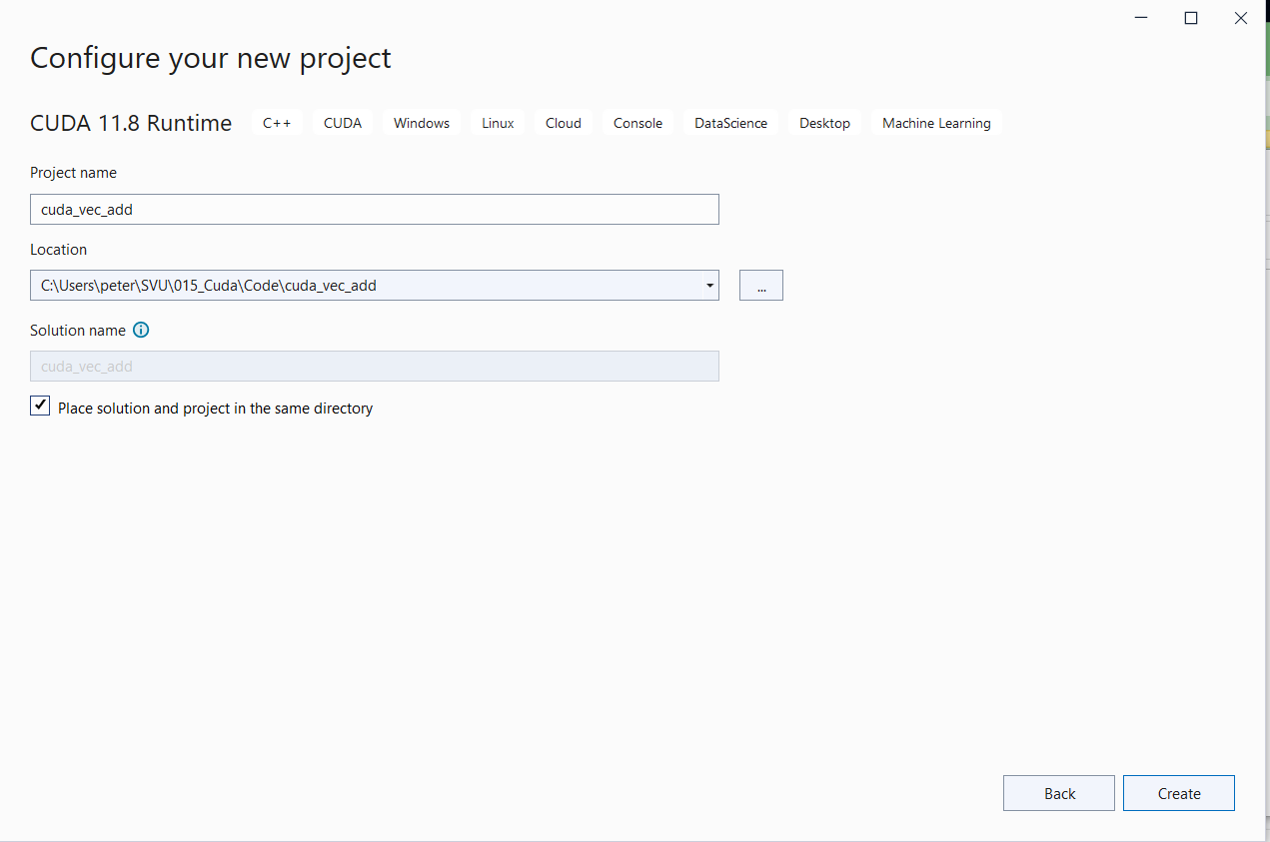
003.5 Create New Project
https://www.youtube.com/watch?v=cuCWbztXk4Y
Create Project and Solution
1. Project Name: cuda_vec_add
2. Click “Place solution and project in the same directory”
1
2

Slide 23
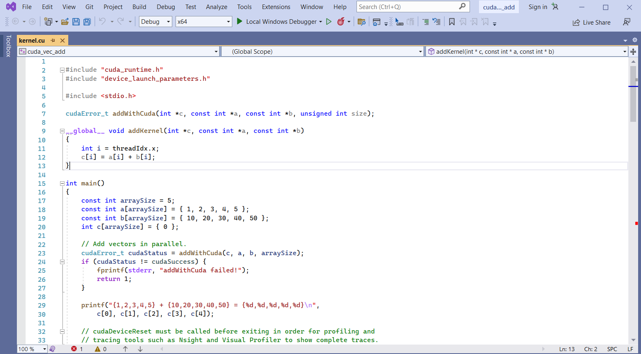
003.5 Create New Project
https://www.youtube.com/watch?v=cuCWbztXk4Y
Generate Default Cuda Program
Visual Studio generates a default Cuda Vector Addition program.
We have two arrays to add together.
1. We have array a with {1, 2, 3, 4, 5}
2. We have another array b with {10, 20, 30, 40, 50}
3. And then, we have array C to accumulate array a and array b.

Slide 24
003.6 Build Project

Slide 25
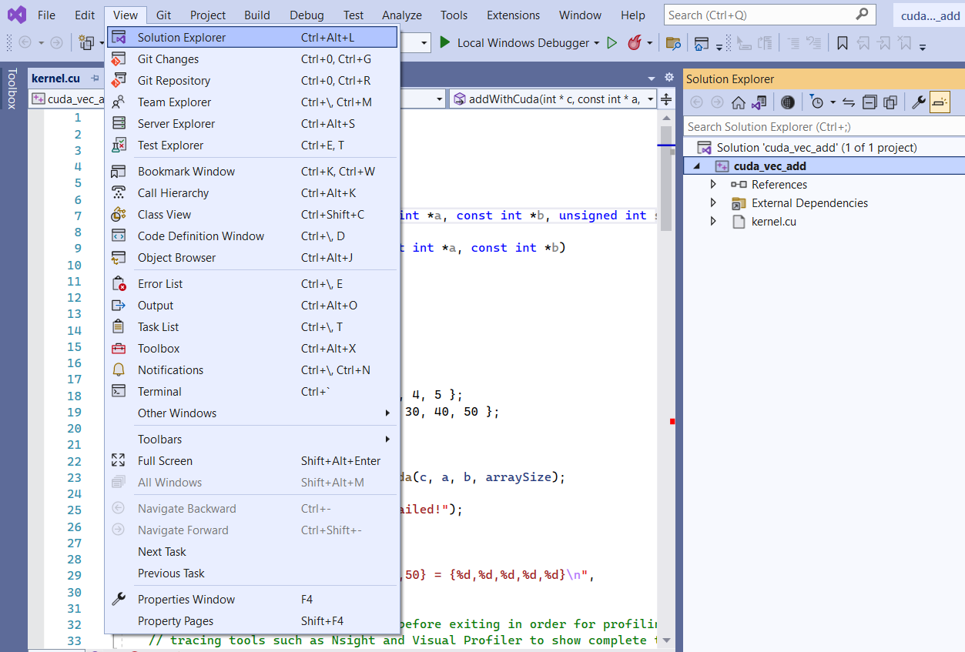
003.6 Build Project
https://www.youtube.com/watch?v=cuCWbztXk4Y
Build Project
View > Solution Explorer: Turn on the Solution Explore.

Slide 26
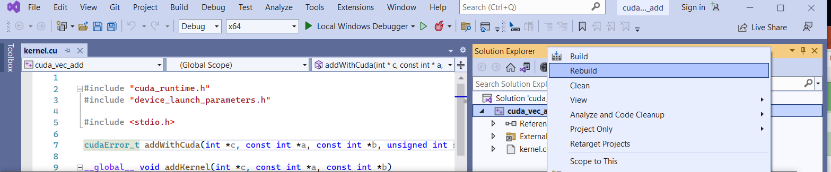
003.6 Build Project
https://www.youtube.com/watch?v=cuCWbztXk4Y
Build Project
In the Solution Explorer, Select the Project Name “cuda_vec_add” and
Use Right Mouse Button and select “Rebuild” to compile the project.

Slide 27
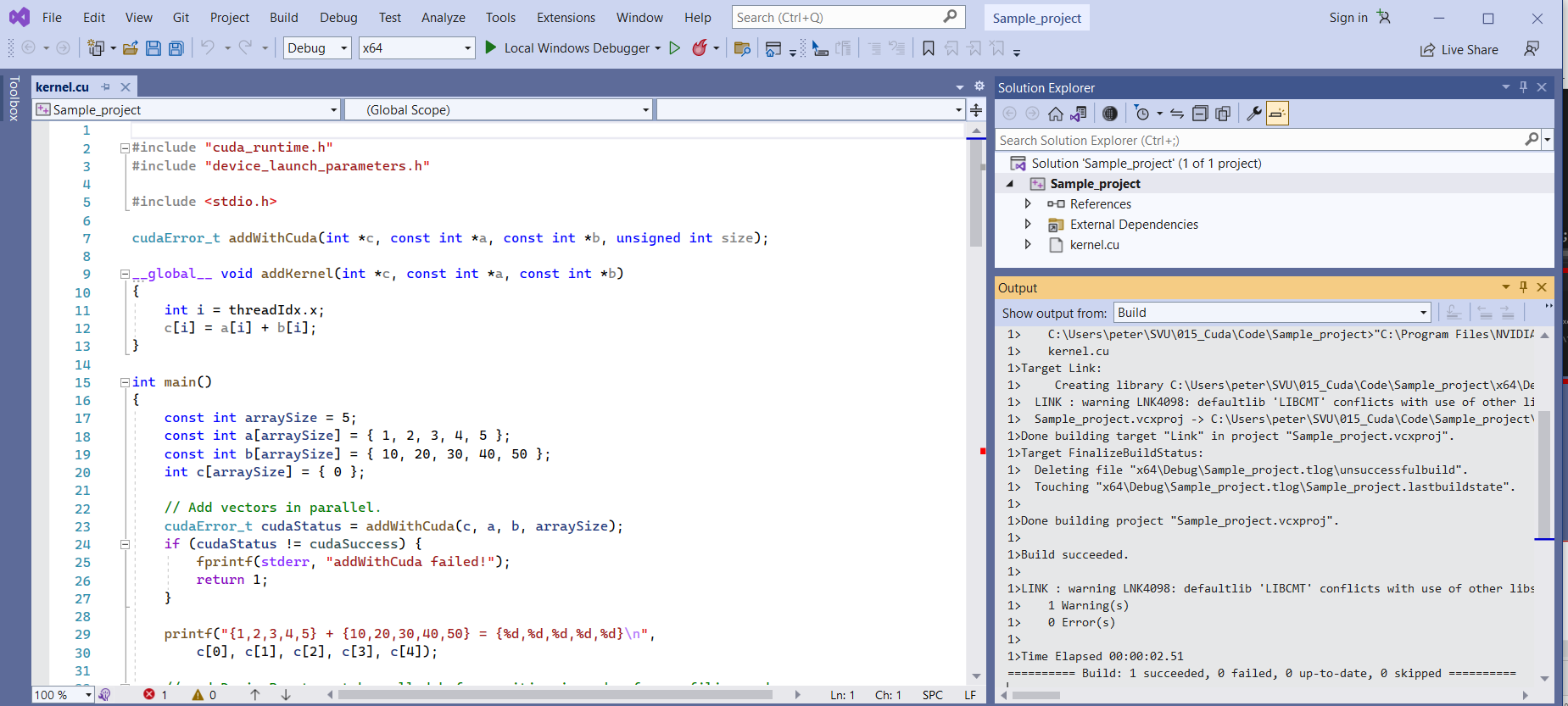
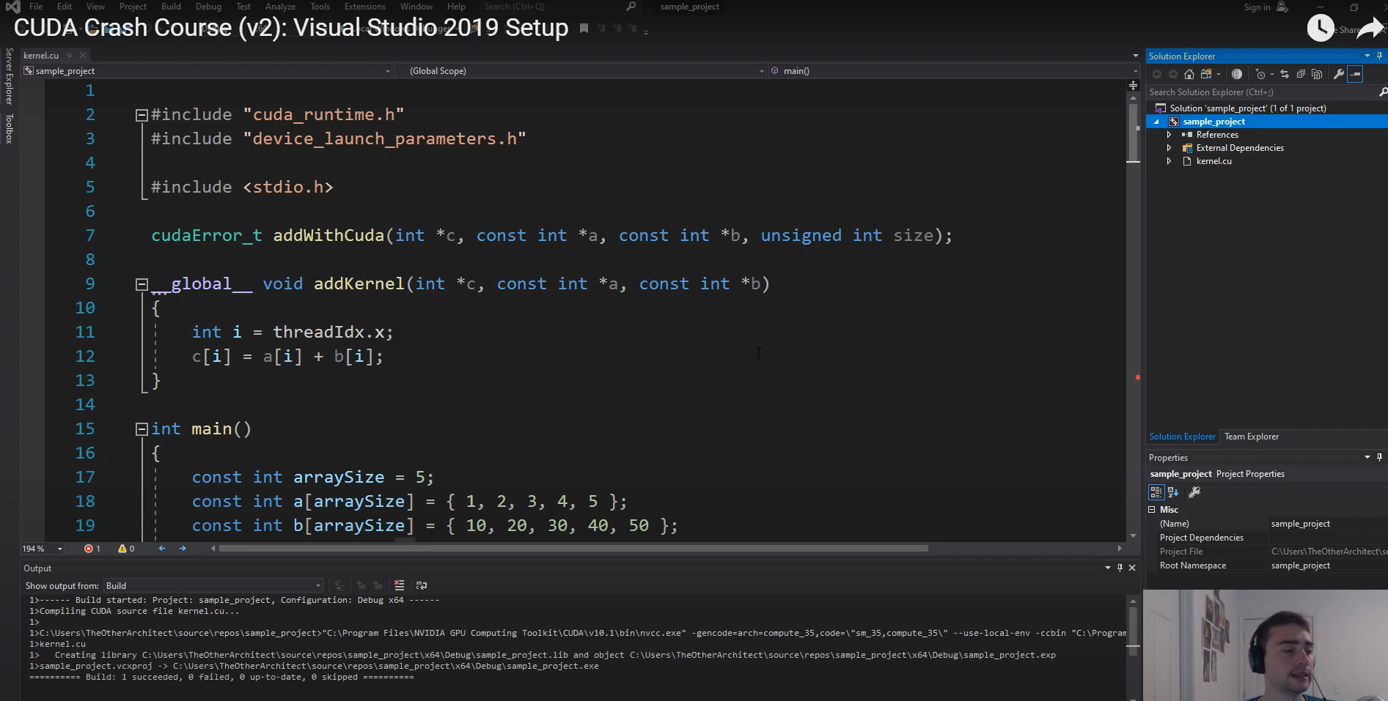
003.6 Build Project
https://www.youtube.com/watch?v=cuCWbztXk4Y
Build Project
We have the project compiled as below.

Slide 28
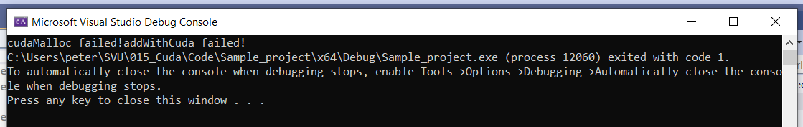
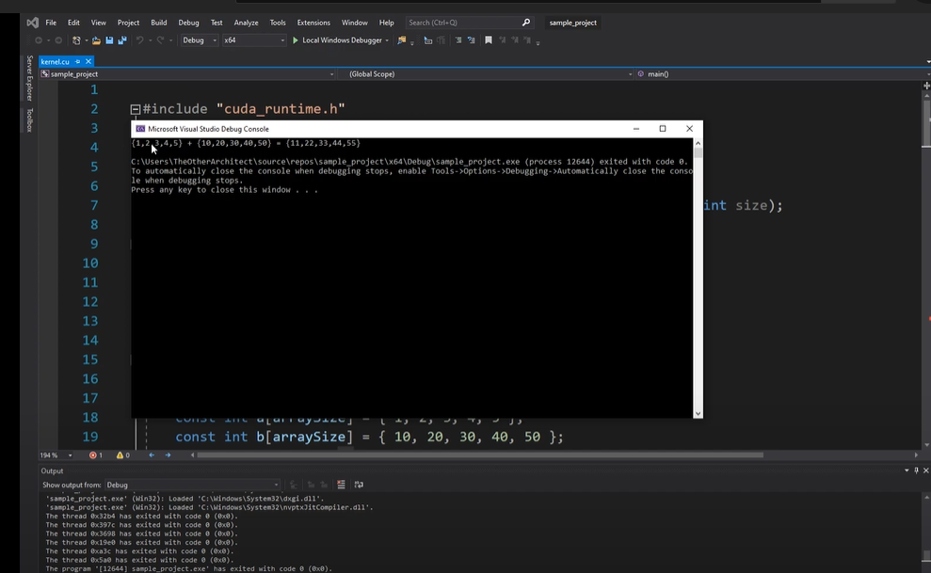
003.6 Build Project
https://www.youtube.com/watch?v=cuCWbztXk4Y
Build Project
Click “Legal Window Debugger”: {1, 2, 3, 4, 5} + {10, 20, 30, 40, 50} = {11, 21, 31, 41, 51}

Slide 29
003.7 Fix Bug in Visual Studio Code Generation

Slide 30
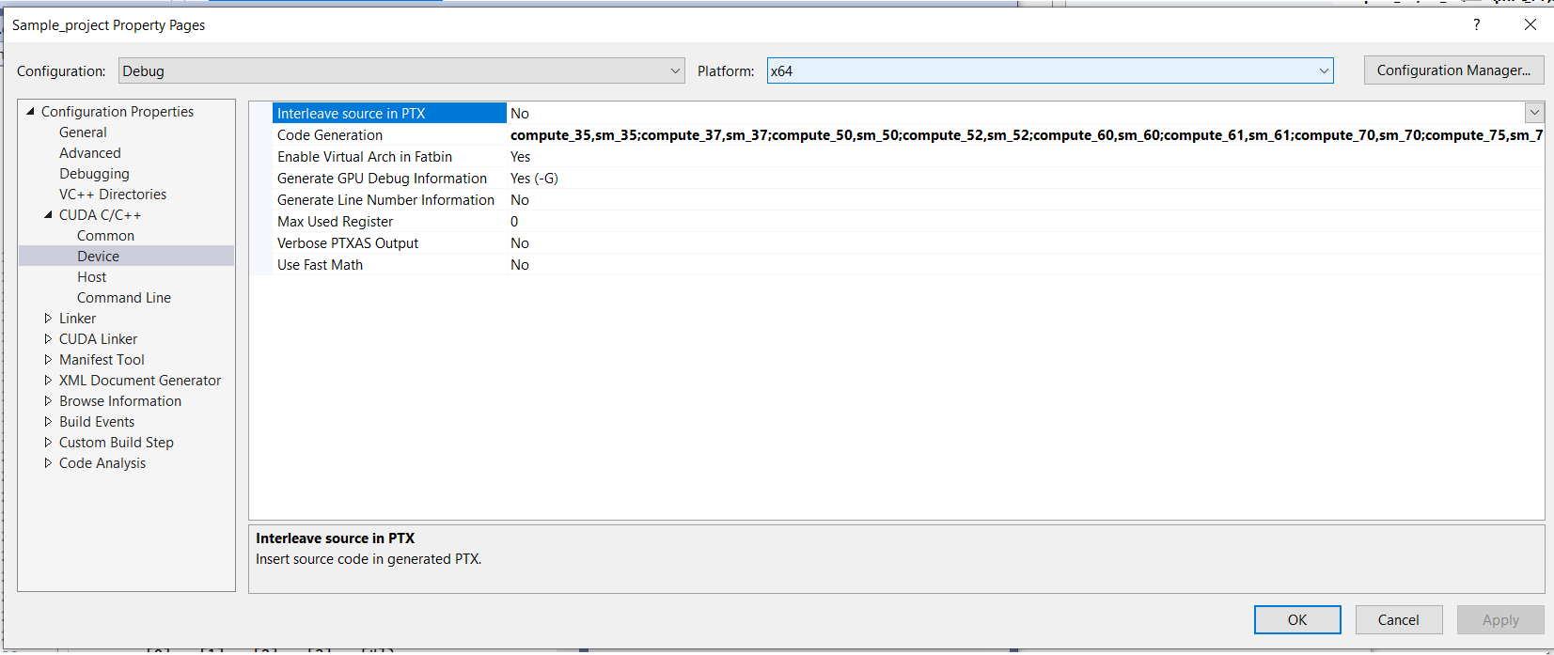
003.7 Fix Bug in Visual Studio Code Generation
https://www.youtube.com/watch?v=cuCWbztXk4Y
Build Project
In the CUDA C/C++ > Device > Code Generation.
Copy from Sample Code:
compute_35,sm_35
compute_37,sm_37
compute_50,sm_50
compute_52,sm_52
compute_60,sm_60
compute_61,sm_61
compute_70,sm_70
compute_75,sm_75
compute_80,sm_80
compute_86,sm_86

Slide 31
003.8 Compile and Run with Code Generation

Slide 32
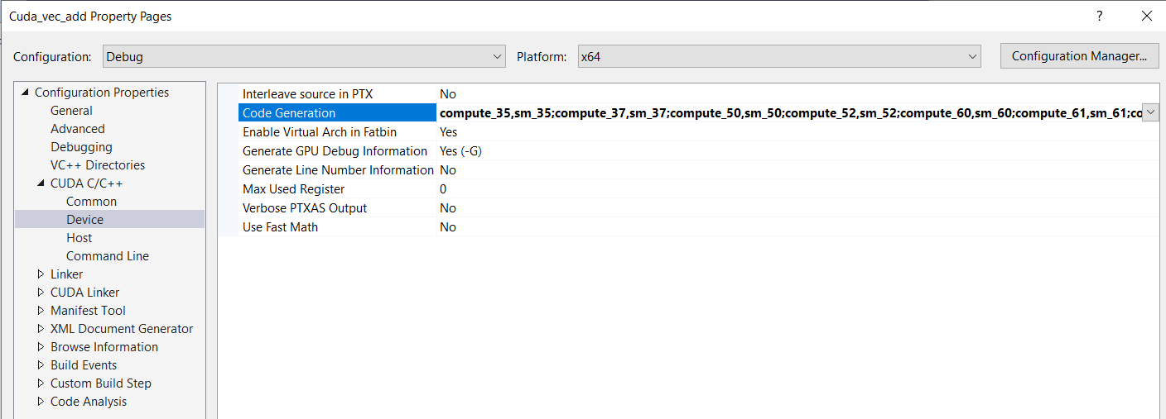
003.8 Compile and Run with Code Generation
https://www.youtube.com/watch?v=cuCWbztXk4Y
Copy Code Generation
In the CUDA C/C++ > Device > Code Generation.
Copy from Sample Code:
compute_35,sm_35
compute_37,sm_3
compute_50,sm_50
compute_52,sm_52
compute_60,sm_60
compute_61,sm_61
compute_70,sm_70
compute_75,sm_75
compute_80,sm_80
compute_86,sm_86

Slide 33
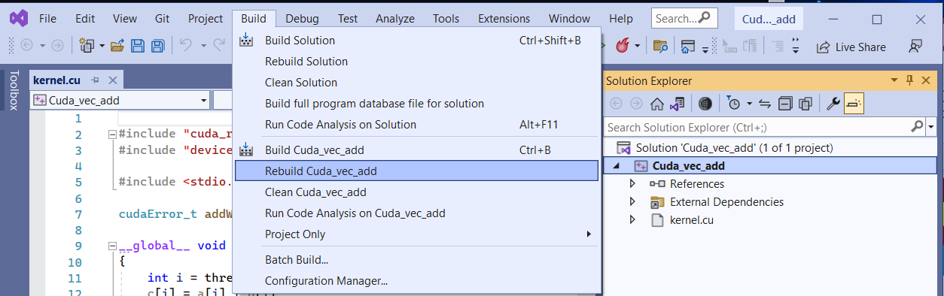
003.8 Compile and Run with Code Generation
https://www.youtube.com/watch?v=cuCWbztXk4Y
Build Project

Slide 34
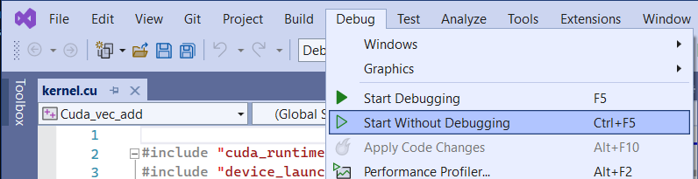
003.8 Compile and Run with Code Generation
https://www.youtube.com/watch?v=cuCWbztXk4Y
Run Project

Slide 35
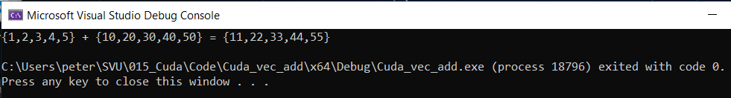
003.8 Compile and Run with Code Generation
https://www.youtube.com/watch?v=cuCWbztXk4Y
View Result

Slide 36
End

