Slide 1

007 Divide and Conquer
Peter H. Chen

Slide 2
007 Divide and Conquer
https://www.tutorialspoint.com/data_structures_algorithms/divide_and_conquer.htm
Divide and Conquer
In divide and conquer approach, the problem in hand, is divided into smaller sub-problems and then each problem is solved independently.
When we keep on dividing the subproblems into even smaller sub-problems, we may eventually reach a stage where no more division is possible.
Those "atomic" smallest possible sub-problem (fractions) are solved.

Slide 3
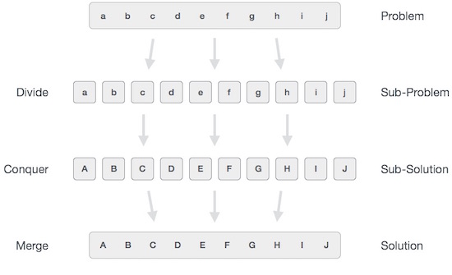
007 Divide and Conquer
https://www.tutorialspoint.com/data_structures_algorithms/divide_and_conquer.htm
Divide and Conquer
The solution of all sub-problems is finally merged in order to obtain the solution of an original problem.
In general, the divide-and-conquer approach is a three-step process.

Slide 4
007.1 Divide/Break

Slide 5
007.1 Divide/Break
https://www.tutorialspoint.com/data_structures_algorithms/divide_and_conquer.htm
Divide/break
This step involves breaking the problem into smaller sub-problems.
Sub-problems should represent a part of the original problem.
This step generally takes a recursive approach to divide the problem until no sub-problem is further divisible.
At this stage, sub-problems become atomic in nature but still represent some part of the actual problem.

Slide 6
007.2 Conquer/Solve

Slide 7
007.2 Conquer/Solve
https://www.tutorialspoint.com/data_structures_algorithms/divide_and_conquer.htm
Conquer/Solve
This step receives a lot of smaller sub-problems to be solved.
Generally, at this level, the problems are considered 'solved' on their own.

Slide 8
007.3 Merge/Combine

Slide 9
007.3 Merge/Combine
https://www.tutorialspoint.com/data_structures_algorithms/divide_and_conquer.htm
Merge/Combine
When the smaller sub-problems are solved, this stage recursively combines them until they formulate a solution of the original problem.
This algorithmic approach works recursively.
The conquer and merge steps works so close that they appear as one.

Slide 10
007.4 Example

Slide 11
007.4 Example
https://www.tutorialspoint.com/data_structures_algorithms/divide_and_conquer.htm
Example
The following computer algorithms are based on divide-and-conquer programming approach −
Merge Sort
Quick Sort
Binary Search
Strassen's Matrix Multiplication
Closest pair (points)
There are various ways available to solve any computer problem, but the mentioned are a good example of divide and conquer approach.

Slide 12
007.5 Summary

Slide 13
007.5 Summary
https://www.tutorialspoint.com/data_structures_algorithms/divide_and_conquer.htm
Summary
In divide and conquer approach, the problem in hand, is divided into smaller sub-problems and then each problem is solved independently.
The following computer algorithms are based on divide-and-conquer programming approach −
Merge Sort
Quick Sort
Binary Search
Strassen's Matrix Multiplication
Closest pair (points)

Slide 14
End

