Slide 1

019_01 Interpolation Search: C
Peter H. Chen

Slide 2
019_01 Interpolation Search: C
https://www.tutorialspoint.com/data_structures_algorithms/interpolation_search_algorithm.htm
Interpolation Search: C
Interpolation search is an improved variant of binary search.
This search algorithm works on the probing position of the required value.
For this algorithm to work properly, the data collection should be in a sorted form and equally distributed.
Binary search has a huge advantage of time complexity over linear search. Linear search has worst-case complexity of Ο(n) whereas binary search has Ο(log n).
There are cases where the location of target data may be known in advance.
For example, in case of a telephone directory, if we want to search the telephone number of Sunnyvale.
Here, linear search and even binary search will seem slow as we can directly jump to memory space where the names start from ‘S' are stored.

Slide 3
019_01.1 Positioning in Binary Search

Slide 4




019_01.1 Positioning in Binary Search
https://www.tutorialspoint.com/data_structures_algorithms/interpolation_search_algorithm.htm
Position Probing in Binary Search
In binary search, if the desired data is not found then the rest of the list is divided in two parts, lower and higher.
The search is carried out in either of them.
Even when the data is sorted, binary search does not take advantage to probe the position of the desired data.

Slide 5
019_01.2 Position Probing in Interpolation

Slide 6


019_01.2 Position Probing in Interpolation
https://www.tutorialspoint.com/data_structures_algorithms/interpolation_search_algorithm.htm
Positioning in Interpolation
Interpolation search finds a particular item by computing the probe position.
Initially, the probe position is the position of the middle most item of the collection.

Slide 7
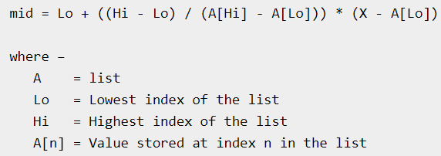
019_01.2 Position Probing in Interpolation
https://www.tutorialspoint.com/data_structures_algorithms/interpolation_search_algorithm.htm
Positioning in Interpolation
If a match occurs, then the index of the item is returned.
To split the list into two parts, we use the following method:

Slide 8
019_01.2 Position Probing in Interpolation
https://www.tutorialspoint.com/data_structures_algorithms/interpolation_search_algorithm.htm
Positioning in Interpolation
If the middle item is greater than the item, then the probe position is again calculated in the sub-array to the right of the middle item.
Otherwise, the item is searched in the subarray to the left of the middle item. This process continues on the sub-array as well until the size of subarray reduces to zero.
Runtime complexity of interpolation search algorithm is Ο(log (log n)) as compared to Ο(log n) of BST in favorable situations.

Slide 9
019_01.3 Pseudo Code

Slide 10
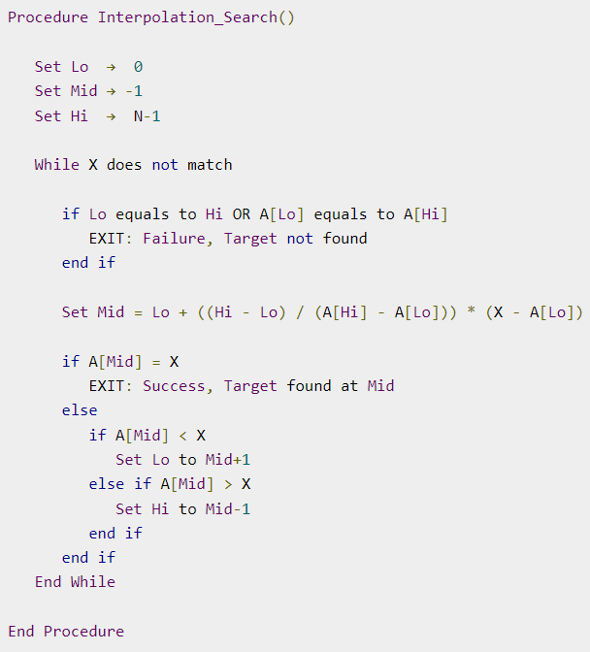
019_01.3 Pseudo Code
https://www.tutorialspoint.com/data_structures_algorithms/interpolation_search_algorithm.htm
C Pseudo Code

Slide 11
019_01.4 C Code

Slide 12

019_01.4 C Code
https://www.tutorialspoint.com/data_structures_algorithms/interpolation_search_algorithm.htm
C Code
Define list data

Slide 13
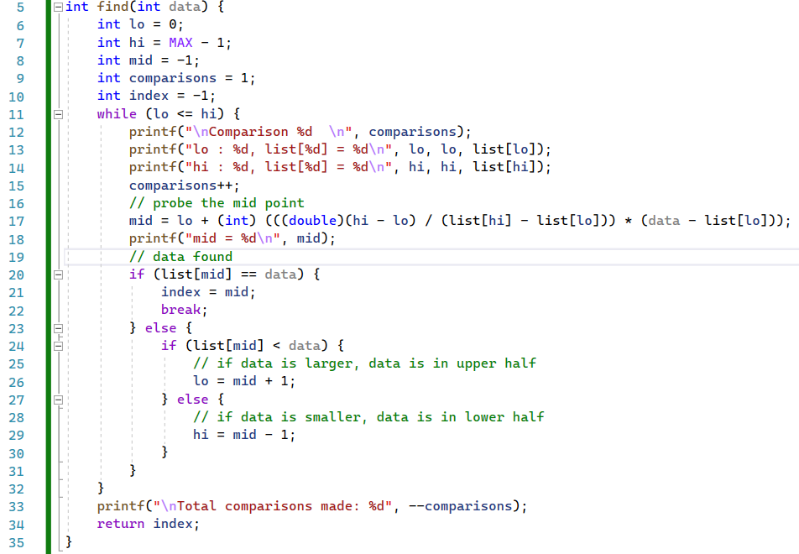
019_01.4 C Code
https://www.tutorialspoint.com/data_structures_algorithms/interpolation_search_algorithm.htm
C Code
find()

Slide 14
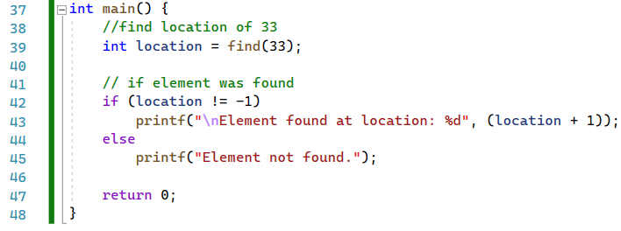
019_01.4 C Code
https://www.tutorialspoint.com/data_structures_algorithms/interpolation_search_algorithm.htm
C Code
main()

Slide 15
019_01.5 Result

Slide 16
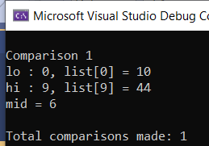
019_01.5 Result
https://www.tutorialspoint.com/data_structures_algorithms/interpolation_search_algorithm.htm
Result

Slide 17
End

