Slide 1

019_02 Interpolation Search: CPP
Peter H. Chen

Slide 2
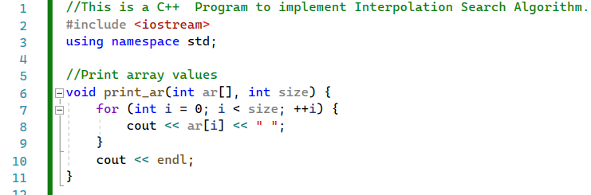
019_02 Interpolation Search: CPP
https://www.sanfoundry.com/cpp-program-implement-interpolation-search/
Interpolation Search: CPP
print_ar()

Slide 3
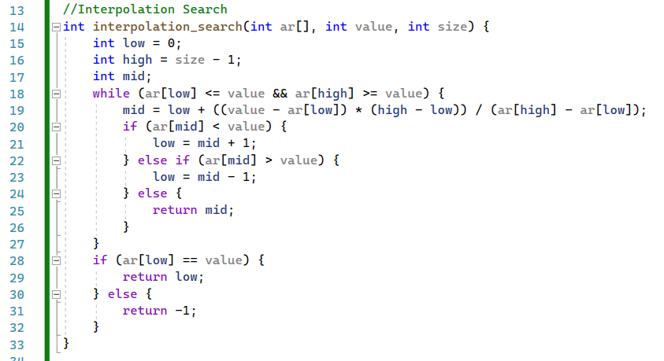
019_02 Interpolation Search: CPP
https://www.sanfoundry.com/cpp-program-implement-interpolation-search/
Interpolation Search: CPP
interpolation_search()

Slide 4
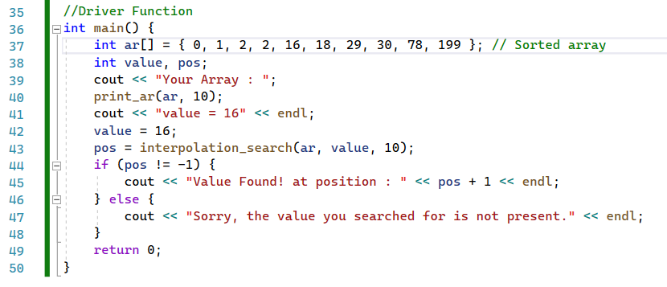
019_02 Interpolation Search: CPP
https://www.sanfoundry.com/cpp-program-implement-interpolation-search/
Interpolation Search: CPP
main()

Slide 5
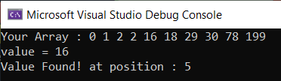
019_02 Interpolation Search: CPP
https://www.sanfoundry.com/cpp-program-implement-interpolation-search/
Interpolation Search: CPP
Result

Slide 6
End

