Slide 1

020_01 Hash Table: C
Peter H. Chen

Slide 2
020_01 Hash Table: C
https://www.tutorialspoint.com/data_structures_algorithms/hash_data_structure.htm
Hash Table: C
Hash Table is a data structure which stores data in an associative manner.
In a hash table, data is stored in an array format, where each data value has its own unique index value.
Access of data becomes very fast if we know the index of the desired data.
Thus, it becomes a data structure in which insertion and search operations are very fast irrespective of the size of the data.
Hash Table uses an array as a storage medium and uses hash technique to generate an index where an element is to be inserted or is to be located from.

Slide 3
020_01.1 Hashing

Slide 4
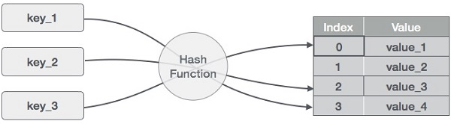
020_01.1 Hashing
https://www.tutorialspoint.com/data_structures_algorithms/hash_data_structure.htm
Hashing
Hashing is a technique to convert a range of key values into a range of indexes of an array.
We're going to use modulo operator to get a range of key values.
Consider an example of hash table of size 20, and the following items are to be stored.
Item are in the (key, value) format.

Slide 5
020_01.1 Hashing
https://www.tutorialspoint.com/data_structures_algorithms/hash_data_structure.htm
Hashing
(1,20)
(2,70)
(42,80)
(4,25)
(12,44)
(14,32)
(17,11)
(13,78)
(37,98)
No. | Key | Hash | Array Index
1 | 1 | 1 % 20 = 1 | 1
2 | 2 | 2 % 20 = 2 | 2
3 | 42 | 42 % 20 = 2 | 2
4 | 4 | 4 % 20 = 4 | 4
5 | 12 | 12 % 20 = 12 | 12
6 | 14 | 14 % 20 = 14 | 14
7 | 17 | 17 % 20 = 17 | 17
8 | 13 | 13 % 20 = 13 | 13
9 | 37 | 37 % 20 = 17 | 17

Slide 6
020_01.2 Linear Probing

Slide 7
020_01.2 Linear Probing
https://www.tutorialspoint.com/data_structures_algorithms/hash_data_structure.htm
Linear Probing
As we can see, it may happen that the hashing technique is used to create an already used index of the array.
No. | Key | Hash | Array Index
1 | 1 | 1 % 20 = 1 | 1
2 | 2 | 2 % 20 = 2 | 2
3 | 42 | 42 % 20 = 2 | 2
4 | 4 | 4 % 20 = 4 | 4
5 | 12 | 12 % 20 = 12 | 12
6 | 14 | 14 % 20 = 14 | 14
7 | 17 | 17 % 20 = 17 | 17
8 | 13 | 13 % 20 = 13 | 13
9 | 37 | 37 % 20 = 17 | 17
In such a case, we can search the next empty location in the array by looking into the next cell until we find an empty cell.
This technique is called linear probing.

Slide 8
020_01.3 Basic Operation

Slide 9
020_01.3 Basic Operation
https://www.tutorialspoint.com/data_structures_algorithms/hash_data_structure.htm
Basic Operation
Following are the basic primary operations of a hash table.
Search − Searches an element in a hash table.
Insert − inserts an element in a hash table.
delete − Deletes an element from a hash table.

Slide 10
020_01.4 Data Item

Slide 11
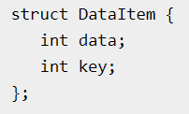
020_01.4 Data Item
https://www.tutorialspoint.com/data_structures_algorithms/hash_data_structure.htm
Data Item
Define a data item having some data and key, based on which the search is to be conducted in a hash table.

Slide 12
020_01.5 Hash Method

Slide 13
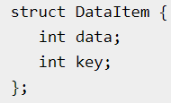
020_01.5 Hash Method
https://www.tutorialspoint.com/data_structures_algorithms/hash_data_structure.htm
Hash Method
Define a hashing method to compute the hash code of the key of the data item.

Slide 14
020_01.6 Search Operation

Slide 15
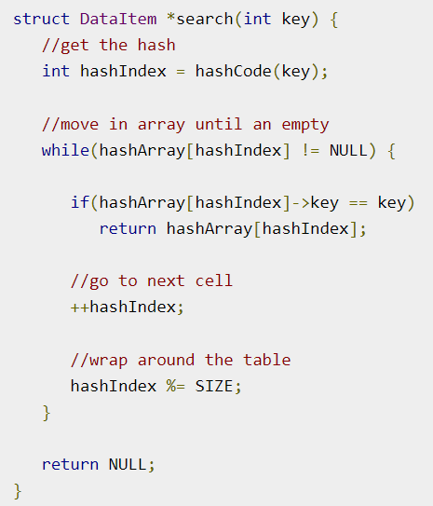
020_01.6 Search Operation
https://www.tutorialspoint.com/data_structures_algorithms/hash_data_structure.htm
Search Operation
Whenever an element is to be searched, compute the hash code of the key passed and locate the element using that hash code as index in the array.
Use linear probing to get the element ahead if the element is not found at the computed hash code.
Example:

Slide 16
020_01.7 Insert Operation

Slide 17
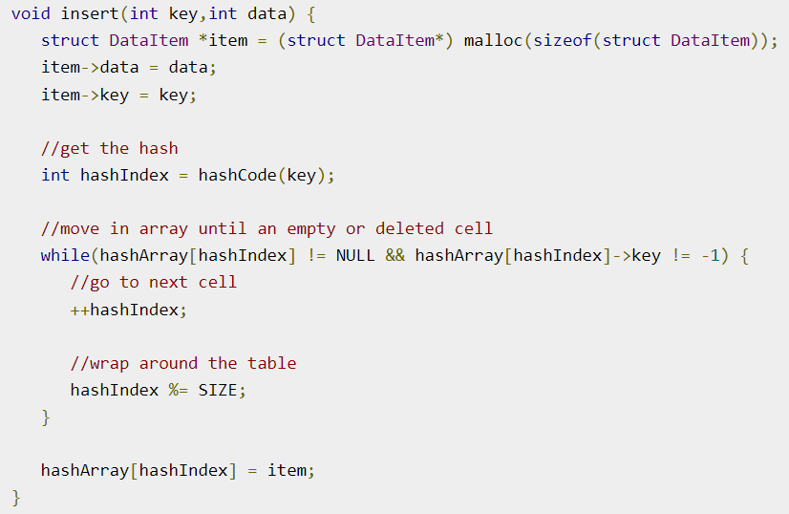
020_01.7 Insert Operation
https://www.tutorialspoint.com/data_structures_algorithms/hash_data_structure.htm
Insert Operation
Whenever an element is to be inserted, compute the hash code of the key passed and locate the index using that hash code as an index in the array.
Use linear probing for empty location, if an element is found at the computed hash code.
Example:

Slide 18
020_01.8 Delete Operation

Slide 19
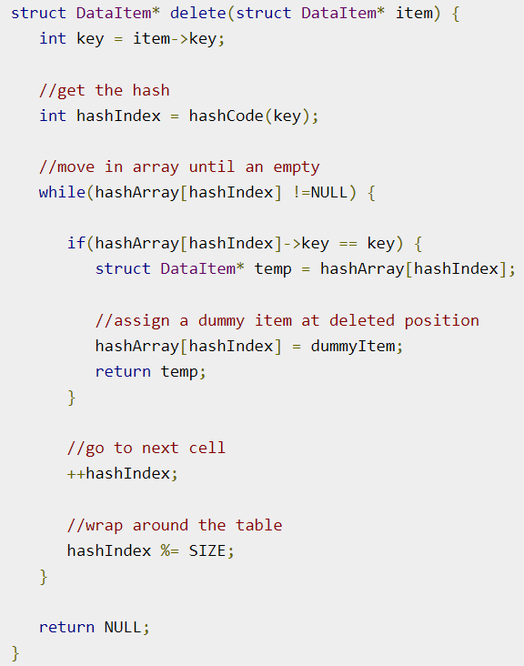
020_01.8 Delete Operation
https://www.tutorialspoint.com/data_structures_algorithms/hash_data_structure.htm
Delete Operation
Whenever an element is to be deleted, compute the hash code of the key passed and locate the index using that hash code as an index in the array.
Use linear probing to get the element ahead if an element is not found at the computed hash code.
When found, store a dummy item there to keep the performance of the hash table intact.
Example:

Slide 20
020_01.9 Hash Table: C Code

Slide 21
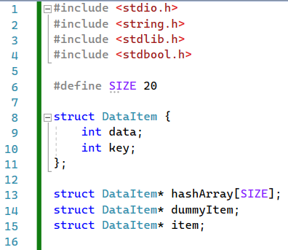
020_01.9 Hash Table: C Code
https://www.tutorialspoint.com/data_structures_algorithms/hash_table_program_in_c.htm
Hash Table: C Code
Defined Data

Slide 22
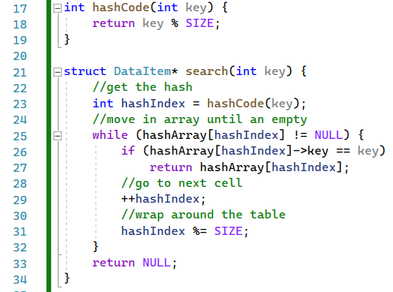
020_01.9 Hash Table: C Code
https://www.tutorialspoint.com/data_structures_algorithms/hash_table_program_in_c.htm
Hash Table: C Code
hashCode () and search()

Slide 23
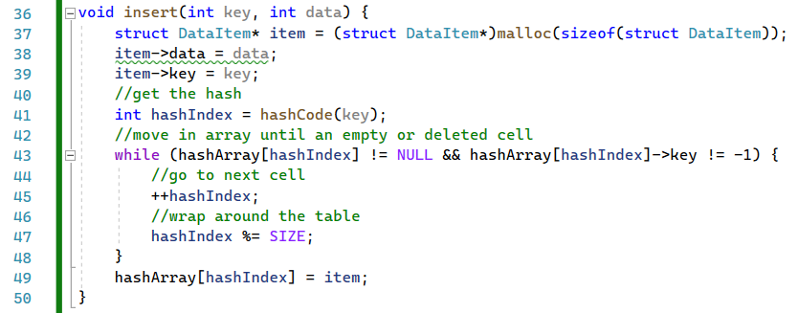
020_01.9 Hash Table: C Code
https://www.tutorialspoint.com/data_structures_algorithms/hash_table_program_in_c.htm
Hash Table: C Code
insert()

Slide 24
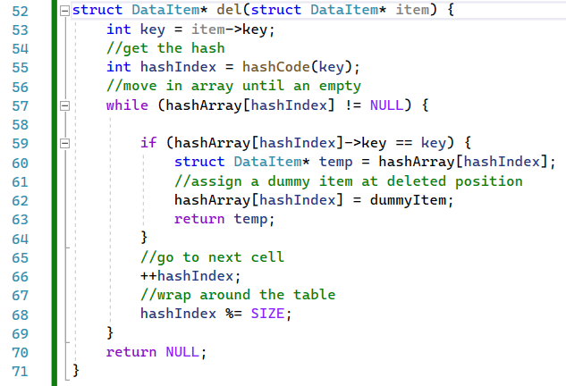
020_01.9 Hash Table: C Code
https://www.tutorialspoint.com/data_structures_algorithms/hash_table_program_in_c.htm
Hash Table: C Code
del()

Slide 25
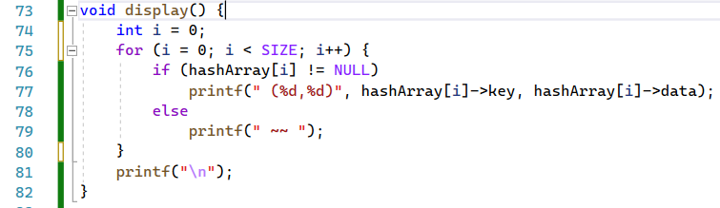
020_01.9 Hash Table: C Code
https://www.tutorialspoint.com/data_structures_algorithms/hash_table_program_in_c.htm
Hash Table: C Code
del()

Slide 26
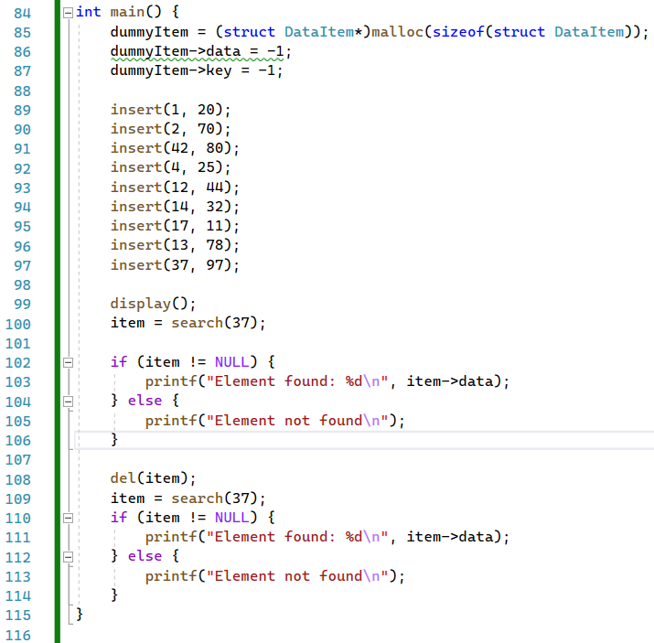
020_01.9 Hash Table: C Code
https://www.tutorialspoint.com/data_structures_algorithms/hash_table_program_in_c.htm
Hash Table: C Code
main()

Slide 27
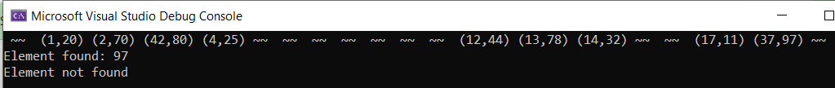
020_01.9 Hash Table: C Code
https://www.tutorialspoint.com/data_structures_algorithms/hash_table_program_in_c.htm
Hash Table: C Code
Result

Slide 28
End

