Slide 1

020_02 Hash Table: STL
Peter H. Chen

Slide 2
020_02 Hash Table: STL
https://www.geeksforgeeks.org/unordered_map-in-cpp-stl/
Hash Table: STL
unordered_map is an associated container that stores elements formed by the combination of a key value and a mapped value.
The key value is used to uniquely identify the element and the mapped value is the content associated with the key.
Both key and value can be of any type predefined or user-defined. In simple terms, an unordered_map is like a data structure of dictionary type that store elements in itself.
It contains successive pairs (key, value), which allows fast retrieval of an individual element based on its unique key.
Internally unordered_map is implemented using Hash Table, the key provided to map is hashed into indices of a hash table which is why the performance of data structure depends on the hash function a lot but on average, the cost of search, insert, and delete from the hash table is O(1).

Slide 3
020_02 Hash Table: STL
https://www.geeksforgeeks.org/unordered_map-in-cpp-stl/
Hash Table: STL
Note:
In the worst case, its time complexity can go from O(1) to O(n), especially for big prime numbers.
In this situation, it is highly advisable to use a map instead to avoid getting a TLE (Time Limit Exceeded) error.
Note:
Prime number: 2, 3, 5, 7, 11, 13, 17, 19, 23, 29, 31, 37, 41, 43, 47, 53, 59, 61, 67, 71, 73, 79, 83, 89, 97, …
Big prime number will have big array space with a lot of unused spaces for index.

Slide 4
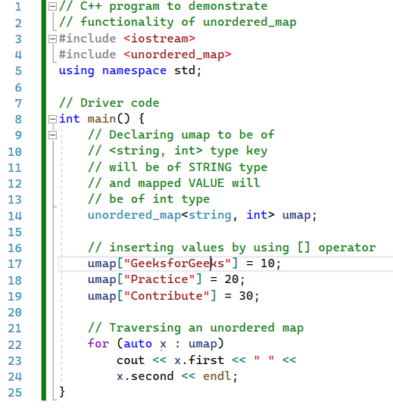

020_02 Hash Table: STL
https://www.geeksforgeeks.org/unordered_map-in-cpp-stl/
Hash Table: STL
STL Unordered map for Hash Table.
Note:
Unordered_map: store {key, Value} format.

Slide 5
End

