Slide 1

014_01 Stack: C
Peter H. Chen

Slide 2

014_01 Stack: C
https://www.tutorialspoint.com/data_structures_algorithms/stack_algorithm.htm
Stack: C
A stack is an Abstract Data Type (ADT), commonly used in most programming languages.
It is named stack as it behaves like a real-world stack, for example – a deck of cards or a pile of plates, etc.

Slide 3
014_01 Stack: C
https://www.tutorialspoint.com/data_structures_algorithms/stack_algorithm.htm
Stack: C
A real-world stack allows operations at one end only.
For example, we can place or remove a card or plate from the top of the stack only.
Likewise, Stack ADT allows all data operations at one end only.
At any given time, we can only access the top element of a stack.
This feature makes it LIFO data structure.
LIFO stands for Last-in-first-out.
Here, the element which is placed (inserted or added) last, is accessed first.
In stack terminology, insertion operation is called PUSH operation and removal operation is called POP operation.

Slide 4
014_01.1 Stack Representation

Slide 5
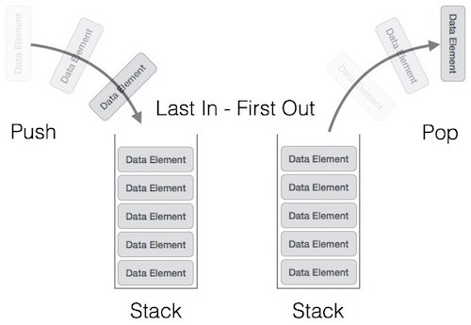
014_01.1 Stack Representation
https://www.tutorialspoint.com/data_structures_algorithms/stack_algorithm.htm
Stack Representation
The following diagram depicts a stack and its operations.

Slide 6
014_01.1 Stack Representation
https://www.tutorialspoint.com/data_structures_algorithms/stack_algorithm.htm
Stack Representation
A stack can be implemented by means of Array, Structure, Pointer, and Linked List.
Stack can either be a fixed size one or it may have a sense of dynamic resizing.
Here, we are going to implement stack using arrays, which makes it a fixed size stack implementation.

Slide 7
014_01.2 Stack Operation

Slide 8
014_01.2 Stack Operation
https://www.tutorialspoint.com/data_structures_algorithms/stack_algorithm.htm
Stack Operation
Stack operations may involve initializing the stack, using it and then de-initializing it.
Apart from these basic stuffs, a stack is used for the following two primary operations −
push() − Pushing (storing) an element on the stack.
pop() − Removing (accessing) an element from the stack.

Slide 9
014_01.2 Stack Operation
https://www.tutorialspoint.com/data_structures_algorithms/stack_algorithm.htm
Stack Operation
When data is Pushed onto stack.
To use a stack efficiently, we need to check the status of stack as well.
For the same purpose, the following functionality is added to stacks −
peek() − get the top data element of the stack, without removing it.
isFull() − check if stack is full.
isEmpty() − check if stack is empty.
At all times, we maintain a pointer to the last Pushed data on the stack.
As this pointer always represents the top of the stack, hence named top.
The top pointer provides top value of the stack without removing it.
First, we should learn about procedures to support stack functions −

Slide 10
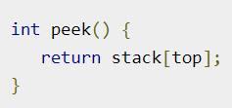
014_01.2 Stack Operation
https://www.tutorialspoint.com/data_structures_algorithms/stack_algorithm.htm
Peek()
Algorithm of peek() function implementation of peek() function in C programming language

Slide 11
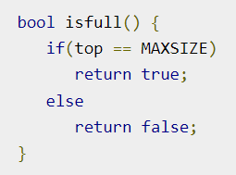
014_01.2 Stack Operation
https://www.tutorialspoint.com/data_structures_algorithms/stack_algorithm.htm
isfull()
Algorithm of isfull() function.
Implementation of isfull() function in C programming language.

Slide 12
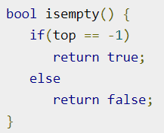
014_01.2 Stack Operation
https://www.tutorialspoint.com/data_structures_algorithms/stack_algorithm.htm
isempty()
Algorithm of isempty() function.
Implementation of isempty() function in C programming language is slightly different.
We initialize top at -1, as the index in array starts from 0.
So, we check if the top is below zero or -1 to determine if the stack is empty.
Here's the code:

Slide 13
014_01.3 Push Operation

Slide 14
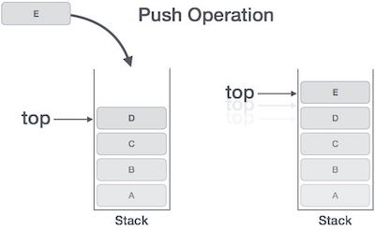
014_01.3 Push Operation
https://www.tutorialspoint.com/data_structures_algorithms/stack_algorithm.htm
Push Operation
The process of putting a new data element onto stack is known as a Push Operation.
Push operation involves a series of steps −
Step 1 − Checks if the stack is full.
Step 2 − If the stack is full, produces an error and exit.
Step 3 − If the stack is not full, increments top to point next empty space.
Step 4 − Adds data element to the stack location, where top is pointing.
Step 5 − Returns success.
If the linked list is used to implement the stack, then in step 3, we need to allocate space dynamically..

Slide 15
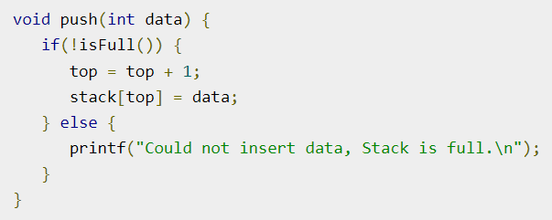
014_01.3 Push Operation
https://www.tutorialspoint.com/data_structures_algorithms/stack_algorithm.htm
Push Operation
C code implementation.

Slide 16
014_01.4 Pop Operation

Slide 17
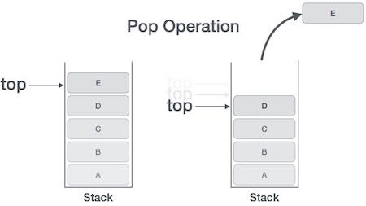
014_01.4 Pop Operation
https://www.tutorialspoint.com/data_structures_algorithms/stack_algorithm.htm
Pop Operation
Accessing the content while removing it from the stack, is known as a Pop Operation.
In an array implementation of pop() operation, the data element is not actually removed, instead top is decremented to a lower position in the stack to point to the next value.
But in linked-list implementation, pop() actually removes data element and deallocates memory space.
A Pop operation steps −
Step 1 − Checks if the stack is empty.
Step 2 − If the stack is empty, produces an error and exit.
Step 3 − If the stack is not empty, accesses the data element at which top is pointing.
Step 4 − Decreases the value of top by 1.
Step 5 − Returns success.

Slide 18
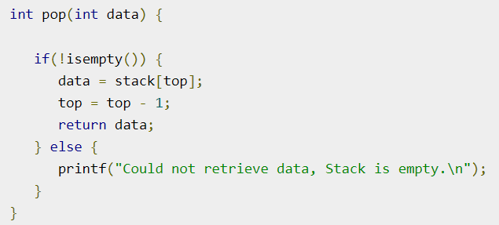
014_01.3 Pop Operation
https://www.tutorialspoint.com/data_structures_algorithms/stack_algorithm.htm
Pop Operation
C code implementation.

Slide 19
014_01.5 Stack: C Code

Slide 20
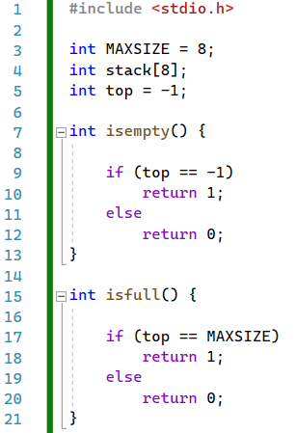
014_01.5 Stack: C Code
https://www.tutorialspoint.com/data_structures_algorithms/stack_algorithm.htm
Stack: C Code
isempty() and isfull().

Slide 21
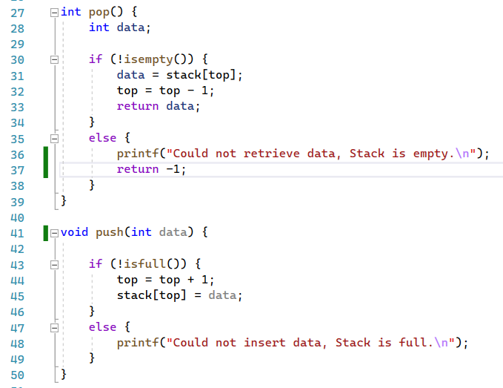
014_01.5 Stack: C Code
https://www.tutorialspoint.com/data_structures_algorithms/stack_algorithm.htm
Stack: C Code
pop() and push()

Slide 22
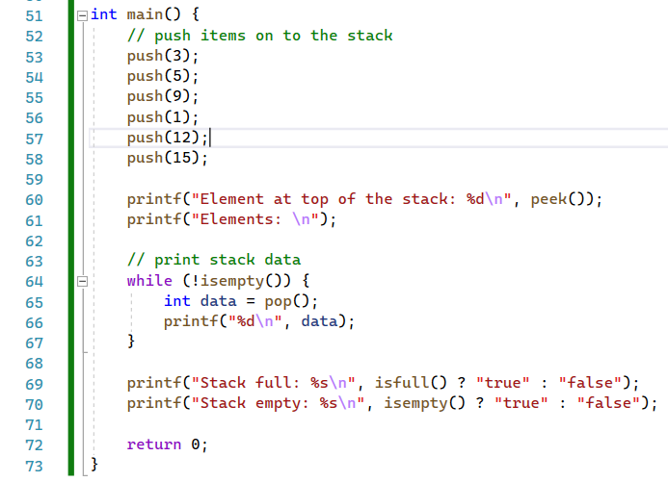
014_01.5 Stack: C Code
https://www.tutorialspoint.com/data_structures_algorithms/stack_algorithm.htm
Stack: C Code
main()

Slide 23
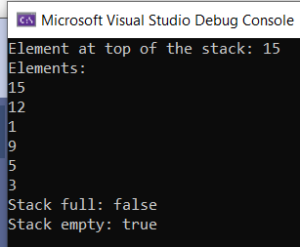
014_01.5 Stack: C Code
https://www.tutorialspoint.com/data_structures_algorithms/stack_algorithm.htm
Stack: C Code
Result.

Slide 24
End

