Slide 1

014_02 Stack: STL
Peter H. Chen

Slide 2
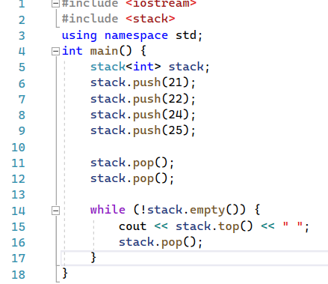
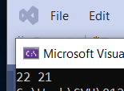
014_02 Stack: STL
https://www.tutorialspoint.com/data_structures_algorithms/stack_algorithm.htm
Stack: STL

Slide 3
End

