Slide 1

015_01 Expression Parsing: C
Peter H. Chen

Slide 2
015_01 Expression Parsing: C
https://www.tutorialspoint.com/data_structures_algorithms/expression_parsing.htm
Expression Parsing: C
The way to write arithmetic expression is known as a notation (Symbol).
An arithmetic expression can be written in three different but equivalent notations, i.e., without changing the essence or output of an expression.
These notations are −
Infix Notation
Prefix (Polish) Notation
Postfix (Reverse-Polish) Notation
These notations are named as how they use operator in expression.

Slide 3
015_01.1 Infix Notation: C

Slide 4
015_01.1 Infix Notation: C
https://www.tutorialspoint.com/data_structures_algorithms/expression_parsing.htm
Infix Notation: C
We write expression in infix notation, e.g., a - b + c, where operators are used in-between operands.
It is easy for us humans to read, write, and speak in infix notation but the same does not go well with computing devices.
An algorithm to process infix notation could be difficult and costly in terms of time and space consumption.

Slide 5
015_01.2 Prefix Notation: C

Slide 6
015_01.2 Prefix Notation: C
https://www.tutorialspoint.com/data_structures_algorithms/expression_parsing.htm
Prefix Notation: C
In prefix notation, operator is prefixed to operands, i.e., operator is written ahead of operands.
For example, +ab. This is equivalent to its infix notation a + b.
Prefix notation is also known as Polish Notation.

Slide 7
015_01.3 Postfix Notation: C

Slide 8
015_01.3 Postfix Notation: C
https://www.tutorialspoint.com/data_structures_algorithms/expression_parsing.htm
Postfix Notation: C
The postfix notation style is known as Reversed Polish Notation.
In this notation style, the operator is postfixed to the operands, i.e., the operator is written after the operands.
For example, ab+. This is equivalent to its infix notation a + b.
The following table briefly tries to show the difference in all three notations:
No. | Infix Notation | Prefix Notation | Postfix Notation
1 | a + b | + a b | a b +
2 | (a + b) ∗ c | ∗ + a b c | a b + c ∗
3 | a ∗ (b + c) | ∗ a + b c | a b c + ∗
4 | a / b + c / d | + / a b / c d | a b / c d / +
5 | (a + b) ∗ (c + d) | ∗ + a b + c d | a b + c d + ∗
6 | ((a + b) ∗ c) - d | - ∗ + a b c d | a b + c ∗ d -

Slide 9
015_01.4 Parsing Expression: C

Slide 10
015_01.4 Parsing Expression: C
https://www.tutorialspoint.com/data_structures_algorithms/expression_parsing.htm
Parsing Expression: C
As we have discussed, it is not a very efficient way to design an algorithm or program to parse infix notations.
Instead, these infix notations are first converted into either postfix or prefix notations and then computed.
To parse any arithmetic expression, we need to take care of operator precedence and associativity also.

Slide 11
015_01.5 Precedence: C

Slide 12

015_01.5 Precedence: C
https://www.tutorialspoint.com/data_structures_algorithms/expression_parsing.htm
Precedence: C
When an operand is in between two different operators, which operator will take the operand first, is decided by the precedence of an operator over others.
For example
As multiplication operation has precedence over addition, b * c will be evaluated first.
A table of operator precedence is provided later.

Slide 13
015_01.6 Associativity: C

Slide 14
015_01.6 Associativity: C
https://www.tutorialspoint.com/data_structures_algorithms/expression_parsing.htm
Associativity: C
Associativity describes the rule where operators with the same precedence appear in an expression.
For example, in expression a + b − c, both + and – have the same precedence, then which part of the expression will be evaluated first, is determined by associativity of those operators.
Here, both + and − are left associative, so the expression will be evaluated as (a + b) − c.
Precedence and associativity determines the order of evaluation of an expression. Following is an operator precedence and associativity table (highest to lowest)
No. | Operator | Precedence | Associativity
1 | Exponentiation ^ | Highest | Right Associative
2 | Multiplication ( ∗ ) & Division ( / ) | Second Highest | Left Associative
3 | Addition ( + ) & Subtraction ( − ) | Lowest | Left Associative

Slide 15
015_01.6 Associativity: C
https://www.tutorialspoint.com/data_structures_algorithms/expression_parsing.htm
Associativity: C
The above table shows the default behavior of operators.
At any point of time in expression evaluation, the order can be altered by using parenthesis. For example −
In a + b*c, the expression part b*c will be evaluated first, with multiplication as precedence over addition.
We here use parenthesis for a + b to be evaluated first, like (a + b)*c.

Slide 16
015_01.7 Postfix Evaluation Algorithm: C

Slide 17
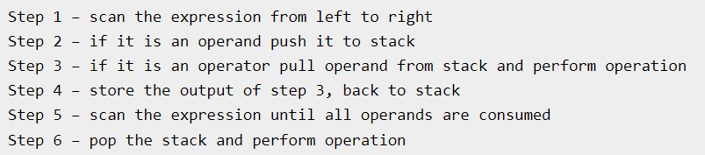
015_01.7 Postfix Evaluation Algorithm: C
https://www.tutorialspoint.com/data_structures_algorithms/expression_parsing.htm
Postfix Evaluation Algorithm: C
We look at the algorithm on how to evaluate postfix notation

Slide 18
015_01.8 Postfix Evaluation Example: C

Slide 19
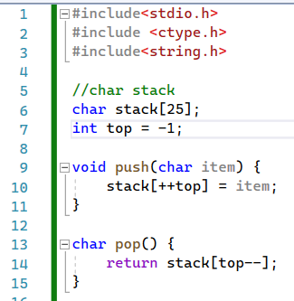
015_01.8 Postfix Evaluation Example: C
https://www.tutorialspoint.com/data_structures_algorithms/expression_parsing_using_statck.htm
Postfix Evaluation Example: C
push() and pop()

Slide 20
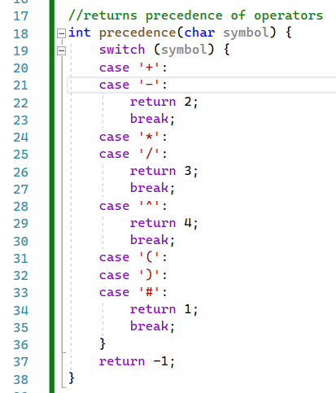
015_01.8 Postfix Evaluation Example: C
https://www.tutorialspoint.com/data_structures_algorithms/expression_parsing_using_statck.htm
Postfix Evaluation Example: C
Precedence(): ^: 4, *, /: 3, +, -: 2, ()#: 1.

Slide 21
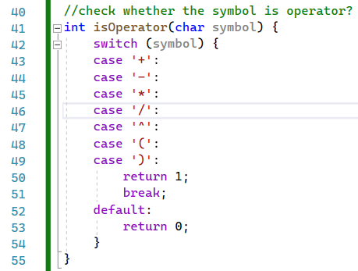
015_01.8 Postfix Evaluation Example: C
https://www.tutorialspoint.com/data_structures_algorithms/expression_parsing_using_statck.htm
Postfix Evaluation Example: C
isOperator()

Slide 22
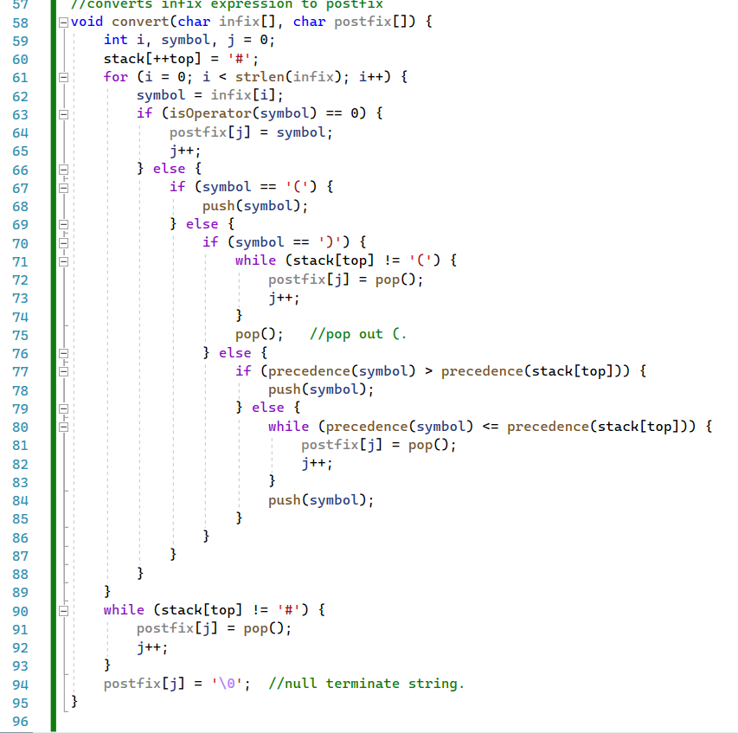
015_01.8 Postfix Evaluation Example: C
https://www.tutorialspoint.com/data_structures_algorithms/expression_parsing_using_statck.htm
Operator: Push
Postfix Evaluation Example: C
convert()
(: Push
): Pop operator to posfix
Push high precedence operator
Push low precedence operator

Slide 23
015_01.9 Infix to Postfix: C

Slide 24
015_01.9 Infix to Postfix: C
https://www.tutorialspoint.com/data_structures_algorithms/expression_parsing_using_statck.htm
Operator: Push
Infix to posfix: C
convert()
(: Push
): Pop operator to posfix
Push high precedence operator
Push low precedence operator

Slide 25
015_01.10 Evaluate: C

Slide 26
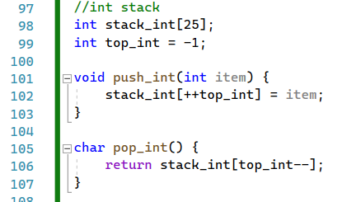
015_01.10 Evaluate: C
https://www.tutorialspoint.com/data_structures_algorithms/expression_parsing_using_statck.htm
Evaluate: C
push_int() and pop_int()

Slide 27
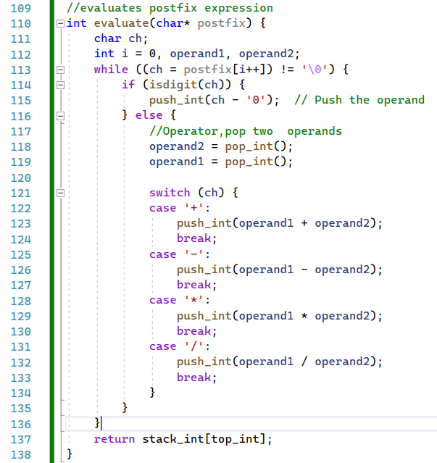
015_01.10 Evaluate: C
https://www.tutorialspoint.com/data_structures_algorithms/expression_parsing_using_statck.htm
Evaluate: C
evaluate()

Slide 28
015_01.11 main(): C

Slide 29
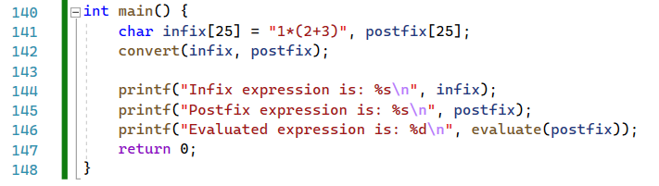
015_01.11 main(): C
https://www.tutorialspoint.com/data_structures_algorithms/expression_parsing_using_statck.htm
main(): C

Slide 30
End

