Slide 1

015_02 Expression Parsing: CPP
Peter H. Chen

Slide 2
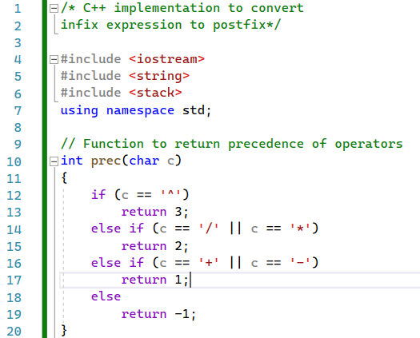
015_02 Expression Parsing: CPP
https://www.geeksforgeeks.org/stack-set-2-infix-to-postfix/
Expression Parsing: CPP

Slide 3
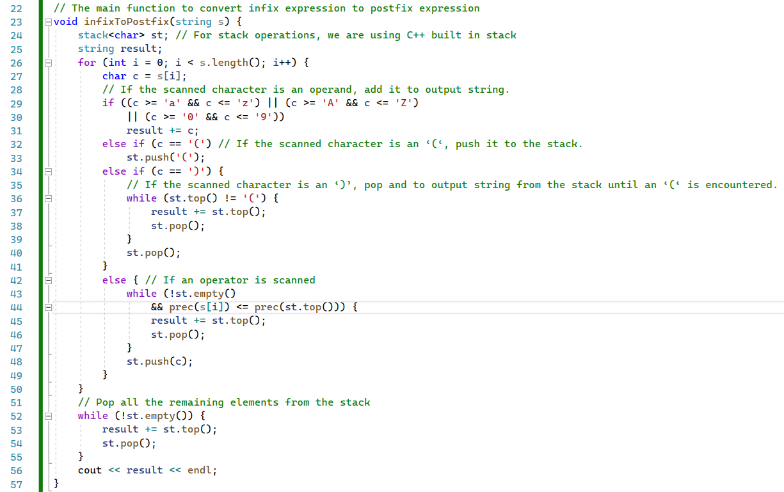
015_02 Expression Parsing: CPP
https://www.geeksforgeeks.org/stack-set-2-infix-to-postfix/
Expression Parsing: CPP

Slide 4
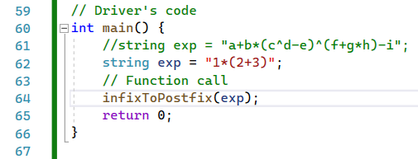

015_02 Expression Parsing: CPP
https://www.geeksforgeeks.org/stack-set-2-infix-to-postfix/
Expression Parsing: CPP

Slide 5
End

