Slide 1

015_03 Postfix Evaluation: CPP
Peter H. Chen

Slide 2
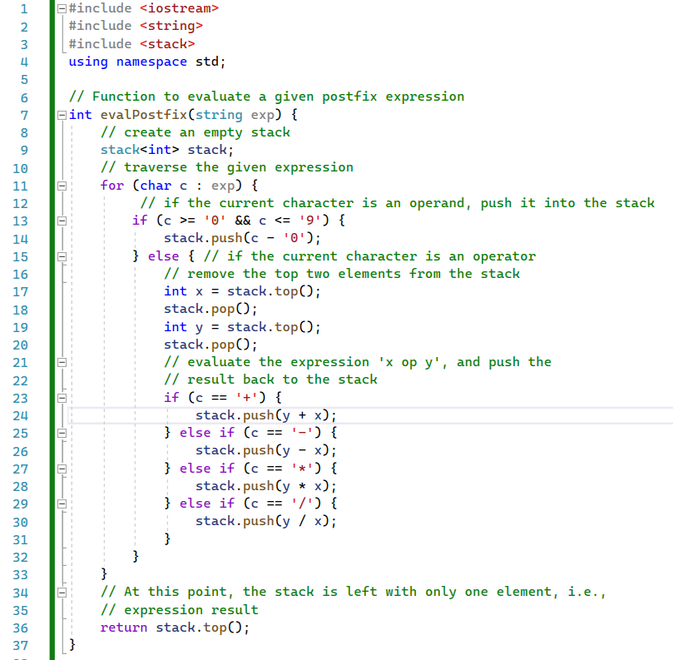
015_03 Postfix Evaluation: CPP
https://www.techiedelight.com/evaluate-given-postfix-expression/
Postfix Evaluation: CPP

Slide 3
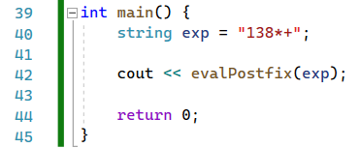
015_03 Postfix Evaluation: CPP
https://www.techiedelight.com/evaluate-given-postfix-expression/
Postfix Evaluation: CPP

Slide 4
End

