Slide 1

038_01 Tower of Hanoi: C
Peter H. Chen

Slide 2
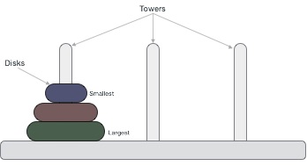
038_01 Tower of Hanoi: C
https://www.tutorialspoint.com/data_structures_algorithms/tower_of_hanoi.htm
Tower of Hanoi: C
Tower of Hanoi, is a mathematical puzzle which consists of three towers (pegs) and more than one rings is as the following diagram:
These rings are of different sizes and stacked upon in an ascending order, i.e., the smaller one sits over the larger one.
There are other variations of the puzzle where the number of disks increase, but the tower count remains the same.

Slide 3
038_01.2 Rule

Slide 4
038_01.2 Rule
https://www.tutorialspoint.com/data_structures_algorithms/tower_of_hanoi.htm
Rule
The mission is to move all the disks to some another tower without violating the sequence of arrangement.
A few rules to be followed for Tower of Hanoi are −
Only one disk can be moved among the towers at any given time.
Only the "top" disk can be removed.
No large disk can sit over a small disk.
Following is an animated representation of solving a Tower of Hanoi puzzle with three disks.
Tower of Hanoi puzzle with n disks can be solved in minimum 2^{n}−1 steps. This presentation shows that a puzzle with 3 disks has taken 2³ - 1 = 7 steps.

Slide 5
038_01.3 Algorithm

Slide 6
038_01.3 Algorithm
https://www.tutorialspoint.com/data_structures_algorithms/tower_of_hanoi.htm
Algorithm
To write an algorithm for Tower of Hanoi, first we need to learn how to solve this problem with lesser number of disks, say → 1 or 2.
We mark three towers with name, source, destination and aux (only to help moving the disks).
If we have only one disk, then it can easily be moved from source to destination peg.

Slide 7
038_01.3 Algorithm
https://www.tutorialspoint.com/data_structures_algorithms/tower_of_hanoi.htm
Algorithm
If we have 2 disks −
First, we move the smaller (top) disk to aux peg.
Then, we move the larger (bottom) disk to destination peg.
And finally, we move the smaller disk from aux to destination peg.

Slide 8

038_01.3 Algorithm
https://www.tutorialspoint.com/data_structures_algorithms/tower_of_hanoi.htm
Algorithm
So now, we are in a position to design an algorithm for Tower of Hanoi with more than two disks.
We divide the stack of disks in two parts.
The largest disk (n^{th} disk) is in one part and all other (n-1) disks are in the second part.
Our goal is to move disk n from source to destination and then put all other (n1) disks onto it.
We can imagine to apply the same in a recursive way for all given set of disks.
The steps to follow are:

Slide 9
038_01.4 Pseudo Code

Slide 10
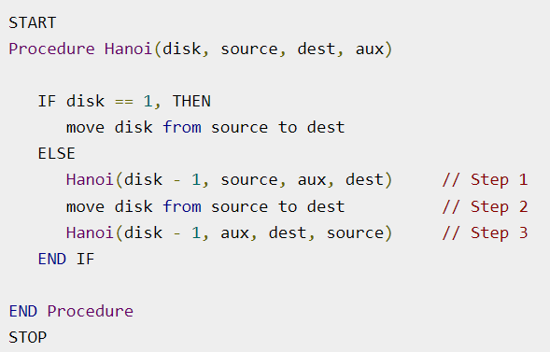
038_01.4 Pseudo Code
https://www.tutorialspoint.com/data_structures_algorithms/tower_of_hanoi.htm
Pseudo Code

Slide 11
038_01.5 Tower of Hanoi: C Code

Slide 12
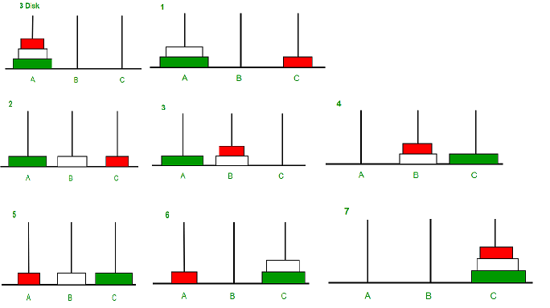
038_01.5 Tower of Hanoi: C Code
https://www.geeksforgeeks.org/c-program-for-tower-of-hanoi-2/
Tower of Hanoi: C Code
Tower of Hanoi is a mathematical puzzle where we have three rods and n disks.
The objective of the puzzle is to move the entire stack to another rod, obeying the following simple rules:
1) Only one disk can be moved at a time.
2) Each move consists of taking the upper disk from one of the stacks and placing it on top of another stack, i.e., a disk can only be moved if it is the uppermost disk on a stack.
3) No disk may be placed on top of a smaller disk.

Slide 13
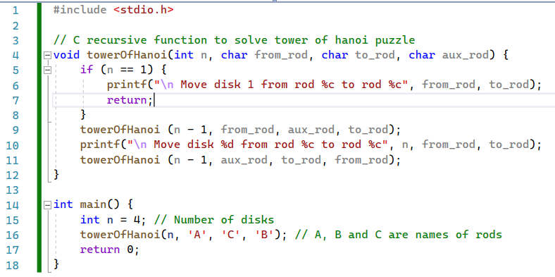
038_01.5 Tower of Hanoi: C Code
https://www.geeksforgeeks.org/c-program-for-tower-of-hanoi-2/
Tower of Hanoi: C Code

Slide 14
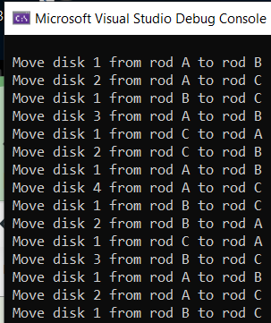
038_01.5 Tower of Hanoi: C Code
https://www.geeksforgeeks.org/c-program-for-tower-of-hanoi-2/
A
B
C
Tower of Hanoi: C Code
Result
A
B
C

Slide 15
038_01.5 Tower of Hanoi: C Code
https://www.geeksforgeeks.org/c-program-for-tower-of-hanoi-2/
A
B
C
Tower of Hanoi: C Code
Result
A
B
C

Slide 16
038_01.5 Tower of Hanoi: C Code
https://www.geeksforgeeks.org/c-program-for-tower-of-hanoi-2/
Tower of Hanoi: C Code
Result
A
B
C
A
B
C

Slide 17
038_01.5 Tower of Hanoi: C Code
https://www.geeksforgeeks.org/c-program-for-tower-of-hanoi-2/
A
B
C
Tower of Hanoi: C Code
Result
A
B
C

Slide 18
038_01.5 Tower of Hanoi: C Code
https://www.geeksforgeeks.org/c-program-for-tower-of-hanoi-2/
A
B
C
Tower of Hanoi: C Code
Result
A
B
C

Slide 19
038_01.5 Tower of Hanoi: C Code
https://www.geeksforgeeks.org/c-program-for-tower-of-hanoi-2/
A
B
C
Tower of Hanoi: C Code
Result
A
B
C

Slide 20
038_01.5 Tower of Hanoi: C Code
https://www.geeksforgeeks.org/c-program-for-tower-of-hanoi-2/
A
B
C
Tower of Hanoi: C Code
Result
A
B
C

Slide 21
038_01.5 Tower of Hanoi: C Code
https://www.geeksforgeeks.org/c-program-for-tower-of-hanoi-2/
A
B
C
Tower of Hanoi: C Code
Result
A
B
C

Slide 22
End

