Slide 1

038_02 Tower of Hanoi: CPP
Peter H. Chen

Slide 2
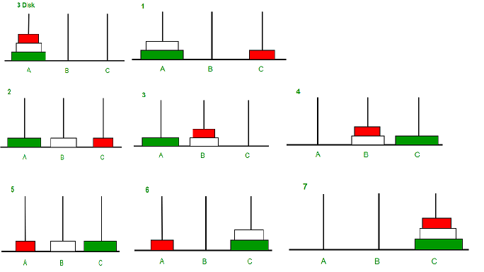
038_02 Tower of Hanoi: CPP
https://www.geeksforgeeks.org/c-program-for-tower-of-hanoi/
Tower of Hanoi: CPP
Tower of Hanoi using Recursion:
The idea is to use the helper node to reach the destination using recursion. Below is the pattern for this problem:
Shift ‘N-1’ disks from ‘A’ to ‘B’, using C.
Shift last disk from ‘A’ to ‘C’.
Shift ‘N-1’ disks from ‘B’ to ‘C’, using A.

Slide 3
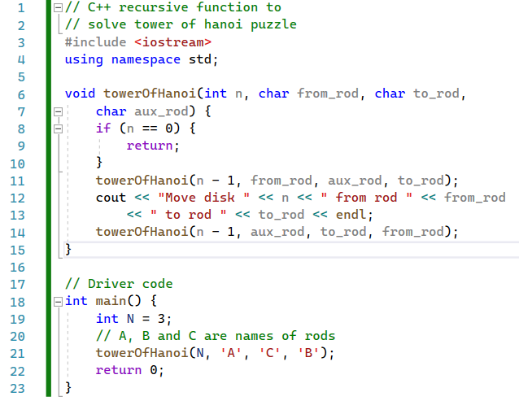
038_02 Tower of Hanoi: CPP
https://www.geeksforgeeks.org/c-program-for-tower-of-hanoi-2/
Tower of Hanoi: CPP

Slide 4
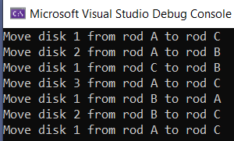
038_01.5 Tower of Hanoi: C Code
https://www.geeksforgeeks.org/c-program-for-tower-of-hanoi-2/
A
B
C
Tower of Hanoi: C Code
Result
A
B
C

Slide 5
038_01.5 Tower of Hanoi: C Code
https://www.geeksforgeeks.org/c-program-for-tower-of-hanoi-2/
A
B
C
Tower of Hanoi: C Code
Result
A
B
C

Slide 6
038_01.5 Tower of Hanoi: C Code
https://www.geeksforgeeks.org/c-program-for-tower-of-hanoi-2/
A
B
C
Tower of Hanoi: C Code
Result
A
B
C

Slide 7
038_01.5 Tower of Hanoi: C Code
https://www.geeksforgeeks.org/c-program-for-tower-of-hanoi-2/
A
B
C
Tower of Hanoi: C Code
Result
A
B
C

Slide 8
End

