Slide 1

024_02 Selection Sort: STL
Peter H. Chen

Slide 2
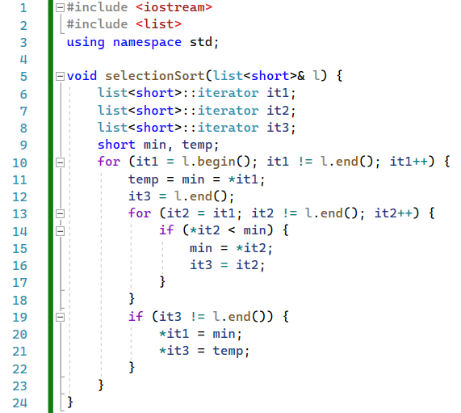
024_02 Selection Sort: STL
https://stackoverflow.com/questions/56410010/writing-a-selection-sort-for-stl-list
Selection Sort: STL
selectionSort().

Slide 3
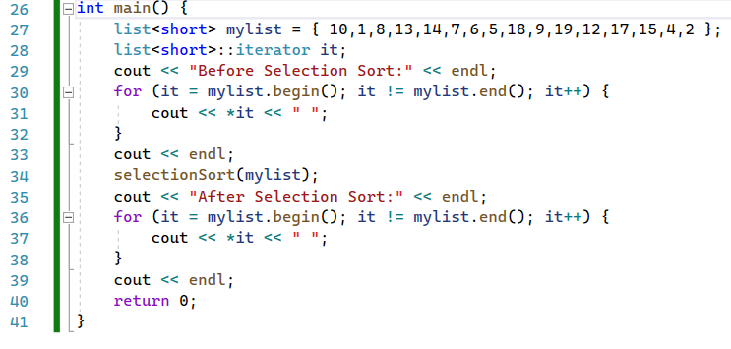
024_02 Selection Sort: STL
https://stackoverflow.com/questions/56410010/writing-a-selection-sort-for-stl-list
Selection Sort: STL
selectionSort().

Slide 4
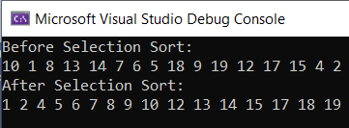
024_02 Selection Sort: STL
https://stackoverflow.com/questions/56410010/writing-a-selection-sort-for-stl-list
Selection Sort: STL
Result

Slide 5
End

