Slide 1

017_02 Linear Search: STL
Peter H. Chen

Slide 2
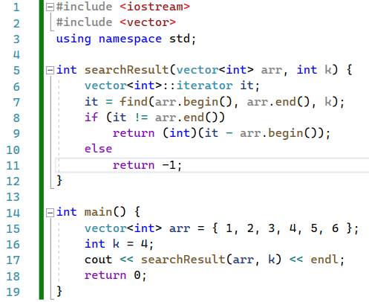
017_02 Linear Search: STL
https://iq.opengenus.org/find-element-in-vector-cpp-stl/
Linear Search: STL
Code

Slide 3

017_02 Linear Search: STL
https://iq.opengenus.org/find-element-in-vector-cpp-stl/
Linear Search: STL
Result

Slide 4
End

