Slide 1

029_01 Depth First Traverse: CPP
Peter H. Chen

Slide 2
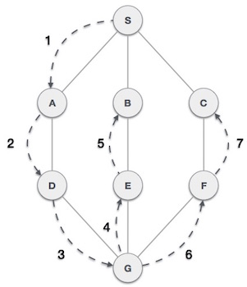
029_01 Depth First Traverse: CPP
https://www.tutorialspoint.com/data_structures_algorithms/depth_first_traversal.htm
Depth First Traverse
Depth First Search (DFS) algorithm traverses a graph in a depthward motion and uses a stack to remember to get the next vertex to start a search, when a dead end occurs in any iteration.

Slide 3
029_01 Depth First Traverse: CPP
https://www.tutorialspoint.com/data_structures_algorithms/depth_first_traversal.htm
Depth First Traverse
As in the example given above, DFS algorithm traverses from S to A to D to G to E to B first, then to F and lastly to C.
It employs the following rules.
Rule 1 − Visit the adjacent unvisited vertex. Mark it as visited. Display it. Push it in a stack.
Rule 2 − If no adjacent vertex is found, pop up a vertex from the stack. (It will pop up all the vertices from the stack, which do not have adjacent vertices.)
Rule 3 − Repeat Rule 1 and Rule 2 until the stack is empty.

Slide 4
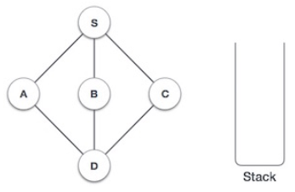
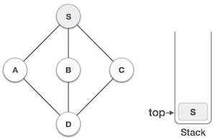
029_01 Depth First Traverse: CPP
https://www.tutorialspoint.com/data_structures_algorithms/depth_first_traversal.htm
Depth First Traverse
Step | Traversal | Description
1 |  | Initialize the stack.
2 |  | Mark S as visited and put it onto the stack. Explore any unvisited adjacent node from S. We have three nodes and we can pick any of them. For this example, we shall take the node in an alphabetical order.

Slide 5
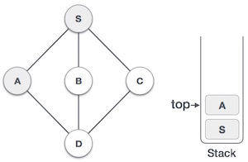
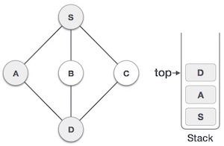
029_01 Depth First Traverse: CPP
https://www.tutorialspoint.com/data_structures_algorithms/depth_first_traversal.htm
Depth First Traverse
Step | Traversal | Description
3 |  | Mark A as visited and put it onto the stack. Explore any unvisited adjacent node from A. Both S and D are adjacent to A but we are concerned for unvisited nodes only.
4 |  | Visit D and mark it as visited and put onto the stack. Here, we have B and C nodes, which are adjacent to D and both are unvisited. However, we shall again choose in an alphabetical order.

Slide 6
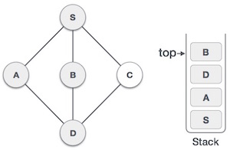
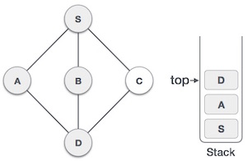
029_01 Depth First Traverse: CPP
https://www.tutorialspoint.com/data_structures_algorithms/depth_first_traversal.htm
Depth First Traverse
Step | Traversal | Description
5 |  | We choose B, mark it as visited and put onto the stack. Here B does not have any unvisited adjacent node. So, we pop B from the stack.
6 |  | We check the stack top for return to the previous node and check if it has any unvisited nodes. Here, we find D to be on the top of the stack.

Slide 7
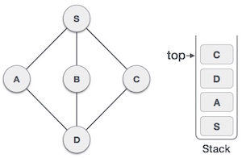
029_01 Depth First Traverse: CPP
https://www.tutorialspoint.com/data_structures_algorithms/depth_first_traversal.htm
Depth First Traverse
Step | Traversal | Description
7 |  | Only unvisited adjacent node is from D is C now. So, we visit C, mark it as visited and put it onto the stack.

Slide 8
029_01 Depth First Traverse: CPP
https://www.tutorialspoint.com/data_structures_algorithms/depth_first_traversal.htm
Depth First Traverse
As C does not have any unvisited adjacent node so we keep popping the stack until we find a node that has an unvisited adjacent node.
In this case, there's none and we keep popping until the stack is empty.

Slide 9
029_01.1 Depth First Traverse: C Code

Slide 10
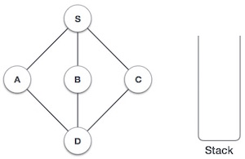
029_01.1 Depth First Traverse: C Code
https://www.tutorialspoint.com/data_structures_algorithms/depth_first_traversal.htm
Depth First Traverse: C Code
We see the implementation of Depth First Traversal (or Depth First Search) in C programming language.
For our reference purpose, we shall follow our example and take this as our graph model.

Slide 11
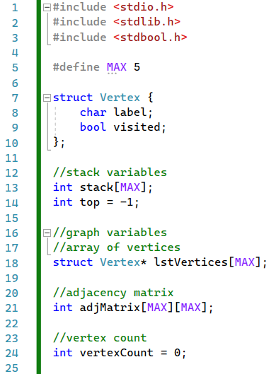
029_01.1 Depth First Traverse: C Code
https://www.tutorialspoint.com/data_structures_algorithms/depth_first_traversal.htm
Depth First Traverse: C Code
Define data.

Slide 12
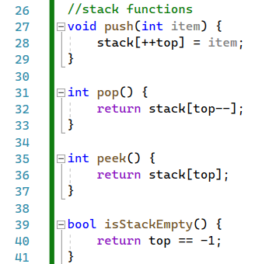
029_01.1 Depth First Traverse: C Code
https://www.tutorialspoint.com/data_structures_algorithms/depth_first_traversal.htm
Depth First Traverse: C Code
push(), pop(), peek(), and isStackEmpty()

Slide 13
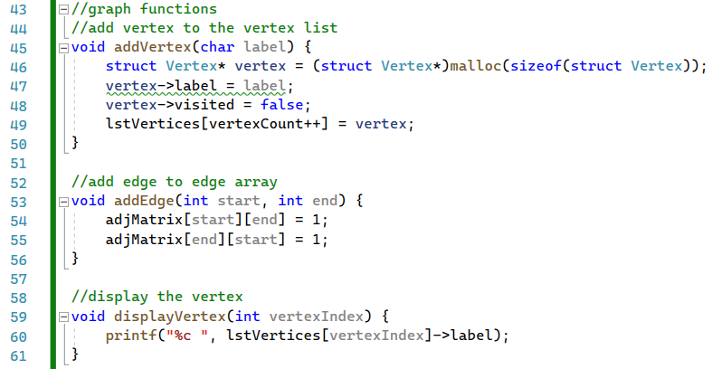
029_01.1 Depth First Traverse: C Code
https://www.tutorialspoint.com/data_structures_algorithms/depth_first_traversal.htm
Depth First Traverse: C Code
addVertex(), addEdge(), displayVertex()

Slide 14
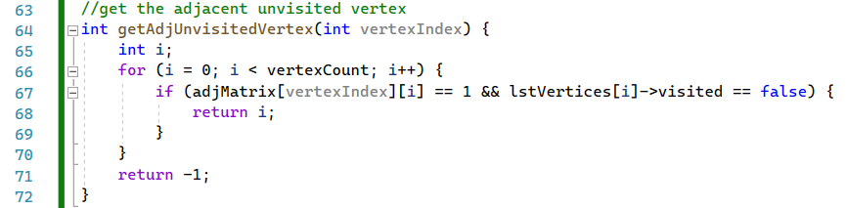
029_01.1 Depth First Traverse: C Code
https://www.tutorialspoint.com/data_structures_algorithms/depth_first_traversal.htm
Depth First Traverse: C Code
getAdjUnvisitedVertex()

Slide 15
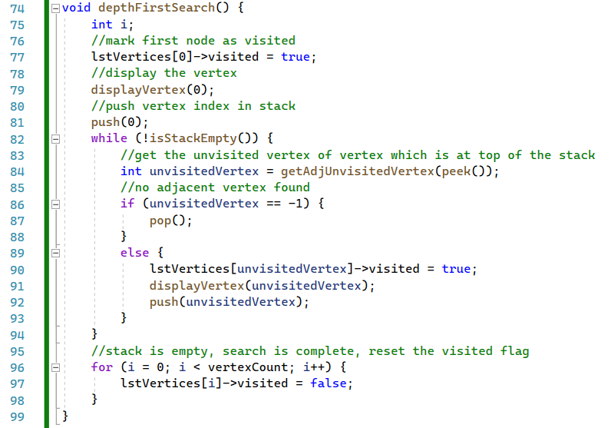
029_01.1 Depth First Traverse: C Code
https://www.tutorialspoint.com/data_structures_algorithms/depth_first_traversal.htm
Depth First Traverse: C Code
depthFirstSearch()

Slide 16
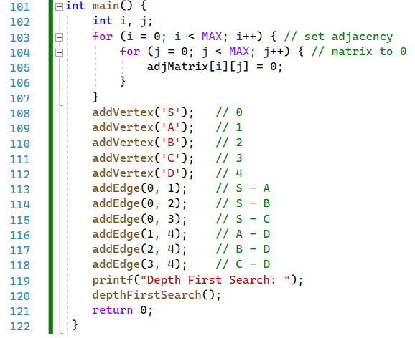
029_01.1 Depth First Traverse: C Code
https://www.tutorialspoint.com/data_structures_algorithms/depth_first_traversal.htm
Depth First Traverse: C Code
main()

Slide 17

029_01.1 Depth First Traverse: C Code
https://www.tutorialspoint.com/data_structures_algorithms/depth_first_traversal.htm
Depth First Traverse: C Code
Result

Slide 18
End

