Slide 1

029_02 Depth First Traverse: STL
Peter H. Chen

Slide 2
029_02 Depth First Traverse: STL
https://www.geeksforgeeks.org/depth-first-search-or-dfs-for-a-graph/
Depth First Traverse: STL
Depth First Traversal (or Search) for a graph is similar to Depth First Traversal of a tree.
The only catch here is, that, unlike trees, graphs may contain cycles (a node may be visited twice).
To avoid processing a node more than once, use a boolean visited array.
A graph can have more than one DFS traversal.

Slide 3
029_02 Depth First Traverse: STL
https://www.geeksforgeeks.org/depth-first-search-or-dfs-for-a-graph/
Depth First Traverse: STL
Example 1:
Input: n = 4, e = 6
0 -> 1, 0 -> 2, 1 -> 2, 2 -> 0, 2 -> 3, 3 -> 3
Output: DFS from vertex 1 : 1 2 0 3

Slide 4
029_02 Depth First Traverse: STL
https://www.geeksforgeeks.org/depth-first-search-or-dfs-for-a-graph/
Depth First Traverse: STL
Example 2:
Input: n = 4, e = 6
2 -> 0, 0 -> 2, 1 -> 2, 0 -> 1, 3 -> 3, 1 -> 3
Output: DFS from vertex 2 : 2 0 1 3

Slide 5
029_02.1 Depth First Traverse: STL

Slide 6
029_02.1 Depth First Traverse: STL
https://www.geeksforgeeks.org/depth-first-search-or-dfs-for-a-graph/
Depth First Traverse: STL
Depth-first search is an algorithm for traversing or searching tree or graph data structures.
The algorithm starts at the root node (selecting some arbitrary node as the root node in the case of a graph) and explores as far as possible along each branch before backtracking.
So, the basic idea is to start from the root or any arbitrary node and mark the node and move to the adjacent unmarked node and continue this loop until there is no unmarked adjacent node.
Then backtrack and check for other unmarked nodes and traverse them.
Finally, print the nodes in the path.

Slide 7
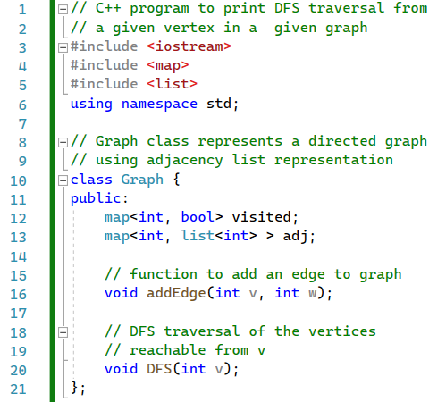
029_02.1 Depth First Traverse: STL
https://www.geeksforgeeks.org/depth-first-search-or-dfs-for-a-graph/
Depth First Traverse: STL
Class Graph {}

Slide 8
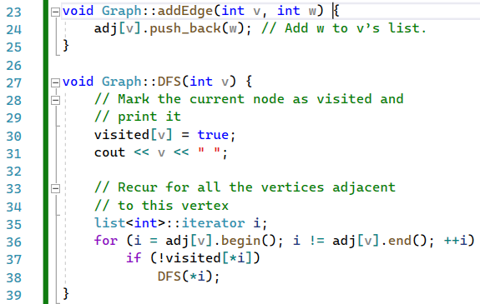
029_02.1 Depth First Traverse: STL
https://www.geeksforgeeks.org/depth-first-search-or-dfs-for-a-graph/
Depth First Traverse: STL
addEdge(), DFS()

Slide 9
029_02.1 Depth First Traverse: STL
https://www.geeksforgeeks.org/depth-first-search-or-dfs-for-a-graph/
Depth First Traverse: STL
addEdge(), DFS()

Slide 10
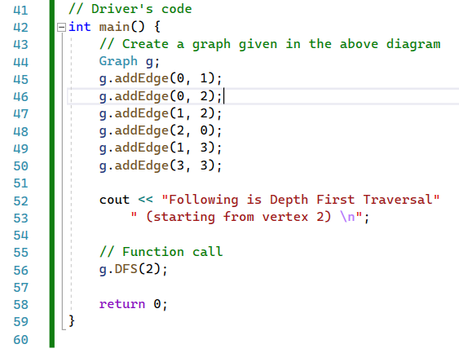
029_02.1 Depth First Traverse: STL
https://www.geeksforgeeks.org/depth-first-search-or-dfs-for-a-graph/
Depth First Traverse: STL
main()
0
1
2
3

Slide 11

029_02.1 Depth First Traverse: STL
https://www.geeksforgeeks.org/depth-first-search-or-dfs-for-a-graph/
Depth First Traverse: STL Code
Result

Slide 12
End

