Slide 1

016_01 Queue: C
Peter H. Chen

Slide 2
016_01 Queue: C
https://www.tutorialspoint.com/data_structures_algorithms/dsa_queue.htm
Queue: C
Queue is an abstract data structure, somewhat similar to Stacks.
Unlike stacks, a queue is open at both its ends.
One end is always used to insert data (enqueue) and the other is used to remove data (dequeue).
Queue follows First-In-First-Out methodology, i.e., the data item stored first will be accessed first.

Slide 3

016_01 Queue: C
https://www.tutorialspoint.com/data_structures_algorithms/dsa_queue.htm
Queue: C
A real-world example of queue can be a single-lane one-way road, where the vehicle enters first, exits first.
More real-world examples can be seen as queues at the ticket windows and bus-stops.

Slide 4
016_01.1 Queue Representation

Slide 5
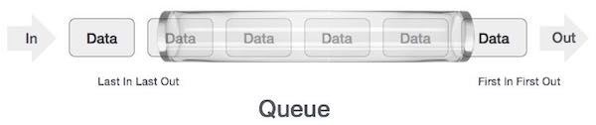
016_01.1 Queue Representation
https://www.tutorialspoint.com/data_structures_algorithms/dsa_queue.htm
Queue Representation
As we now understand that in queue, we access both ends for different reasons.
The following diagram given below tries to explain queue representation as data structure
As in stacks, a queue can also be implemented using Arrays, Linked-lists, Pointers and Structures.
For the sake of simplicity, we implement queues using one-dimensional array.

Slide 6
016_01.2 Basic Operations

Slide 7
016_01.2 Basic Operations
https://www.tutorialspoint.com/data_structures_algorithms/dsa_queue.htm
Basic Operations
Queue operations may involve initializing or defining the queue, utilizing it, and then completely erasing it from the memory.
Here we shall try to understand the basic operations associated with queues −
enqueue() − add (store) an item to the queue.
dequeue() − remove (access) an item from the queue.
Few more functions are required to make the above-mentioned queue operation efficient.
These are −
peek() − Gets the element at the front of the queue without removing it.
isfull() − Checks if the queue is full.
isempty() − Checks if the queue is empty.
In queue, we always dequeue (or access) data, pointed by front pointer and while enqueuing (or storing) data in the queue we take help of rear pointer.
Let's first learn about supportive functions of a queue

Slide 8
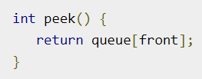
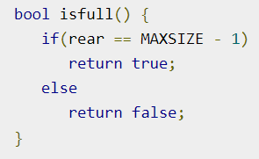
016_01.2 Basic Operations
https://www.tutorialspoint.com/data_structures_algorithms/dsa_queue.htm
peek()
peek() function in C programming language.
isfull()
isfull() function in C programming language.

Slide 9
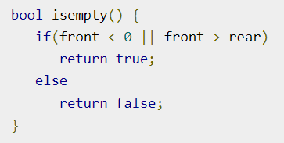
016_01.2 Basic Operations
https://www.tutorialspoint.com/data_structures_algorithms/dsa_queue.htm
isempty()
isempty() function in C programming language.

Slide 10
016_01.3 Enqueue Operation

Slide 11
016_01.3 Enqueue Operation
https://www.tutorialspoint.com/data_structures_algorithms/dsa_queue.htm
Enqueue Operation
Queues maintain two data pointers, front and rear.
Therefore, its operations are comparatively difficult to implement than that of stacks.

Slide 12
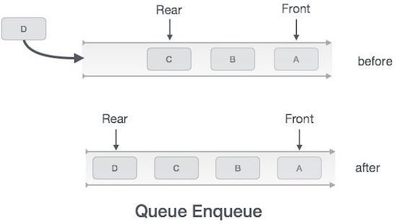
016_01.3 Enqueue Operation
https://www.tutorialspoint.com/data_structures_algorithms/dsa_queue.htm
Enqueue Operation
The following steps should be taken to enqueue (insert) data into a queue −
Step 1 − Check if the queue is full.
Step 2 − If the queue is full, produce overflow error and exit.
Step 3 − If the queue is not full, increment rear pointer to point the next empty space.
Step 4 − Add data element to the queue location, where the rear is pointing.
Step 5 − return success.

Slide 13
016_01.3 Enqueue Operation
https://www.tutorialspoint.com/data_structures_algorithms/dsa_queue.htm
Enqueue Operation
enqueue() C implementation.
int enqueue (int data) {
if (isfull())
return 0;
rear = rear + 1;
queue[read] = data;
return 1;
}

Slide 14
016_01.4 Dequeue Operation

Slide 15
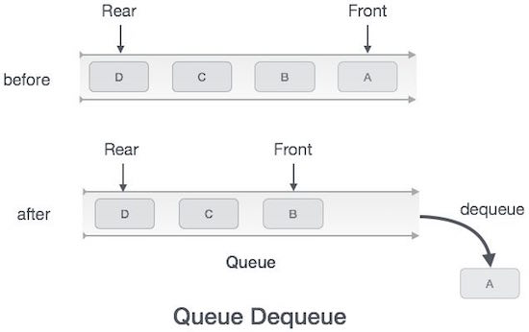
016_01.4 Dequeue Operation
https://www.tutorialspoint.com/data_structures_algorithms/dsa_queue.htm
Dequeue Operation
Accessing data from the queue is a process of two tasks − access the data where front is pointing and remove the data after access.
The following steps are taken to perform dequeue operation −
Step 1 − Check if the queue is empty.
Step 2 − If the queue is empty, produce underflow error and exit.
Step 3 − If the queue is not empty, access the data where front is pointing.
Step 4 − Increment front pointer to point to the next available data element.
Step 5 − Return success.

Slide 16
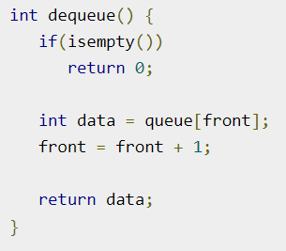
016_01.4 Dequeue Operation
https://www.tutorialspoint.com/data_structures_algorithms/dsa_queue.htm
Dequeue Operation
dequeue() C implementation.

Slide 17
016_01.5 Queue Program in C

Slide 18
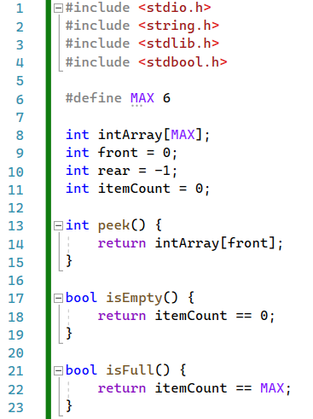
016_01.5 Queue Program in C
https://www.tutorialspoint.com/data_structures_algorithms/dsa_queue.htm
Queue Program in C
peek(), isEmpty(), isfull()

Slide 19
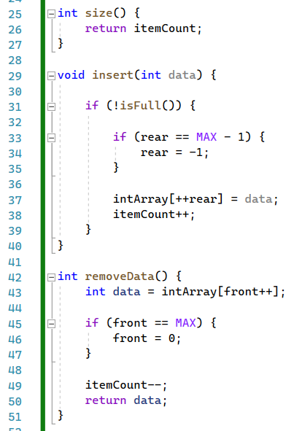
016_01.5 Queue Program in C
https://www.tutorialspoint.com/data_structures_algorithms/dsa_queue.htm
Queue Program in C
size(), insert(), removeData()

Slide 20
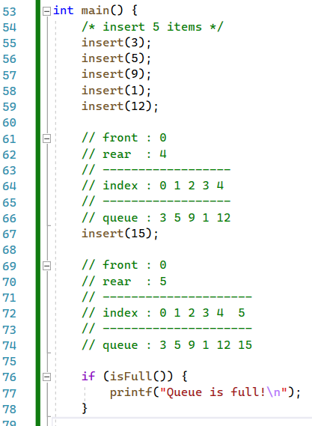
016_01.5 Queue Program in C
https://www.tutorialspoint.com/data_structures_algorithms/dsa_queue.htm
Queue Program in C
main()

Slide 21
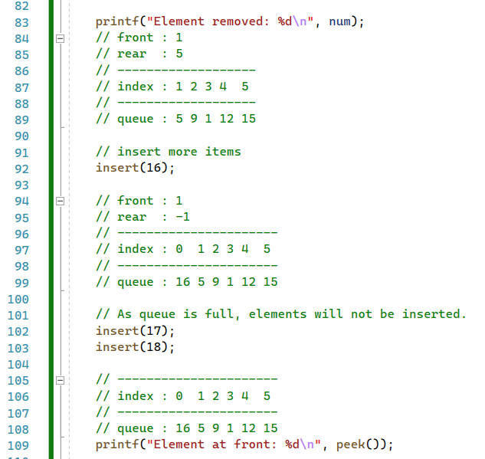
016_01.5 Queue Program in C
https://www.tutorialspoint.com/data_structures_algorithms/dsa_queue.htm
Queue Program in C
main()

Slide 22
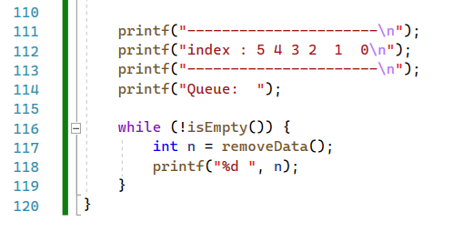
016_01.5 Queue Program in C
https://www.tutorialspoint.com/data_structures_algorithms/dsa_queue.htm
Queue Program in C
main()

Slide 23
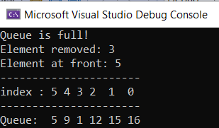
016_01.5 Queue Program in C
https://www.tutorialspoint.com/data_structures_algorithms/dsa_queue.htm
Queue Program in C
Result

Slide 24
End

