Slide 1

016_02 Queue: STL
Peter H. Chen

Slide 2
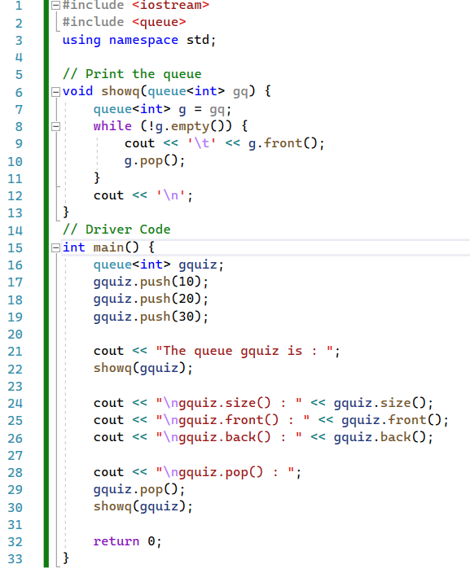
016_02 Queue: STL
https://www.tutorialspoint.com/data_structures_algorithms/dsa_queue.htm
Queue: STL

Slide 3
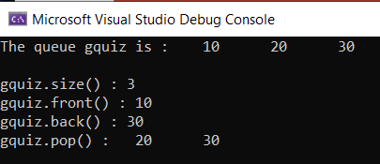
016_02 Queue: STL
https://www.tutorialspoint.com/data_structures_algorithms/dsa_queue.htm
Queue: STL
Result

Slide 4
End

