Slide 1

508 Sync Widgets and Layout
Peter H. Chen

Slide 2
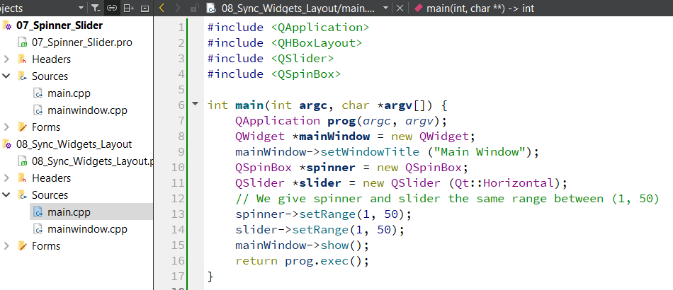
508 Sync Widgets and Layout
https://www.youtube.com/watch?v=7ZuSs27tQPA&list=PLD0D54219E5F2544D&index=8
Sync Widgets and Layout
We discuss the sync of Widgets and Layout.
We create 08_Sync_Widgets_Layout project as below.
We copy the code from main.cpp from 07_Spinner_Slider project as below.

Slide 3
508.1 Connect Spinner to Slider

Slide 4
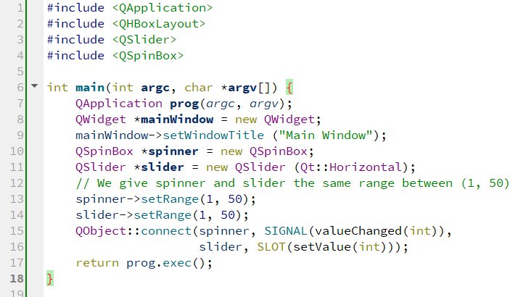
508.1 Connect Spinner to Slider
https://www.youtube.com/watch?v=7ZuSs27tQPA&list=PLD0D54219E5F2544D&index=8
Connect Spinner to Slider
We already used connect() function to connect Signal and Slot.
1. We put the spinner object pointer in the first parameter,
2. We get the value changed signal in spinner by SIGNAL(valueChanged()),
3. We have the slider object pointer in the third parameter.
4. We then set the value of the slider with the SLOT(setValue(int)).

Slide 5
508.1 Connect Spinner to Slider
https://www.youtube.com/watch?v=7ZuSs27tQPA&list=PLD0D54219E5F2544D&index=8
Connect Spinner to Slider
The first parameter is spinner widget to trigger the signal.
The spinner widget is the place waiting for user to do something to.
The third parameters is the slider to get the signal and applied to.
The slider widget is the place where we want to apply to.
Whenever user get the changes from spinner, then we change the slider value.

Slide 6
508.2 Connect Slider to Spinner

Slide 7
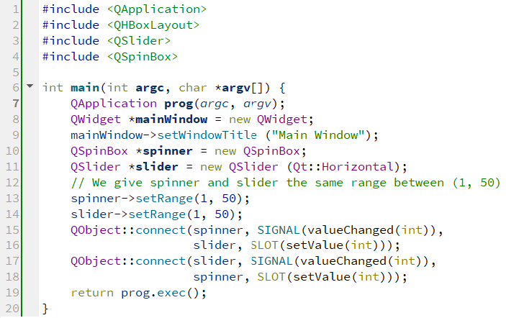
508.2 Connect Slider to Spinner
https://www.youtube.com/watch?v=7ZuSs27tQPA&list=PLD0D54219E5F2544D&index=8
Connect Spinner to Slider
We have spinner to slider connection.
Now, we need to do reverse connection: from slider to spinner connection.
Whenever spinner changes, the slider changes.
Whenever slider changes, the spinner also changes.

Slide 8
508.2 Connect Slider to Spinner
https://www.youtube.com/watch?v=7ZuSs27tQPA&list=PLD0D54219E5F2544D&index=8
Connect Slider to Spinner
This is the sync between two widgets: the slider and spinner .

Slide 9
508.3 Set Initial Values for Spinner/Slider

Slide 10
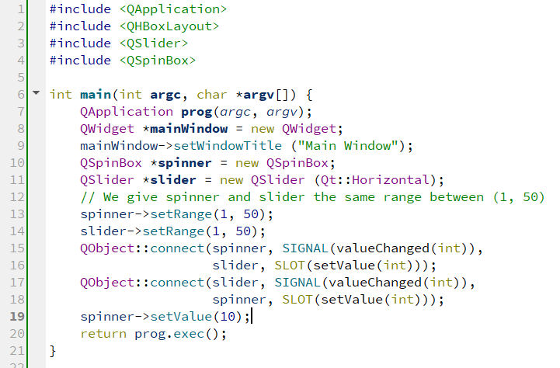
508.3 Set Initial Values for Spinner/Slider
https://www.youtube.com/watch?v=7ZuSs27tQPA&list=PLD0D54219E5F2544D&index=8
Set Initial Values for Spinner and Slider
Now, we want to set the initial values for spinner.
Both values in spinner and slide will be set up.

Slide 11
508.4 Layout Includes Widgets

Slide 12
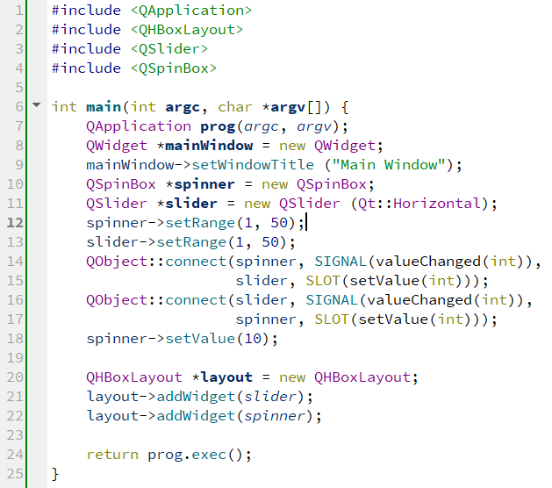
508.4 Layout Includes Widgets
https://www.youtube.com/watch?v=7ZuSs27tQPA&list=PLD0D54219E5F2544D&index=8
Layout Includes Two Widgets
We include QHBoxLayout.
This stands for Qt Horizontal Box Layout.
This layout the widget horizontally from left to right.
> QHBoxLayout *layout = new QHBoxLayout;
After we have layout, we want to put these two spinner and slider widgets into the layout.
Now, this layout include two widgets.

Slide 13
508.5 Set Layout in Window

Slide 14
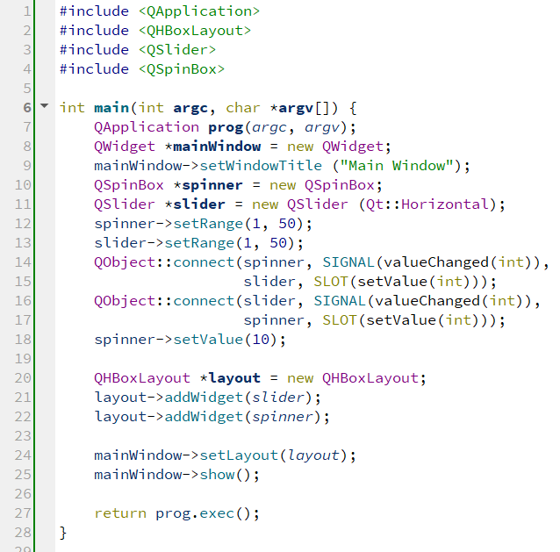
508.5 Set Layout in Window
https://www.youtube.com/watch?v=7ZuSs27tQPA&list=PLD0D54219E5F2544D&index=8
Set Layout in Window
Now, we need to tell the main window to include this layout widget.
We then display the window and its associated child widgets (layout, slider, and spinner).

Slide 15
508.6 Run Sync Widgets

Slide 16
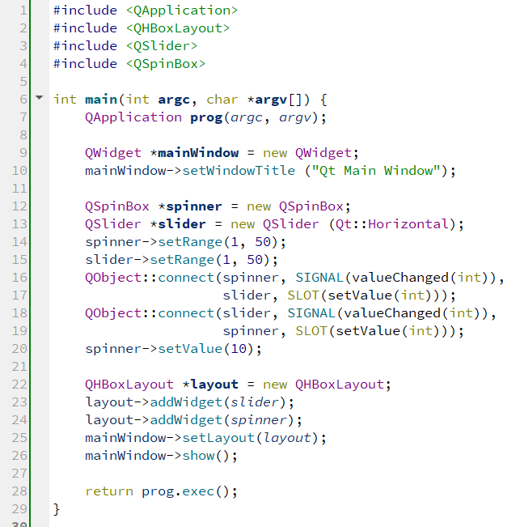
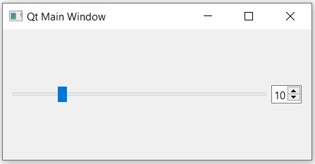
508.6 Run Sync Widgets
https://www.youtube.com/watch?v=7ZuSs27tQPA&list=PLD0D54219E5F2544D&index=8
Run Sync Widgets
The initial slider value is set to 10.

Slide 17
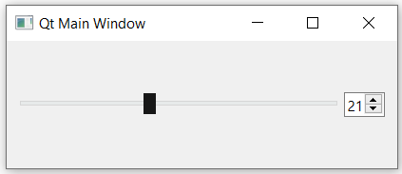
508.6 Run Sync Widgets
https://www.youtube.com/watch?v=7ZuSs27tQPA&list=PLD0D54219E5F2544D&index=8
Run Sync Widgets
When we drag the slider position, the value in spinner box updated.
When we change the values in spinner box, the slider position change as well.
The mainWindow widget is the parent.
The layout is the manager widget.
The children widgets are slider and spinner.
We show the parent widget, the children widgets are automatically displayed.

Slide 18
End

