Slide 1

509 Useful Program
Peter H. Chen

Slide 2
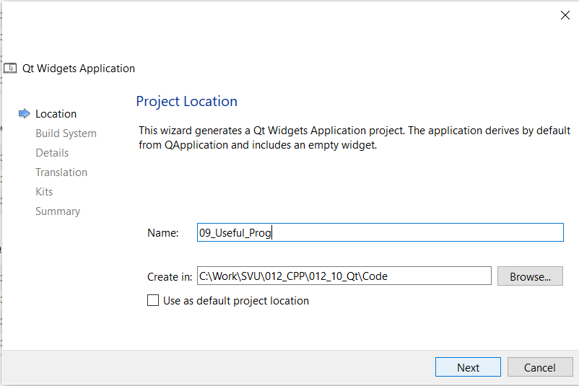
509 Useful Program
https://www.youtube.com/watch?v=HgyocPuO1Hk&list=PLD0D54219E5F2544D&index=9
Useful Program
We already have the basic concept of Qt.
We discuss Useful Program Examples in Qt.
We create 09_Useful_Prog project as below.

Slide 3
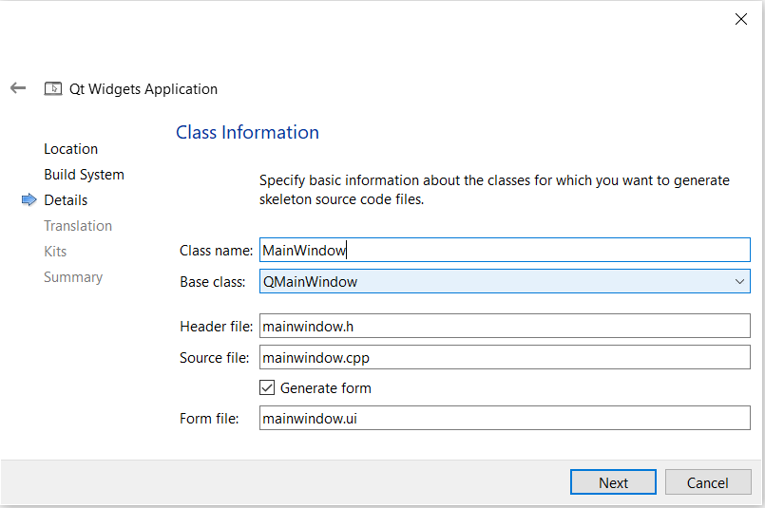
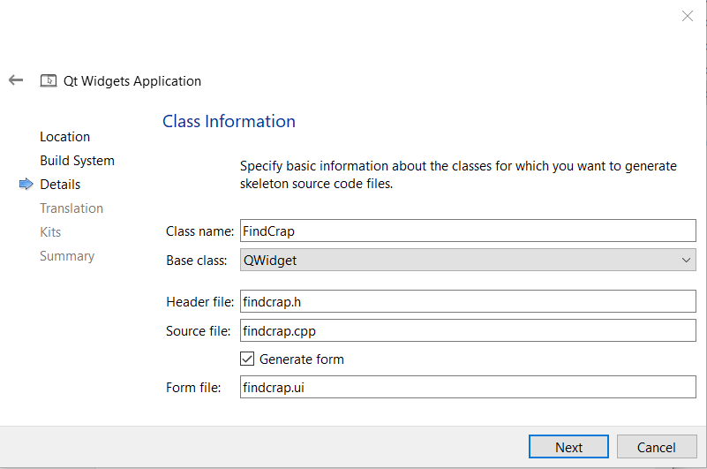
509 Useful Program
https://www.youtube.com/watch?v=HgyocPuO1Hk&list=PLD0D54219E5F2544D&index=9
Useful Program
We change the
1. Base Class from QMainWindow into QWidget.
2. Class Name: findCrap.

Slide 4
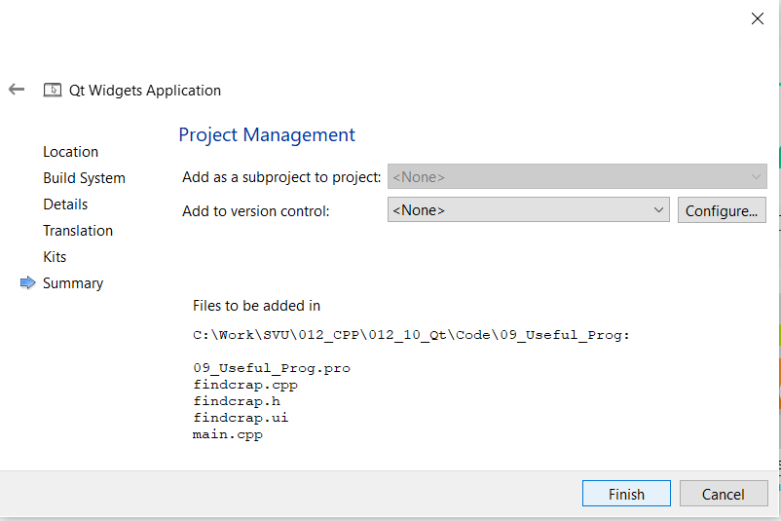
509 Useful Program
https://www.youtube.com/watch?v=HgyocPuO1Hk&list=PLD0D54219E5F2544D&index=9
Useful Program

Slide 5
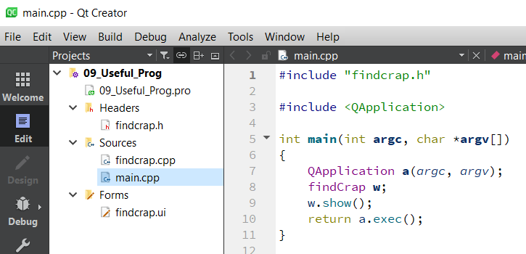
509 Useful Program
https://www.youtube.com/watch?v=HgyocPuO1Hk&list=PLD0D54219E5F2544D&index=9
Useful Program
Now, we have files in our project folders.

Slide 6
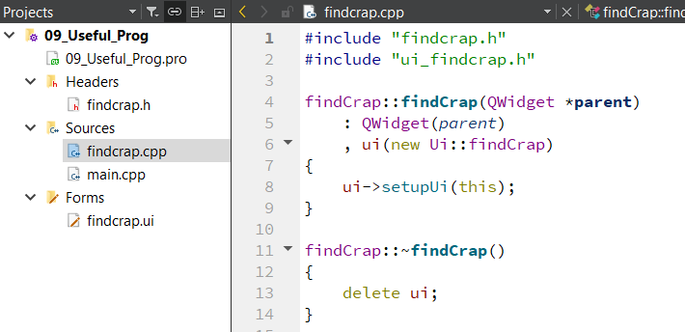
509 Useful Program
https://www.youtube.com/watch?v=HgyocPuO1Hk&list=PLD0D54219E5F2544D&index=9
Useful Program
findcrap.cpp

Slide 7
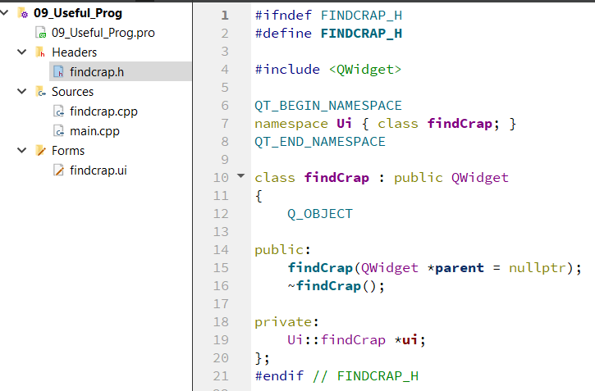
509 Useful Program
https://www.youtube.com/watch?v=HgyocPuO1Hk&list=PLD0D54219E5F2544D&index=9
Useful Program
findcrap.h

Slide 8
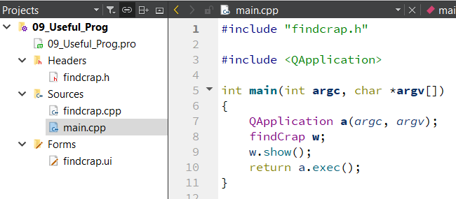
509 Useful Program
https://www.youtube.com/watch?v=HgyocPuO1Hk&list=PLD0D54219E5F2544D&index=9
Useful Program
main.cpp

Slide 9
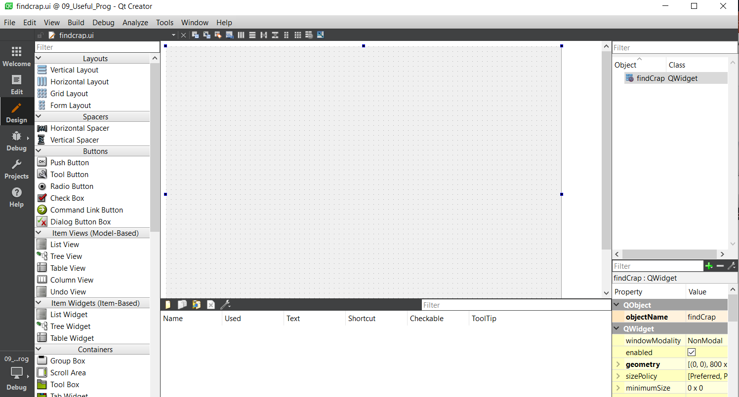
509 Useful Program
https://www.youtube.com/watch?v=HgyocPuO1Hk&list=PLD0D54219E5F2544D&index=9
Useful Program
findcrap.ui

Slide 10
509.1 UI Design: Label Widget

Slide 11
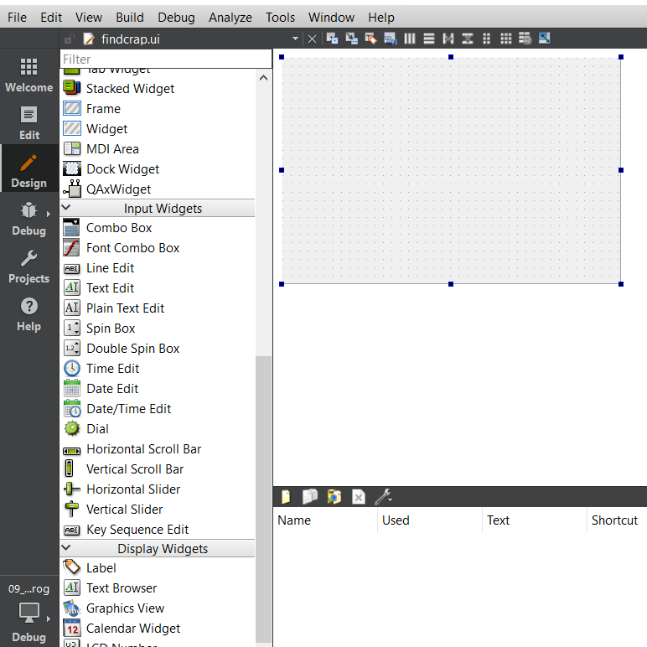
509.1 UI Design: Label Widget
https://www.youtube.com/watch?v=HgyocPuO1Hk&list=PLD0D54219E5F2544D&index=9
UI Design: Label Widget
Now, we will use UI Design tool in Qt Creator to design for our program.
First, we drag and drop the label widget.
Scroll down to the Display Widget section.
We drag “Label” to some place in UI Design.

Slide 12
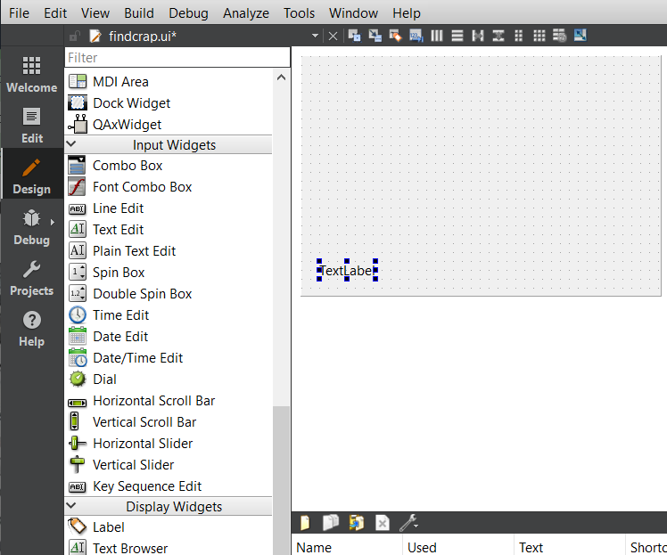
509.1 UI Design: Label Widget
https://www.youtube.com/watch?v=HgyocPuO1Hk&list=PLD0D54219E5F2544D&index=9
UI Design: Label Widget
We the Label widget as below.

Slide 13
509.2 UI Design: Line Edit

Slide 14
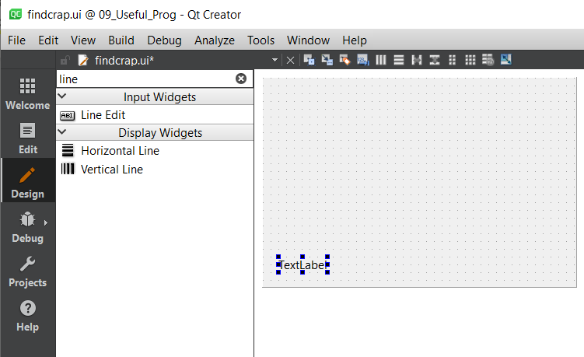
509.2 UI Design: Line Edit
https://www.youtube.com/watch?v=HgyocPuO1Hk&list=PLD0D54219E5F2544D&index=9
UI Design: Line Width
Search for Line: We add Line Width.

Slide 15
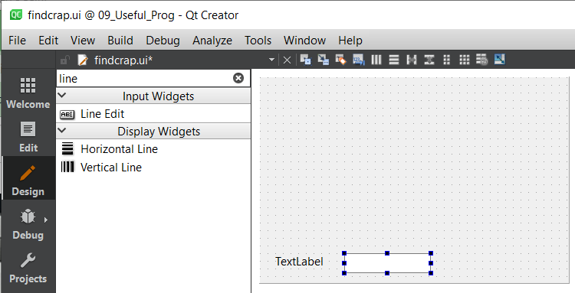
509.2 UI Design: Line Edit
https://www.youtube.com/watch?v=HgyocPuO1Hk&list=PLD0D54219E5F2544D&index=9
UI Design: Line Width
Add “Line Edit” Widget.

Slide 16
509.3 UI Design: Push Button

Slide 17
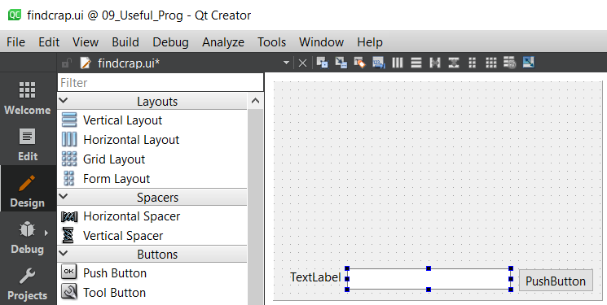
509.3 UI Design: Push Button
https://www.youtube.com/watch?v=HgyocPuO1Hk&list=PLD0D54219E5F2544D&index=9
UI Design: Push Button
Drag and drop Push Button.

Slide 18
509.4 Change Label Text

Slide 19
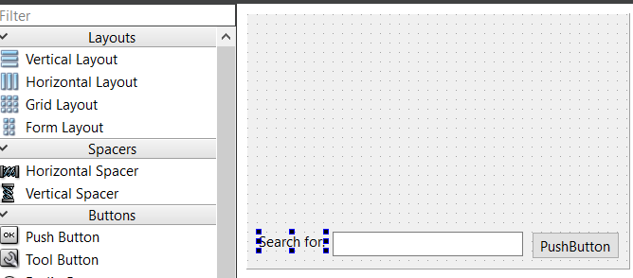
509.4 Change Label Text
https://www.youtube.com/watch?v=HgyocPuO1Hk&list=PLD0D54219E5F2544D&index=9
Change Label Text
Change Label Text to “Search for:”

Slide 20
509.5 Change Text of Push Button

Slide 21
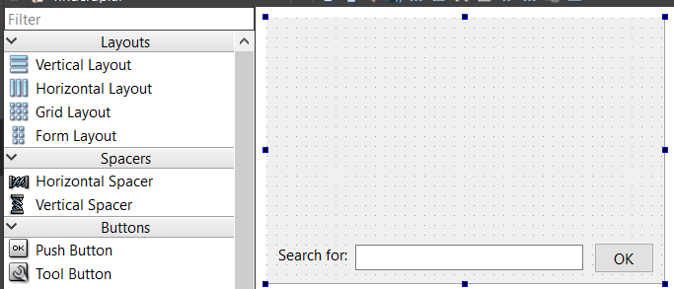
509.5 Change Text of Push Button
https://www.youtube.com/watch?v=HgyocPuO1Hk&list=PLD0D54219E5F2544D&index=9
Change Text of Push Button
Change Push Button Text to “OK”.

Slide 22
End

