Slide 1

507 Spinner and Slider
Peter H. Chen

Slide 2
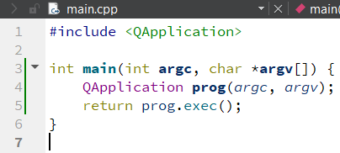
507 Spinner and Slider
https://www.youtube.com/watch?v=kg98E06wm1I&list=PLD0D54219E5F2544D&index=7
Spinner and Slider
We discuss Spinner and Slider.
We create 07_Spinner_Slider project as below.
We will connect two separated widgets: Spinner and Slider.
One of the widgets changes, the other widget changed as well.
These two widgets are very useful.

Slide 3
507.1 Container, Spin Box, and Slider

Slide 4
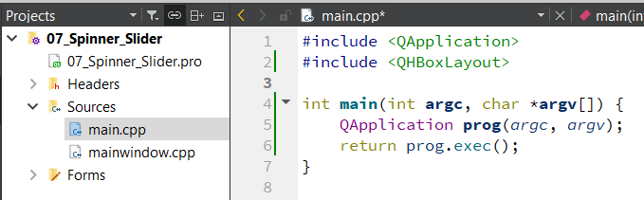
507.1 Container, Spin Box, and Slider
https://www.youtube.com/watch?v=kg98E06wm1I&list=PLD0D54219E5F2544D&index=7
Include Container, Spin Box, and Slider Widgets
1. First, we include the QHBoxLayout.
Any time we want to layout the widget on GUI. A layout helps you to determine the size and position of the widgets.

Slide 5
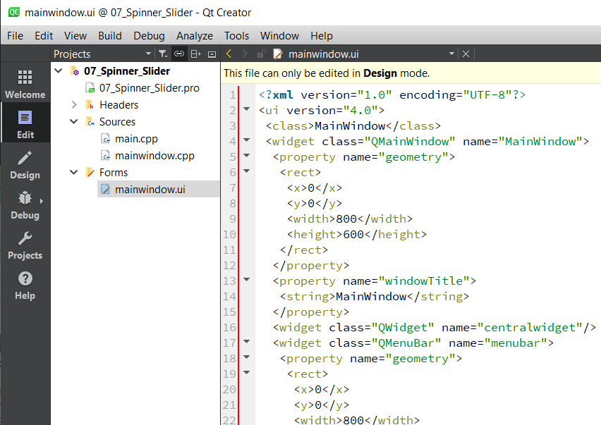
507.1 Container, Spin Box, and Slider
https://www.youtube.com/watch?v=kg98E06wm1I&list=PLD0D54219E5F2544D&index=7
Include Container, Spin Box, and Slider Widgets
We also can do the layout in design mode manually as shown below.
In Edit Mode, we click Forms/mainwindow.ui.

Slide 6
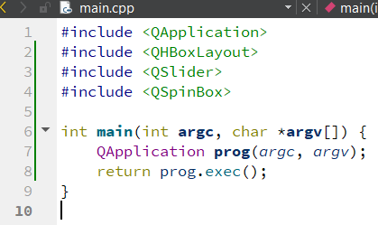
507.1 Container, Spin Box, and Slider
https://www.youtube.com/watch?v=kg98E06wm1I&list=PLD0D54219E5F2544D&index=7
Include Container, Spin Box, and Slider Widgets
We will do this in code. It will give us more understanding and more control in our application.
We also include QSlider and QSpinBox.

Slide 7
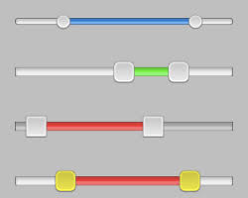
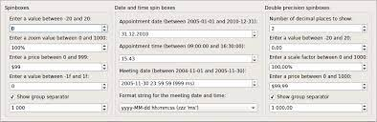
507.1 Container, Spin Box, and Slider
https://www.youtube.com/watch?v=kg98E06wm1I&list=PLD0D54219E5F2544D&index=7
Include Container, Spin Box, and Slider Widgets
The slider let use grab the scroll bar and slide the scroll bar and display the value.
The spin box is a small box. It has up and down arrow.
When you click the up, the value changes by 1, then 2, 3.
When you click down, it goes to 2, 1, and 0.
Slider
Spin box

Slide 8
507.2 Add Container, Spin Box, and Slider

Slide 9
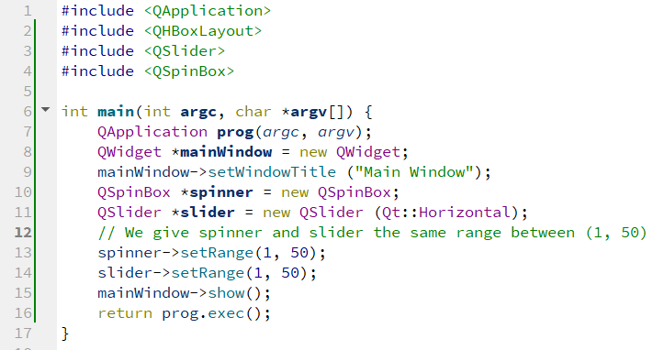
507.2 Add Container, Spin Box, and Slider
https://www.youtube.com/watch?v=kg98E06wm1I&list=PLD0D54219E5F2544D&index=7
Add Container, Spin Box, and Slider
We are going to add the slider and spin box.
If we change one, the other one will be changed as well.
We have three widgets. Two widgets are inside the other widget.
Right now, we build one container for other two widgets.

Slide 10
End

