Slide 1

504 Basic Qt Application
Peter H. Chen

Slide 2
504 Basic Qt Application
https://www.youtube.com/watch?v=HnuY7NhzLGM&list=PLD0D54219E5F2544D&index=4
Basic Qt Application
We discuss Basic Qt Application.

Slide 3
504.1 Create Qt Project

Slide 4
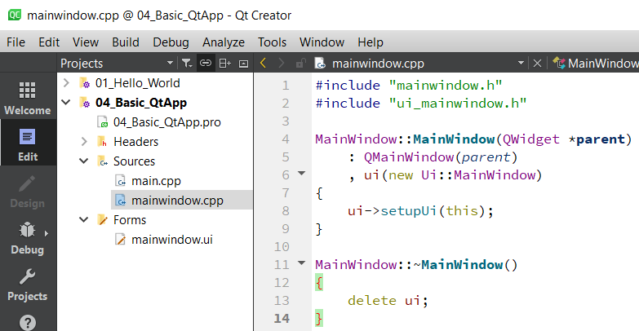
504.1 Create Qt Project
https://www.youtube.com/watch?v=HnuY7NhzLGM&list=PLD0D54219E5F2544D&index=4
Create Qt Project
We create a very basic project.

Slide 5
504.2 Create Basic Qt Application

Slide 6
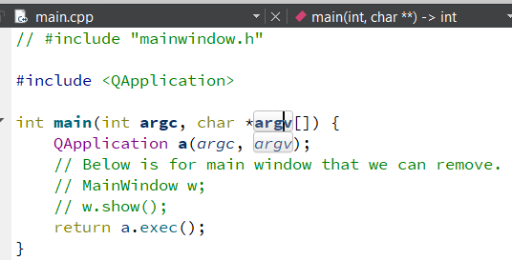
504.2 Create Basic Qt Application
https://www.youtube.com/watch?v=HnuY7NhzLGM&list=PLD0D54219E5F2544D&index=4
Create Basic Qt Application
Very basic Qt Application is four lines (1, 2, 3, 4) below.
1. First line is to include a Q-Application:
<QtGui/QApplication> allows us to create objects that are responsible for controlling our entire program.
QApplication is to create the main object for a.exec() that execute our main program.
The a.exec() is to start it up and begin running the program.
The a.exec() control the main event loop.
1
2
3
4

Slide 7
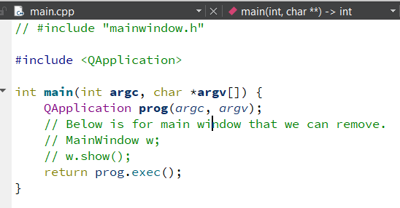
504.2 Create Basic Qt Application
https://www.youtube.com/watch?v=HnuY7NhzLGM&list=PLD0D54219E5F2544D&index=4
Create Basic Qt Application
Very basic Qt Application is four lines (1, 2, 3, 4) below.
We change “a (argc, argv)” into “prog (argc, argv)”.
Object name is prog.
2. Now the main() is the main function. The main() is the first function whenever our program starts running.
1
2
3
4

Slide 8
504.2 Create Basic Qt Application
https://www.youtube.com/watch?v=HnuY7NhzLGM&list=PLD0D54219E5F2544D&index=4
Create Basic Qt Application
We change “a (argc, argv)” into “prog (argc, argv)”.
Object name is prog.
2. Now the main() is the main function. The main() is the first function whenever our program starts running.
3. “QApplication prog (argc, argv)” creates the main object that control our main program.
1
2
3
4

Slide 9
504.2 Create Basic Qt Application
https://www.youtube.com/watch?v=HnuY7NhzLGM&list=PLD0D54219E5F2544D&index=4
Create Basic Qt Application
4. prog.exec () return the program execute. The prog.exec() starts running our program.
Now, once it is done running. It exits the main event loop. It returns 0.
When it returns zero, that means it return to the main function.
Return 0 to main function means that your program finished running and ended successfully.
1
2
3
4

Slide 10
504.2 Create Basic Qt Application
https://www.youtube.com/watch?v=HnuY7NhzLGM&list=PLD0D54219E5F2544D&index=4
Create Basic Qt Application
We do not have anything in our program yet.
It just run successfully and exit.
We do not have any buttons, sliders, menus, etc.
We will go ahead and create some text on the screen.
1
2
3
4

Slide 11
504.3 Create Qt Label

Slide 12
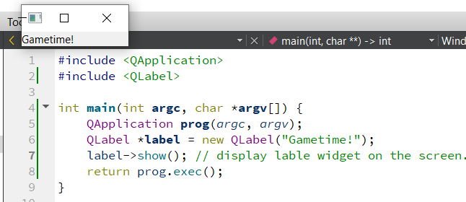
504.3 Create Qt Label
https://www.youtube.com/watch?v=HnuY7NhzLGM&list=PLD0D54219E5F2544D&index=4
Create Qt Label
1. First, we include <QLabel>
2. Now, we create a Qt-Label and put some text “gametime!” on the label.
This label will not display until we tell Qt to display.
We need to call label widget with function “show” as below.
3. label->show()
Build and run the program, we see the “gametime!” is displayed.
1
2
3

Slide 13
504.3 Create Qt Label
https://www.youtube.com/watch?v=HnuY7NhzLGM&list=PLD0D54219E5F2544D&index=4
Create Qt Label
Now, we have some understanding by modifying the *.cpp code instead of UI Designer.

Slide 14
End

