Slide 1

502 Create Qt Project
Peter H. Chen

Slide 2
502 Create Qt Project
https://www.youtube.com/watch?v=HiOOWDb4YjE&list=PLD0D54219E5F2544D&index=2
Create Qt Project
We discuss how to create a project in Qt.

Slide 3
502.1 Start Qt

Slide 4
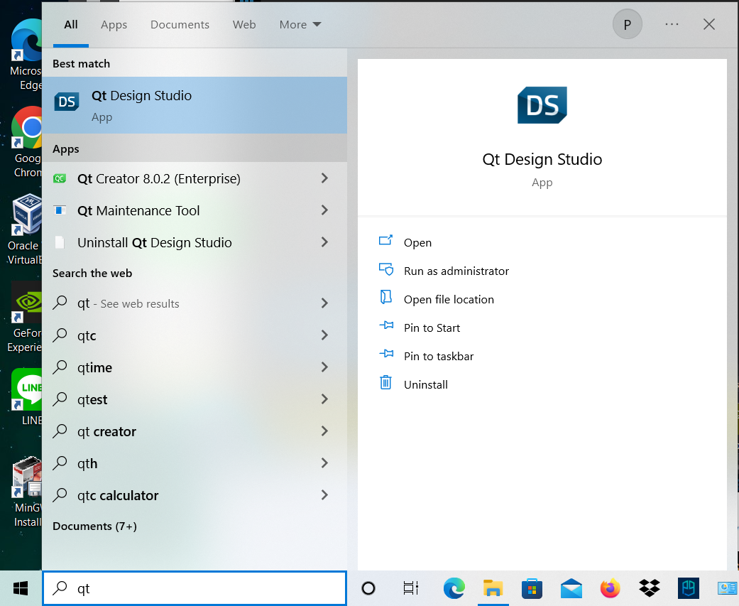
502.1 Start Qt
https://www.youtube.com/watch?v=HiOOWDb4YjE&list=PLD0D54219E5F2544D&index=2
Start Qt
500. Type “qt” in Command prompt
2. Select “Qt Creator”
2
1

Slide 5
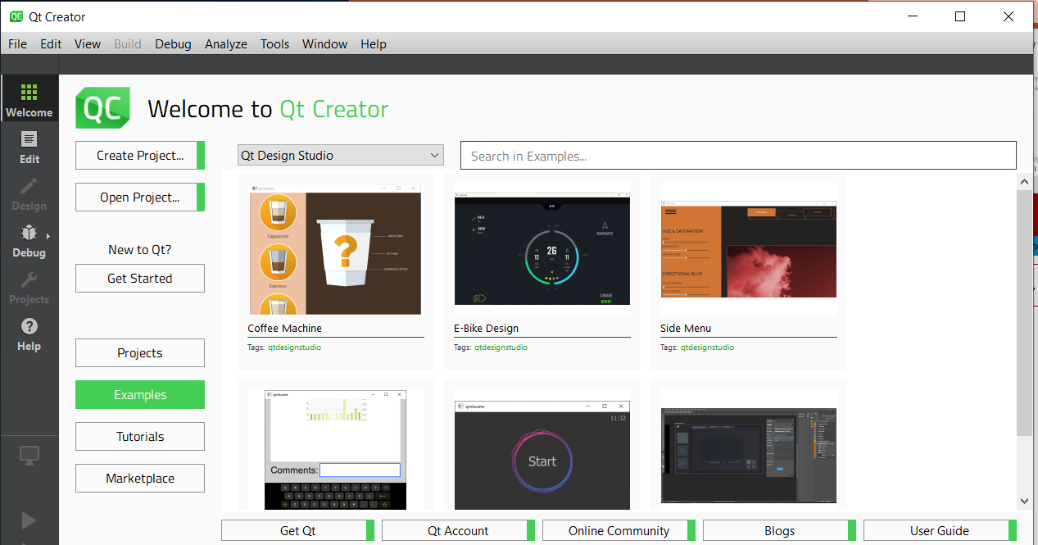
502.1 Start Qt
https://www.youtube.com/watch?v=HiOOWDb4YjE&list=PLD0D54219E5F2544D&index=2
Start Qt
Qt Creator Menu.

Slide 6
502.2 Create Qt Project

Slide 7
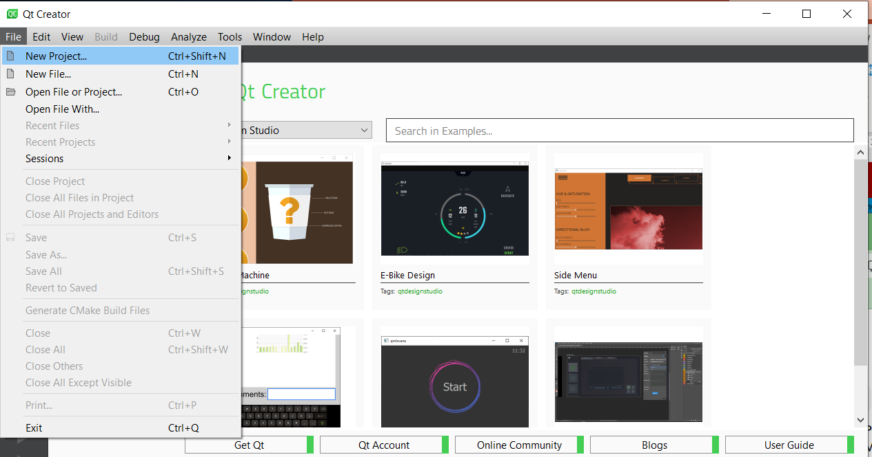
502.2 Create Qt Project
https://www.youtube.com/watch?v=HiOOWDb4YjE&list=PLD0D54219E5F2544D&index=2
Create Qt Project
File > New Project …

Slide 8
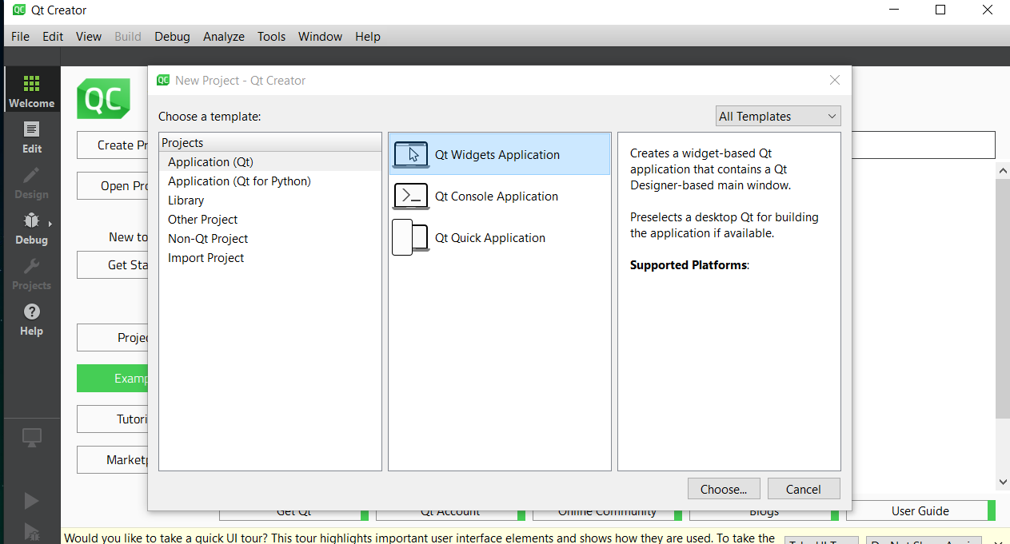
502.2 Create Qt Project
https://www.youtube.com/watch?v=HiOOWDb4YjE&list=PLD0D54219E5F2544D&index=2
Create Qt Project
Select
500. “Application (Qt)”.
2. Qt Widget Applications.
3. Choose
2
1
3

Slide 9
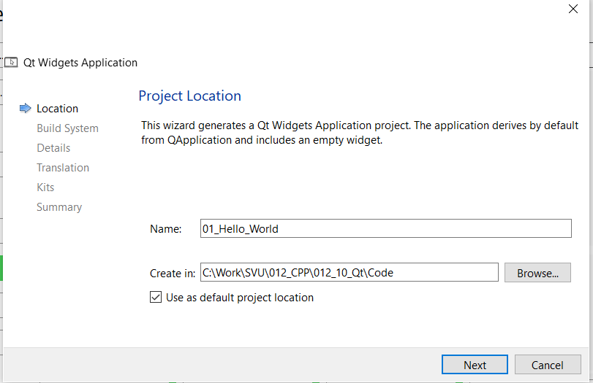
502.2 Create Qt Project
https://www.youtube.com/watch?v=HiOOWDb4YjE&list=PLD0D54219E5F2544D&index=2
Create Qt Project
500. Project name: 01_Hwllo_World
2. Path
3. Click default project location.
1
2
3

Slide 10
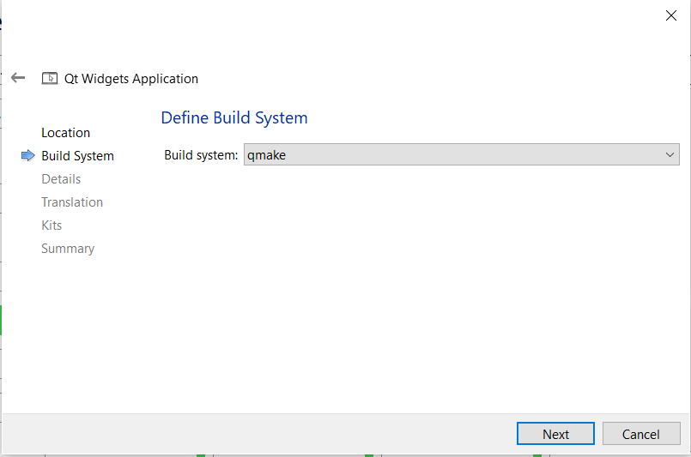
502.2 Create Qt Project
https://www.youtube.com/watch?v=HiOOWDb4YjE&list=PLD0D54219E5F2544D&index=2
Create Qt Project
We can select “qmake” for Qt or “cmake” for c++.
Here, we select “qmake”.
Click “Next”

Slide 11
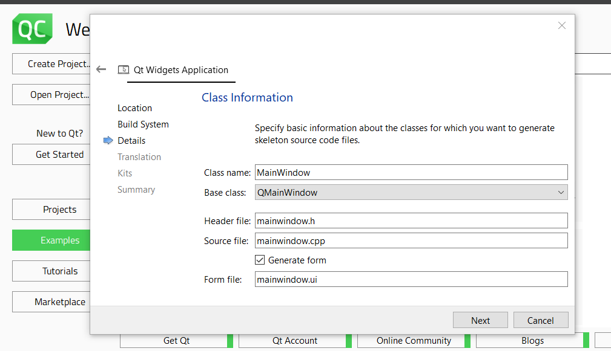
502.2 Create Qt Project
https://www.youtube.com/watch?v=HiOOWDb4YjE&list=PLD0D54219E5F2544D&index=2
Create Qt Project
We have lot of default information.
The default ui is “maninwindow.ui”
Just leave them there for now and click “next”.

Slide 12
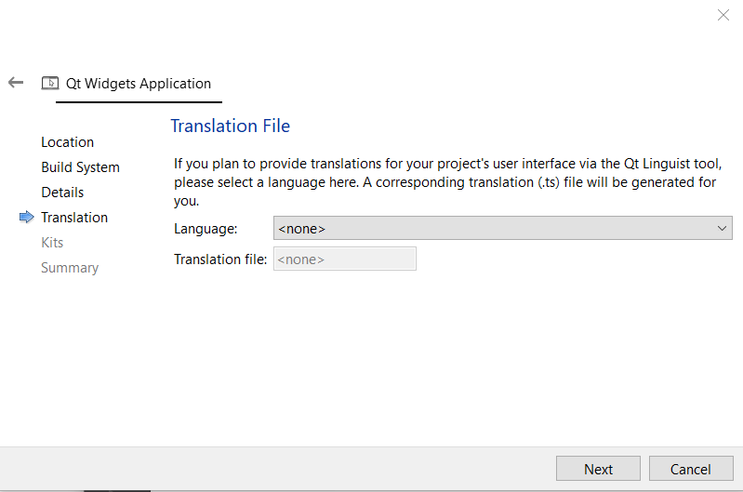
502.2 Create Qt Project
https://www.youtube.com/watch?v=HiOOWDb4YjE&list=PLD0D54219E5F2544D&index=2
Create Qt Project
We have the translation file.
Default is <none>.
Click on “Next”.

Slide 13
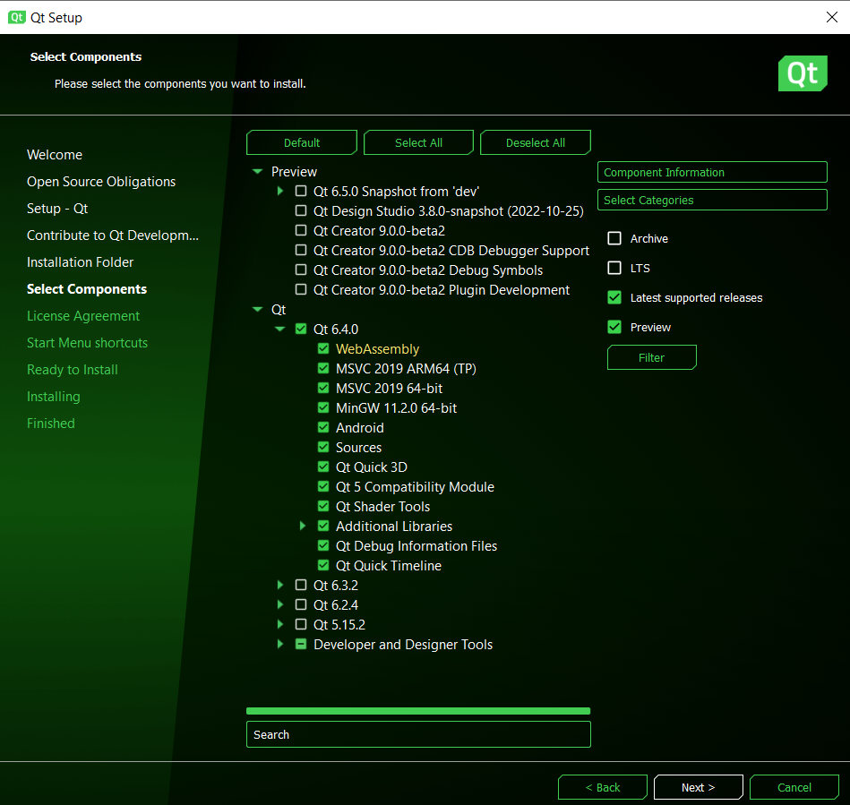
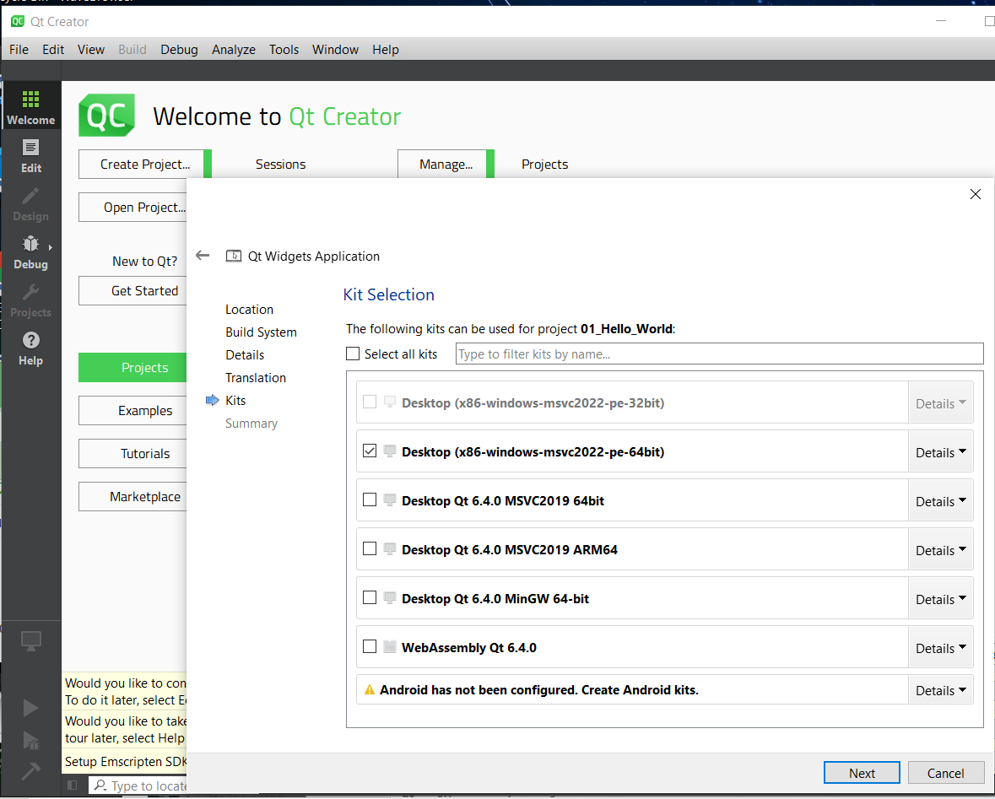
502.2 Create Qt Project
https://www.youtube.com/watch?v=HiOOWDb4YjE&list=PLD0D54219E5F2544D&index=2
Create Qt Project
Since we install in x86-windows-msvc2022-pe-64bit are automatically selected.

Slide 14
End

