Slide 1

503 Qt: UI Creator Mode
Peter H. Chen

Slide 2
503 Qt: UI Creator Mode
https://www.youtube.com/watch?v=CRVwBNkn63s&list=PLD0D54219E5F2544D&index=3
Qt: UI Create Mode
We discuss File Folder and UI Design in Qt Creator Mode.

Slide 3
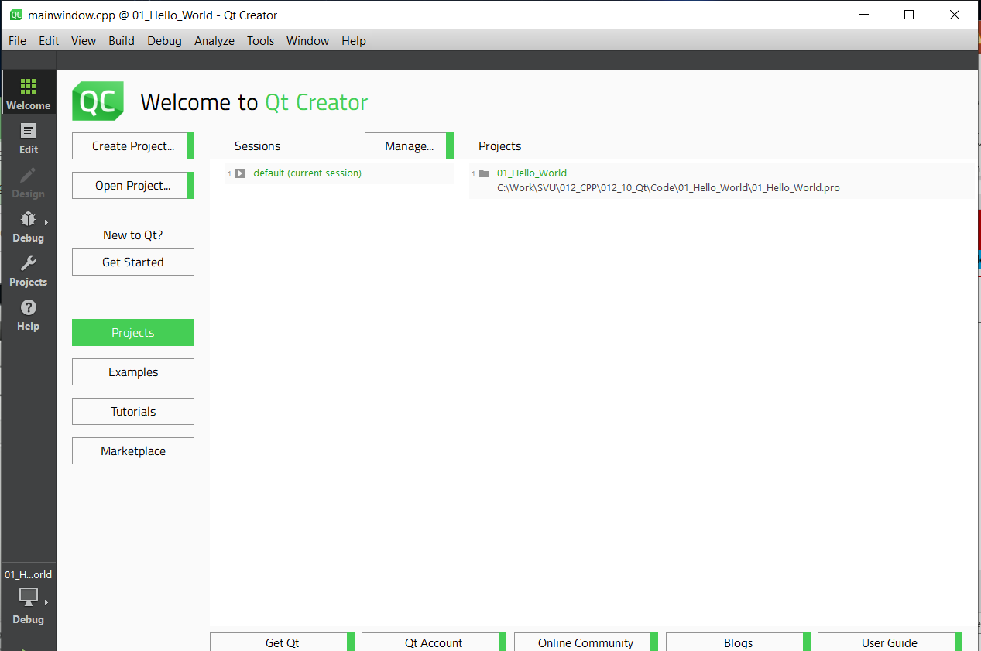
503.1 Qt Folder and File
https://www.youtube.com/watch?v=CRVwBNkn63s&list=PLD0D54219E5F2544D&index=3
Qt Folders and Files
There are several mode on the left side of Qt Creator:
1. Welcome Mode: Create project, open project, examples, tutorials, marketplace. Nothing import.
2. Edit Mode: Text editor to write code. We spend most time here.

Slide 4
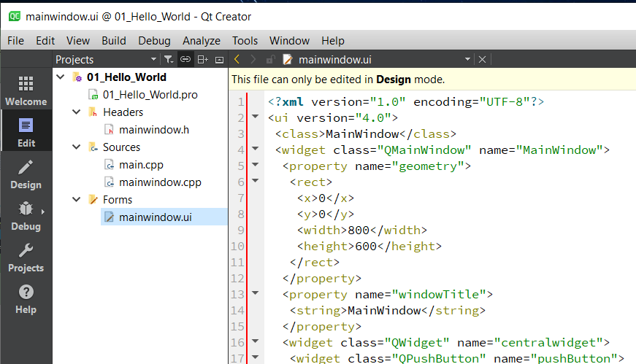
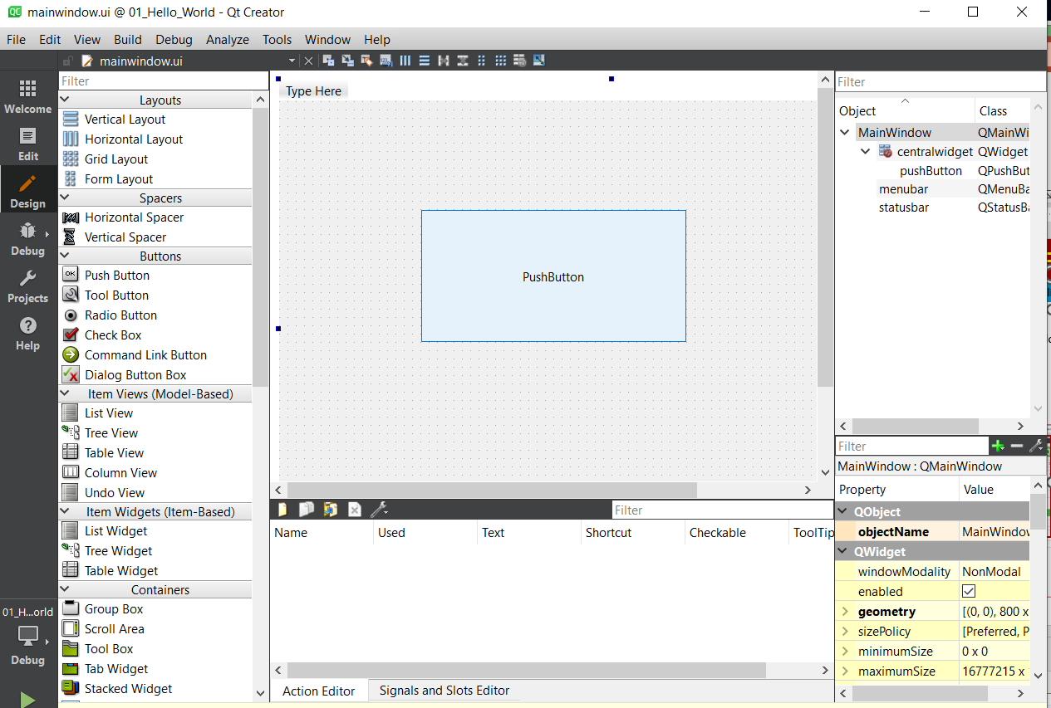
503.1 Qt Folder and File
https://www.youtube.com/watch?v=CRVwBNkn63s&list=PLD0D54219E5F2544D&index=3
Qt Folders and Files
3. Design Mode: Click Forms/mainwindow.ui to start the Design Mode.

Slide 5
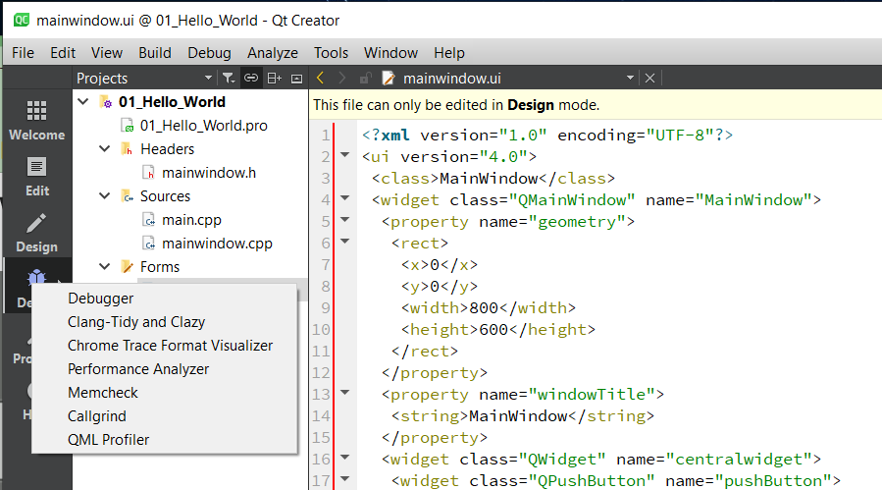
503.1 Qt Folder and File
https://www.youtube.com/watch?v=CRVwBNkn63s&list=PLD0D54219E5F2544D&index=3
Qt Folders and Files
4. Debug Mode: For bugs fixing. We will not spend too much time here.

Slide 6
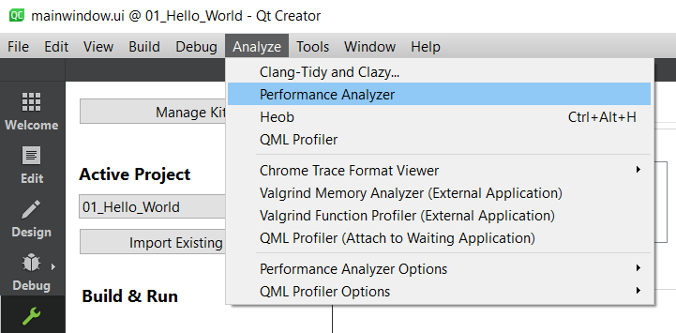
503.1 Qt Folder and File
https://www.youtube.com/watch?v=CRVwBNkn63s&list=PLD0D54219E5F2544D&index=3
Qt Folders and Files
6. Analyze: Tune up the code performance.

Slide 7
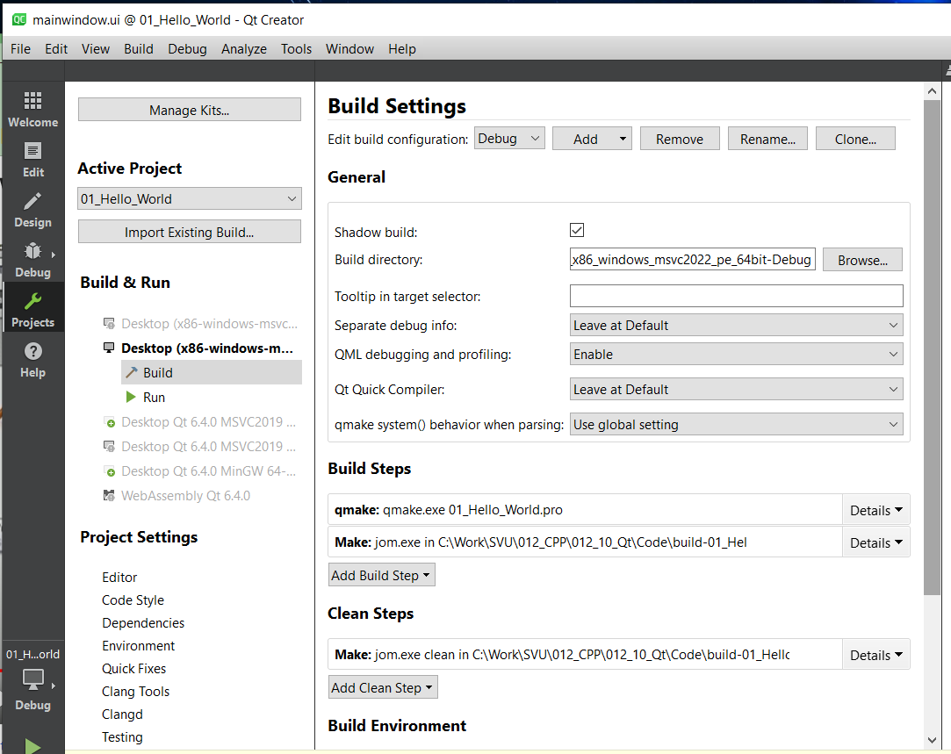
503.1 Qt Folder and File
https://www.youtube.com/watch?v=CRVwBNkn63s&list=PLD0D54219E5F2544D&index=3
Qt Folders and Files
5. Project Mode: main project setting, version of Qt, compiler, editor setting, coding style.

Slide 8
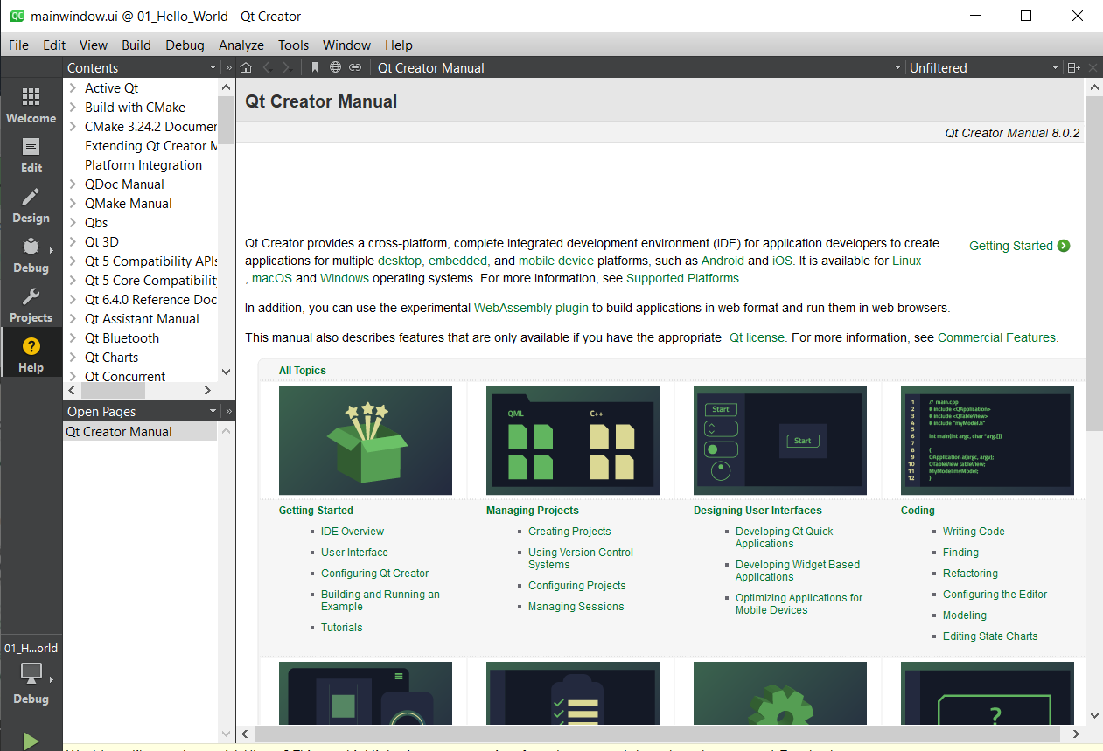
503.1 Qt Folder and File
https://www.youtube.com/watch?v=CRVwBNkn63s&list=PLD0D54219E5F2544D&index=3
Qt Folders and Files
7. Help: Document for help.

Slide 9
503.1 Qt Folder and File

Slide 10
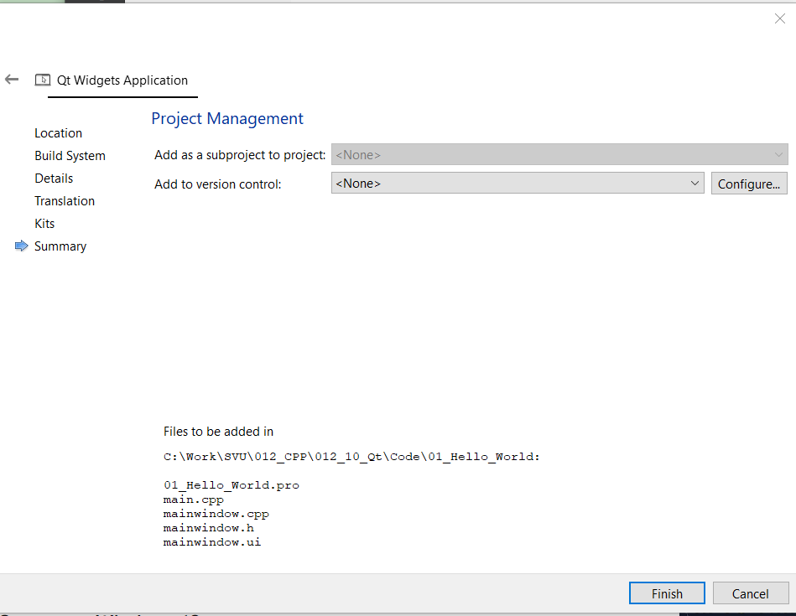
503.1 Qt Folder and File
https://www.youtube.com/watch?v=CRVwBNkn63s&list=PLD0D54219E5F2544D&index=3
Qt Folders and Files
Since we install in x86-windows-msvc2022-pe-64bit are automatically selected.
If we have any project management tools, then click configure button under “Project Management”.

Slide 11
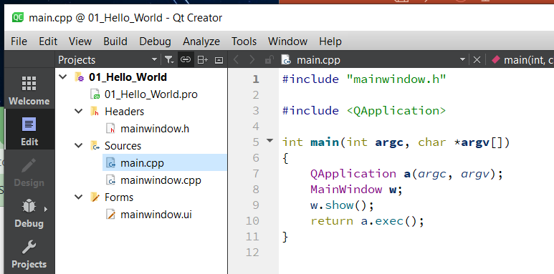
503.1 Qt Folder and File
https://www.youtube.com/watch?v=CRVwBNkn63s&list=PLD0D54219E5F2544D&index=3
Qt Folders and Files
These files are the generated files and in the project folder.

Slide 12
503.1 Qt Folder and File
https://www.youtube.com/watch?v=CRVwBNkn63s&list=PLD0D54219E5F2544D&index=3
Qt Folders and Files
As we can see, this project contains files:
500. 01_Hello_world.pro: This is the project file.
2. Headers folder: mainwindow.h
3. Sources folder: main.cpp and mainwindow.cpp
4. Forms folder: mainwindow.ui

Slide 13
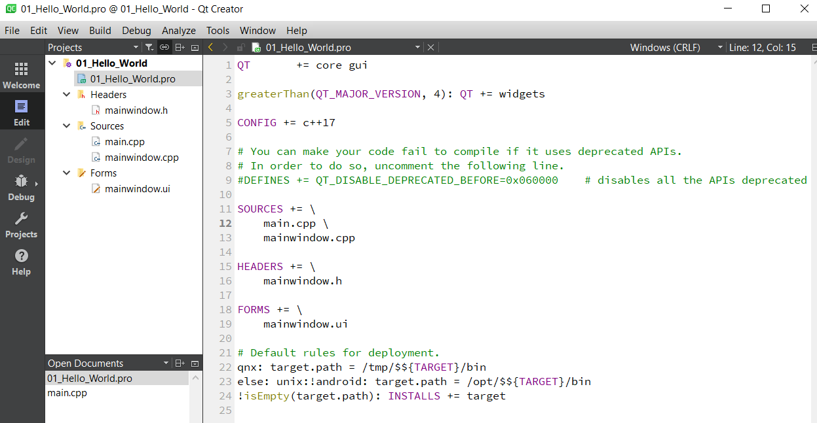
503.1 Qt Folder and File
https://www.youtube.com/watch?v=CRVwBNkn63s&list=PLD0D54219E5F2544D&index=3
Qt Folders and Files
01_Hello_world.pro: This project file allowed you to compile our qt program using qmake.

Slide 14
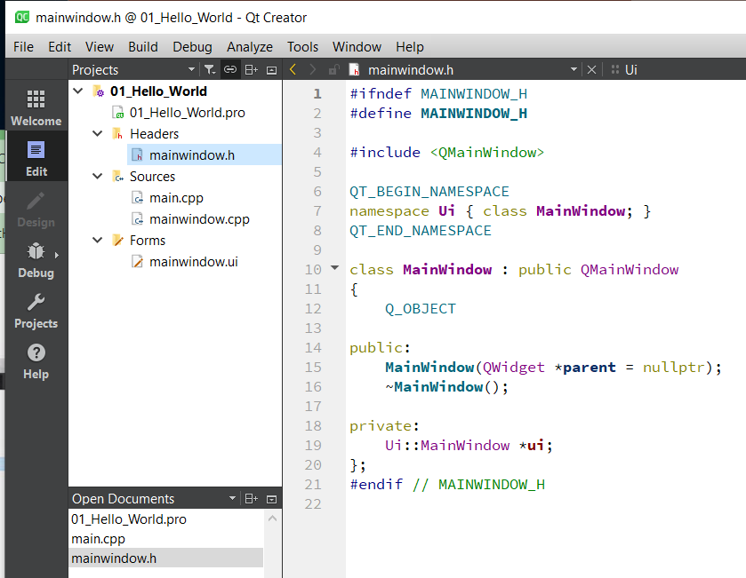
503.1 Qt Folder and File
https://www.youtube.com/watch?v=CRVwBNkn63s&list=PLD0D54219E5F2544D&index=3
Qt Folders and Files
Headers folder: mainwindow.h

Slide 15
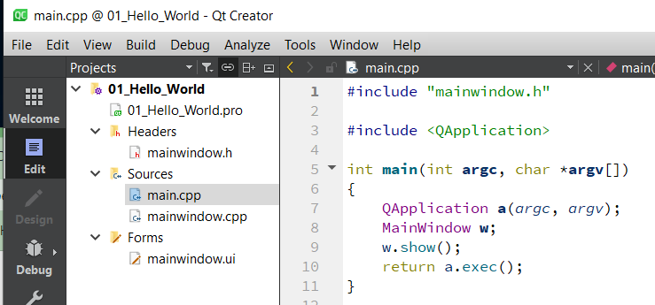
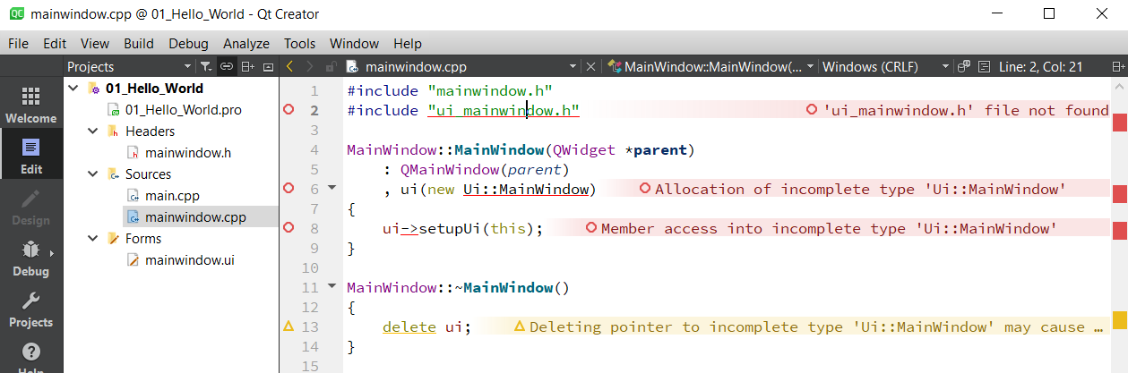
503.1 Qt Folder and File
https://www.youtube.com/watch?v=CRVwBNkn63s&list=PLD0D54219E5F2544D&index=3
Qt Folders and Files
Sources folder: main.cpp and mainwindow.cpp

Slide 16
503.2 UI Design

Slide 17
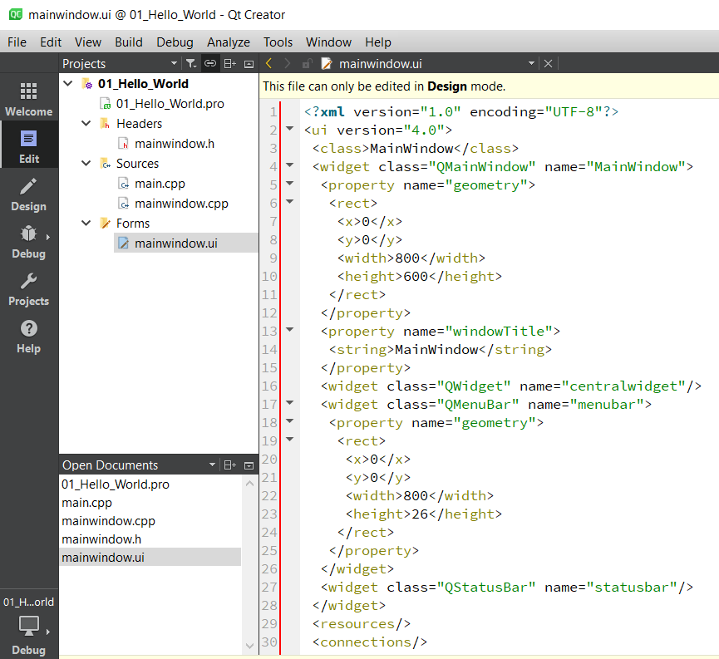
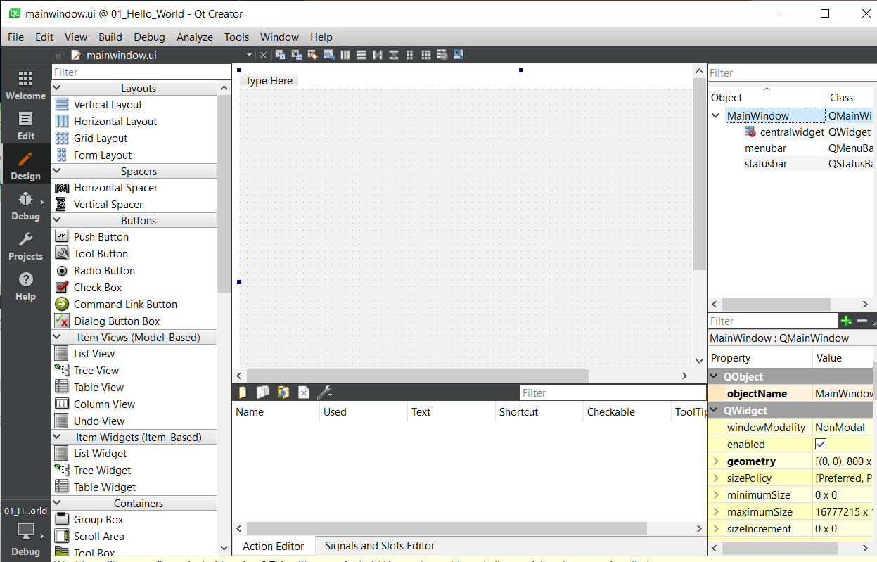
503.2 UI Design
https://www.youtube.com/watch?v=CRVwBNkn63s&list=PLD0D54219E5F2544D&index=3
UI Design
Forms: we can double click mainwindow.ui to “Design Mode” on the right-hand side as below.
Design Mode

Slide 18
503.2 UI Design
https://www.youtube.com/watch?v=CRVwBNkn63s&list=PLD0D54219E5F2544D&index=3
UI Design
Here, we can pick any widget on the left-hand side and drop in the right-hand window.

Slide 19
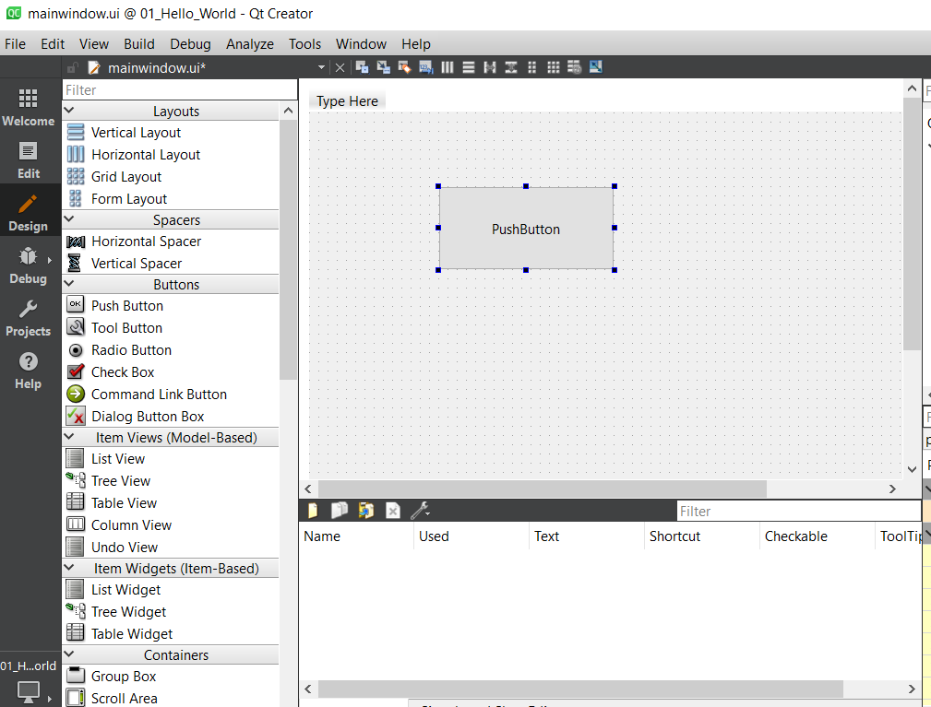
503.2 UI Design
https://www.youtube.com/watch?v=CRVwBNkn63s&list=PLD0D54219E5F2544D&index=3
UI Design
We drag and drop push button.
We make button bigger, and we can add callback function latter.

Slide 20
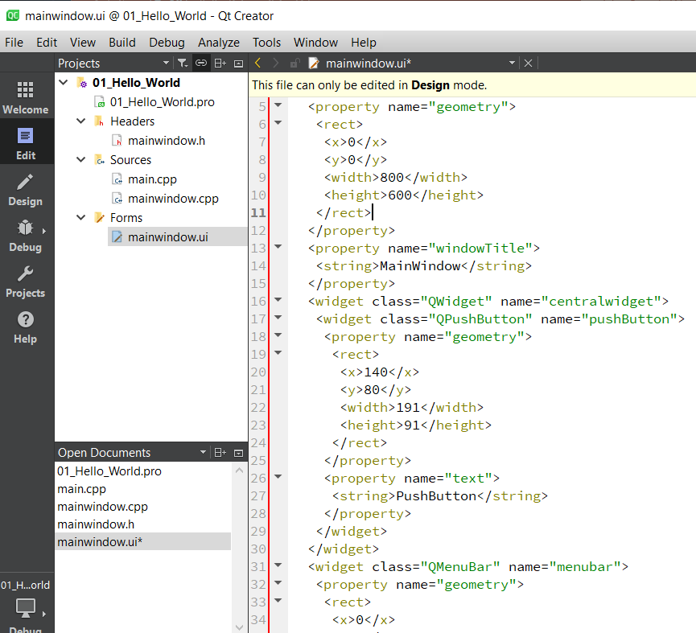
503.2 UI Design
https://www.youtube.com/watch?v=CRVwBNkn63s&list=PLD0D54219E5F2544D&index=3
UI Design
We click “Edit” to see the code.

Slide 21
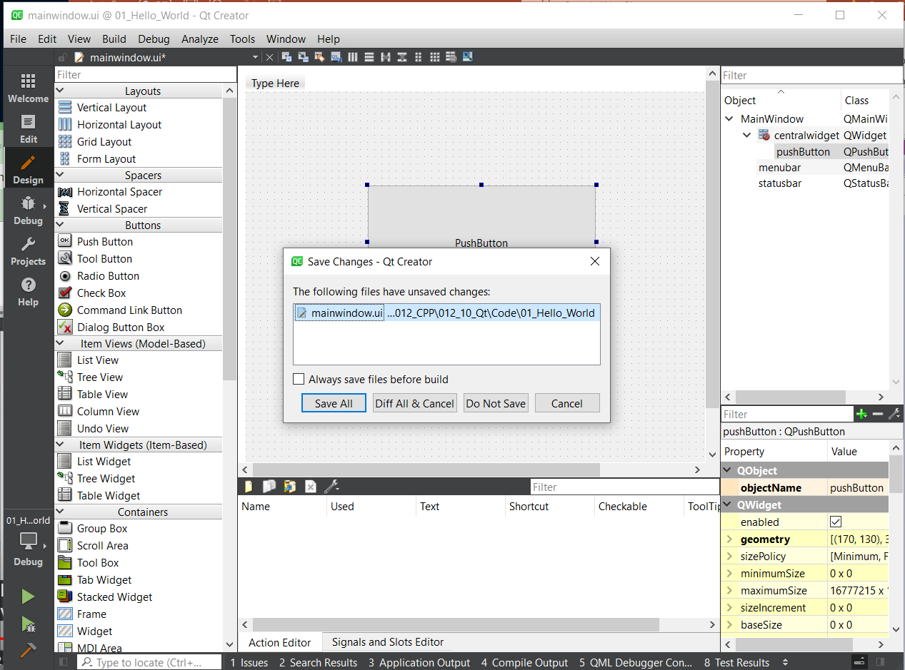
503.2 UI Design
https://www.youtube.com/watch?v=CRVwBNkn63s&list=PLD0D54219E5F2544D&index=3
UI Design
Once we have done the “UI design”, we can
500. click “build” button.
2. Click “Save All”
2
1
Click “build” button.

Slide 22
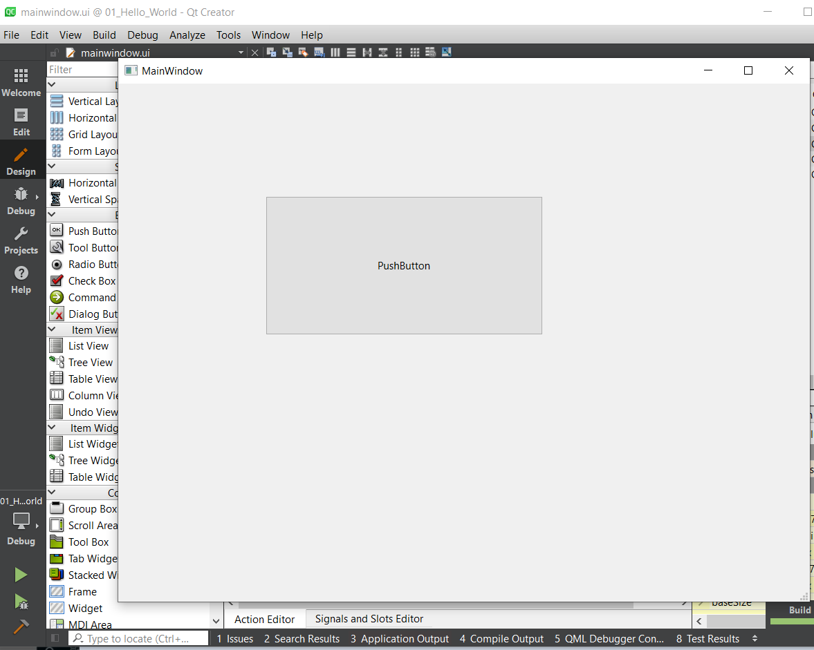
503.2 UI Design
https://www.youtube.com/watch?v=CRVwBNkn63s&list=PLD0D54219E5F2544D&index=3
UI Design
You can
500. run or
2. set up break point and run debugger (start debugging of startup project)
3. The “UI” will be displayed.
1
run
2
Set up break point and run debugger

Slide 23
End

