Slide 1

504 Basic Qt Application
Peter H. Chen

Slide 2
504 Basic Qt Application
https://www.youtube.com/watch?v=HnuY7NhzLGM&list=PLD0D54219E5F2544D&index=4
Basic Qt Application
We discuss Basic Qt Application.

Slide 3
504.1 Qt Folder and File

Slide 4
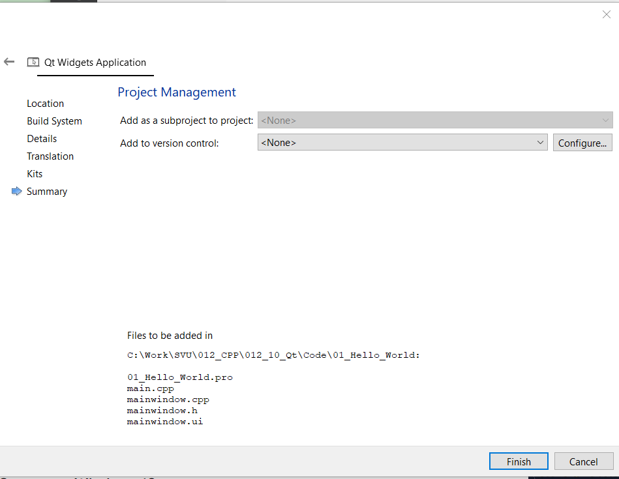
504.1 Qt Folder and File
https://www.youtube.com/watch?v=HnuY7NhzLGM&list=PLD0D54219E5F2544D&index=4
Qt Folders and Files
Since we install in x86-windows-msvc2022-pe-64bit are automatically selected.
If we have any project management tools, then click configure button under “Project Management”.

Slide 5
End

