Slide 1

505 Difference in Operator
Peter H. Chen

Slide 2
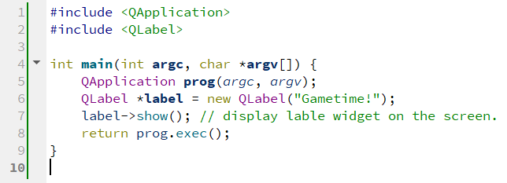
505 Difference in Operator
https://www.youtube.com/watch?v=ufnA4UOKAFE&list=PLD0D54219E5F2544D&index=5
Differences in Operators
We discuss differences in Operators.
We create 05_Operator_Difference project and copy main.cpp from 04_Basic_QtApp project.
We are wondering why we need the arrow in “->” in “label->show();” instead of “.” operator in “label.show();”

Slide 3
505 Difference in Operator
https://www.youtube.com/watch?v=ufnA4UOKAFE&list=PLD0D54219E5F2544D&index=5
Differences in Operators
A lot of people are confused about double columns (::), dot (.), and arrow (->) operators.
All of these are allowed to access functions in the classes or objects.

Slide 4
505.1 Double Columns (::) Operator

Slide 5
505.1 Double Columns (::) Operator
https://www.youtube.com/watch?v=ufnA4UOKAFE&list=PLD0D54219E5F2544D&index=5
Double Columns (::) Operator
If we have a class a, we want to use a member function called b.
We can define the member function b in class a.
> a::b()
The “::” specify which class the member function b is coming from.
We can have same function name b in several classes. For example,
> a::b()
> tuna::b()
> bacon::b()
Here, we have same function name b() in class a, class tuna, and class bacon.
The double column (::) specify which class the member function coming from.
If you have same function b() from classes, we use double column (::) to specify which classes that function b() is coming from.

Slide 6
505.2 Dot (.) Operator

Slide 7
505.2 Dot (.) Operator
https://www.youtube.com/watch?v=ufnA4UOKAFE&list=PLD0D54219E5F2544D&index=5
Dot (.) Operator
Now, the dot (.) operator, such as, a.b() or tuna.b(), is the most common one that we use before, whenever tuna is an object and b is the member function of that object.
The dot (.) operator allows you to use the member function of that object.
The dot (.) operator is the same as c++ syntax for object to access the member function.

Slide 8
505.3 Arrow (->) Operator

Slide 9
505.3 Arrow (->) Operator
https://www.youtube.com/watch?v=ufnA4UOKAFE&list=PLD0D54219E5F2544D&index=5
Arrow (->) Operator
If we create an object use a pointer to point to the created label object.
> QLabel *label = new QLabel (“Gametime!”);
A “pointer to created object” and an “object” are two very different things.
Because the asterisk (*label) indicate that is pointer to object label.
> a->b
is exactly same thing as
> (*a).b
This means that we want to use member function b from class pointer a.
This is the same syntax as c++ which uses “a->b” or “(*a).b” for pointer of object a to member function b.
So, dot (.) operator is used to access member function in object and arrow (->) operator is used to access member function in pointer of class.
The arrow (->) is used to de-reference the address of object to access the member function.

Slide 10
505.3 Arrow (->) Operator
https://www.youtube.com/watch?v=ufnA4UOKAFE&list=PLD0D54219E5F2544D&index=5
Arrow (->) Operator
Whenever we have a pointer, we use arrow (->) to access the member function.
Whenever we have an object, we use dot (.) to access the member function.
Now, we understand when should we use arrow (->) and when do we use dot (.) operator.

Slide 11
End

