Slide 1

506 Signal and Slot
Peter H. Chen

Slide 2
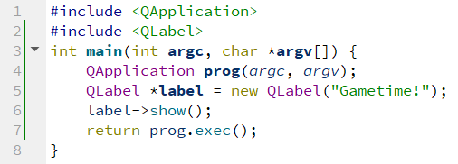
506 Signal and Slot
https://www.youtube.com/watch?v=swZNOKKkQiw&list=PLD0D54219E5F2544D&index=6
Signal and Slot
We discuss Signals and Slots.
We create 06_Signal_Slot project and copy main.cpp from 05_Operator_Difference project.

Slide 3
506 Signal and Slot
https://www.youtube.com/watch?v=swZNOKKkQiw&list=PLD0D54219E5F2544D&index=6
Signal and Slot
Signals and Slots are the way that we can have the user interact with a program.
The program below, the user cannot interact with the program in any way.
That is the reason why we need to learn about signals and slots.

Slide 4
506.1 QPushButton

Slide 5
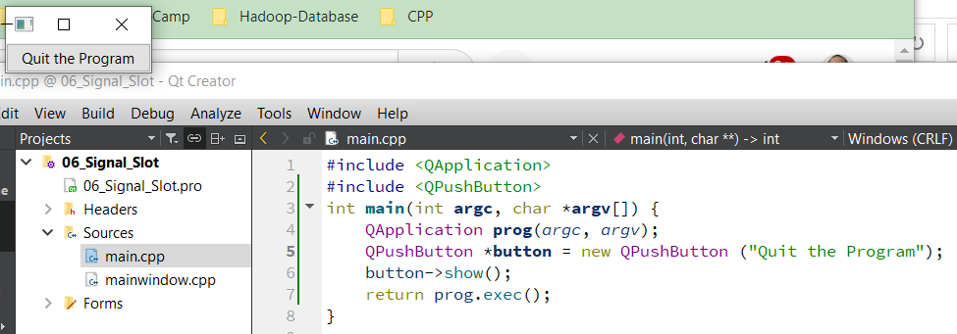
506.1 QPushButton
https://www.youtube.com/watch?v=swZNOKKkQiw&list=PLD0D54219E5F2544D&index=6
QPushButton
1. First, we include the QPushButton.
2. Then, we create *button point to QPushButton object.
3. Then, we use “-> to access the pointer which access the member function show() of button object. The button is displayed as below.

Slide 6
506.2 Signal and Slot of Button

Slide 7
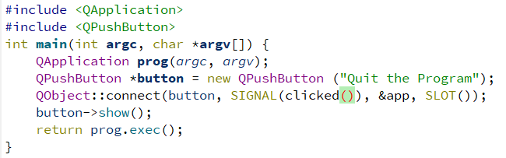
506.2 Signal and Slot of Button
https://www.youtube.com/watch?v=swZNOKKkQiw&list=PLD0D54219E5F2544D&index=6
Signal and Slot of Button
Now, we need the signal and slot for the button.
Signal and slot allow us to add functionality to the widget or functionality to the button.
Before, we display the button on the screen, we want to use QObject to connect signal and slot.
QObject::connect(button, SIGNAL(), &app, SLOT()) takes several parameters.
We will discuss first (button) and third (&app) parameters later.
Now, we only focus on SIGNAL() and SLOT() parameters.
When user click a button, a signal is going to be generated at SIGNAL().

Slide 8
506.2 Signal and Slot of Button
https://www.youtube.com/watch?v=swZNOKKkQiw&list=PLD0D54219E5F2544D&index=6
Signal and Slot of Button
Signal can be generated when user slide a slider, choose an option from a drop-down menu, or click the button.
Since we only concern about generating a signal whenever the user click that button, we add the “SIGNAL (clicked())”. This means generate a signal whenever the user click the button.
We can use the “connect(button, SIGNAL(clicked), &app, SLOY())” function to associate the signal to which is clicked with a certain function.

Slide 9
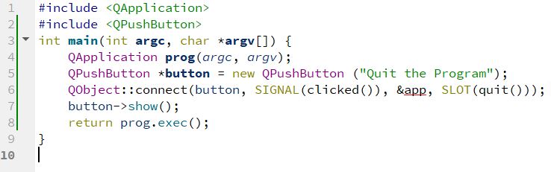
506.2 Signal and Slot of Button
https://www.youtube.com/watch?v=swZNOKKkQiw&list=PLD0D54219E5F2544D&index=6
Signal and Slot of Button
The function is in the SLOT().
Whenever the user clicked the signal, the thing in the slot happens.
What do we want to happen whenever the user clicked the button?
For the slot or the event that happens, we just want to quit.
The quit() function just want to quite the program.
The connect() function is used to associate the SIGNAL() and SLOT().
The signal we chose was click the button and the slot that we chose was quit the program.

Slide 10
506.3 Change app to prog

Slide 11
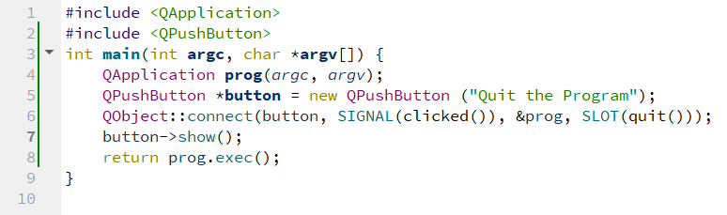
506.3 Change app to prog
https://www.youtube.com/watch?v=swZNOKKkQiw&list=PLD0D54219E5F2544D&index=6
Change app to prog
Now, we need to change app to prog.

Slide 12
506.4 Rerun Signal and Slot App

Slide 13
506.4 Rerun Signal and Slot App
https://www.youtube.com/watch?v=swZNOKKkQiw&list=PLD0D54219E5F2544D&index=6
Rerun Signal and Slot App
We run again.
Then, we click and quit the program.

Slide 14
506.5 Summary

Slide 15
506.5 Summary
https://www.youtube.com/watch?v=swZNOKKkQiw&list=PLD0D54219E5F2544D&index=6
Summary
In order to have user interaction, we need to have signals and slots.
Signals is the event that user does, and the slot is the code to run whenever the user clicks the button.

Slide 16
End

