Slide 1

510 Design UI
Peter H. Chen

Slide 2
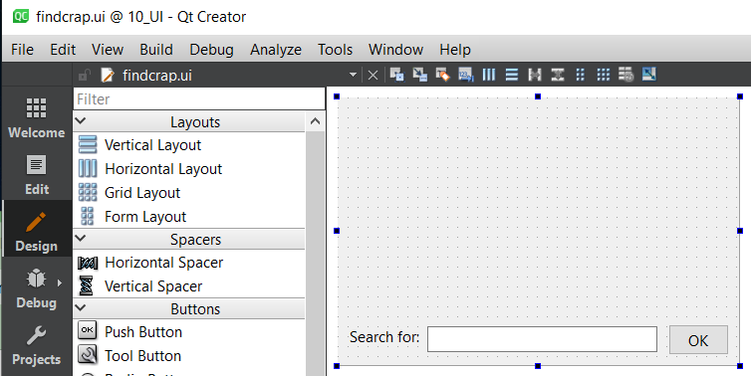
510 Design UI
https://www.youtube.com/watch?v=DUeMzXc2V_Q&list=PLD0D54219E5F2544D&index=10
Design UI
We have created the Label widget, Line Edit widget, and Pub Button Widget by the Qt Creator.

Slide 3
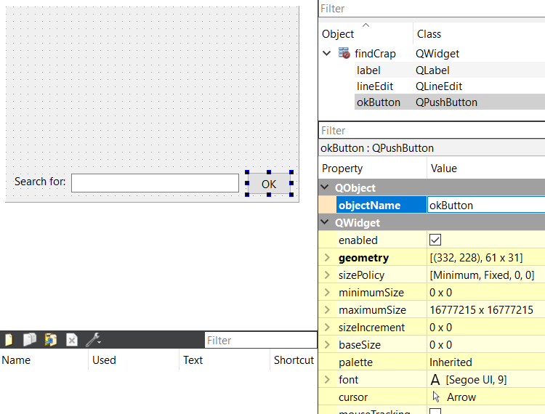
510 Design UI
https://www.youtube.com/watch?v=DUeMzXc2V_Q&list=PLD0D54219E5F2544D&index=10
Design UI
Select the widget, on the right-hand side, we can see the properties.
We can change the objectName to “okButton”.

Slide 4
510.1 UI Design: Text Edit Widget

Slide 5
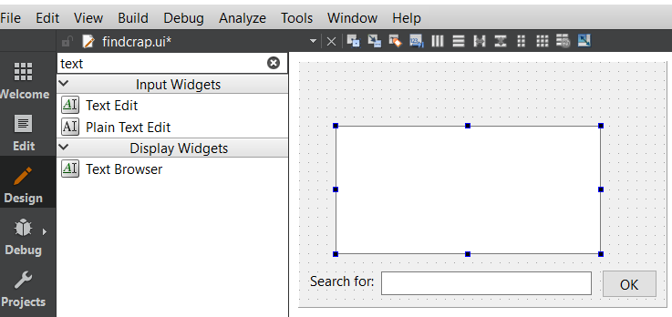
510.1 UI Design: Text Edit Widget
https://www.youtube.com/watch?v=DUeMzXc2V_Q&list=PLD0D54219E5F2544D&index=10
UI Design: Text Edit Widget
Drag and drop the “Text Edit” Widget to the right.
The “Text Edit” widget is for paragraph.
The “Line Edit” Widget for one line search.

Slide 6
510.2 Go To Slot

Slide 7
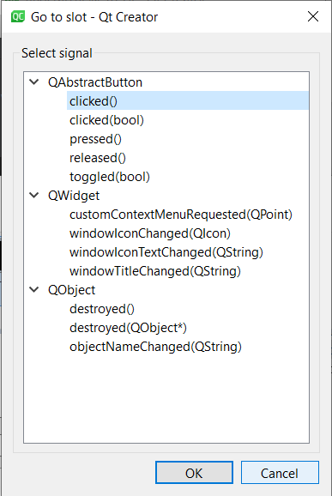
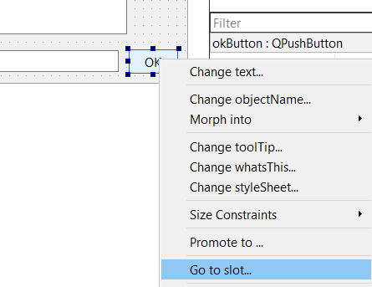
510.1 UI Design: Text Edit Widget
https://www.youtube.com/watch?v=DUeMzXc2V_Q&list=PLD0D54219E5F2544D&index=10
UI Design: Text Edit Widget
Select Push Button Widget, Right Mouse Button, and select “Go to slot…”.
Select “clicked()”, then we are ready to type in the code.

Slide 8
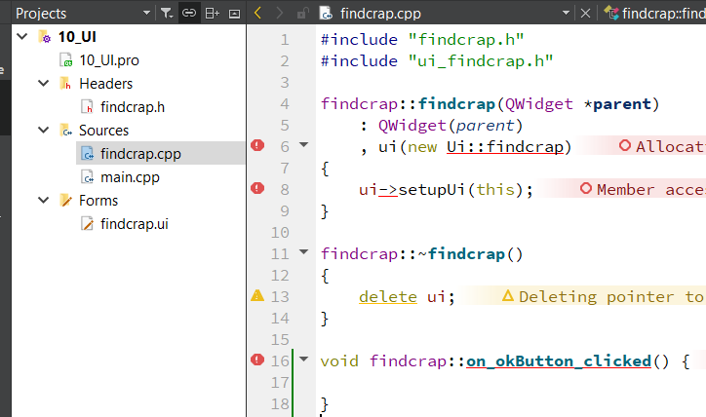
510.1 UI Design: Text Edit Widget
https://www.youtube.com/watch?v=DUeMzXc2V_Q&list=PLD0D54219E5F2544D&index=10
UI Design: Text Edit Widget
We are ready to insert the callback code.

Slide 9
End

