Slide 1

511 FindCrap
Peter H. Chen

Slide 2
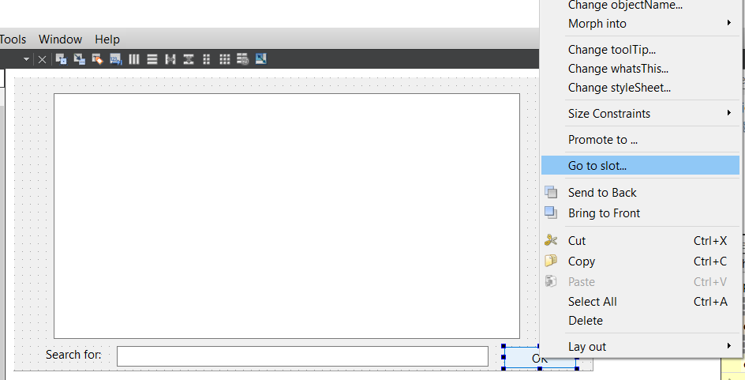
511 FindCrap
https://www.youtube.com/watch?v=pQHFqp0NK4E&list=PLD0D54219E5F2544D&index=11
FindCrap
Select OK widget and Right-mouse-click to select “Go to slot…”.

Slide 3
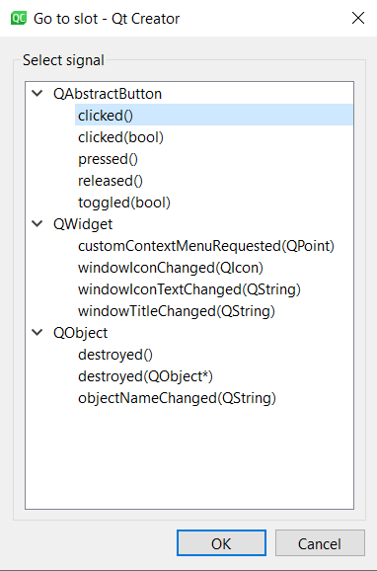
511 FindCrap
https://www.youtube.com/watch?v=pQHFqp0NK4E&list=PLD0D54219E5F2544D&index=11
FindCrap
Select “clicked()” will bring you to the callback function location for code implementation.

Slide 4
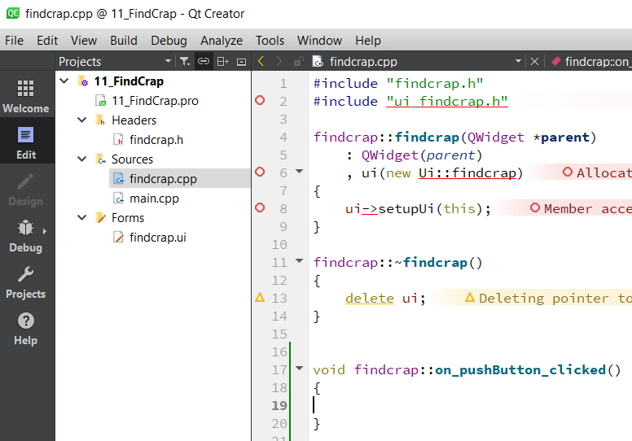
511 FindCrap
https://www.youtube.com/watch?v=pQHFqp0NK4E&list=PLD0D54219E5F2544D&index=11
FindCrap
We are ready to insert the callback code.

Slide 5
511.1 findcrap.h

Slide 6
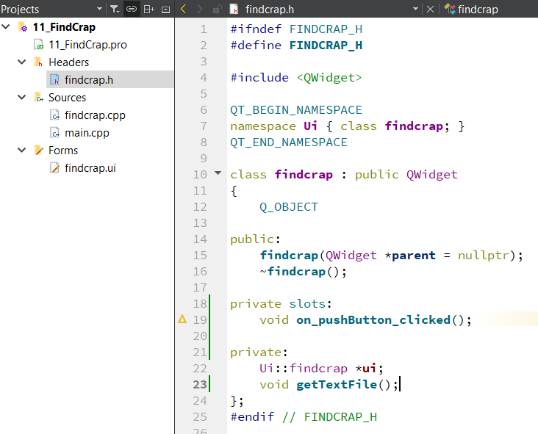
511.1 findcrap.h
https://www.youtube.com/watch?v=pQHFqp0NK4E&list=PLD0D54219E5F2544D&index=11
findcrap.h
We add the header function declaration.

Slide 7
511.1 findcrap.h
https://www.youtube.com/watch?v=pQHFqp0NK4E&list=PLD0D54219E5F2544D&index=11
findcrap.h
We need to understand line-by-line even the code is automatically generated.
namespace is for grouping.
Public and private member functions.

Slide 8
511.2 findcrap.cpp

Slide 9
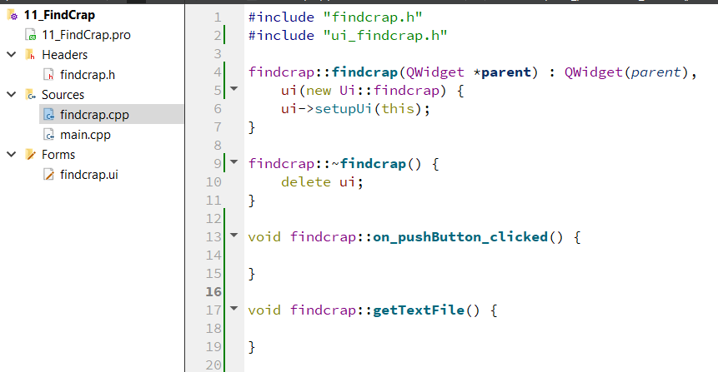
511.2 findcrap.cpp
https://www.youtube.com/watch?v=pQHFqp0NK4E&list=PLD0D54219E5F2544D&index=11
findcrap.cpp
findcrap.h is for function declaration.
findcrap.cpp is the function body definition with (::).
Copy constructor
“:” is for initialization.
QWidget() and ui initialization.
destructor

Slide 10
511.2 findcrap.cpp
https://www.youtube.com/watch?v=pQHFqp0NK4E&list=PLD0D54219E5F2544D&index=11
findcrap.cpp
We need to define
1. callback function: on_pushButton_clicked()
2. Function getTextFile()

Slide 11
End

