Slide 1

3 Cuda Introduction
Peter H. Chen

Slide 2
3 Cuda Introduction
https://www.tutorialspoint.com/cuda/cuda_introduction.htm
Cuda Introduction
The other paradigm is many-core processors that are designed to operate on large chunks of data, in which CPUs prove inefficient.
A GPU comprises many cores (that almost double each passing year), and each core runs at a clock speed significantly slower than a CPU’s clock.
GPUs focus on execution throughput of massively-parallel programs.

Slide 3
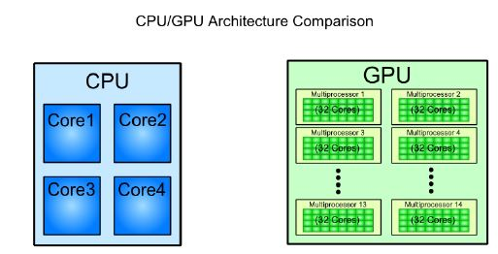
3 Cuda Introduction
https://www.tutorialspoint.com/cuda/cuda_introduction.htm
Cuda Introduction
For example, the Nvidia GeForce GTX 280 GPU has 240 cores, each of which is a heavily multithreaded, in-order, single-instruction issue processor, SIMD (Single Instruction, Multiple-Data) that shares its control and instruction cache with 240 cores.
When it comes to the total throughputs or Floating Point Operations per Second (FLOPS), GPUs have been leading the race for a long time now.

Slide 4
3 Cuda Introduction
https://www.tutorialspoint.com/cuda/cuda_introduction.htm
Cuda Introduction
GPUs do not have virtual memory, interrupts, or means of addressing devices such as the keyboard and the mouse.
GPUs are terribly inefficient when we do not have SPMD (Single Program, Multiple Data).
Such programs (No SIMD or No SPMD) are best handled by CPUs. They are not for GPUs. That is the reason why CPUs are still around.
For example, a CPU can calculate a single hash for a single string much, much faster than a GPU, but when it comes to computing several thousand hashes, the GPU wins.
As of data from 2009, the ratio between GPUs and multi-core CPUs for peak FLOP calculations is about 10:1.
Such a large performance gap forces the developers to outsource their data-intensive applications to the GPU.

Slide 5
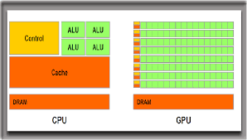
3 Cuda Introduction
https://www.tutorialspoint.com/cuda/cuda_introduction.htm
Cuda Introduction
GPUs are designed for data intensive applications.
This is emphasized-upon by the fact that the bandwidths of GPU DRAM has increased tremendously by each passing year, but not so much in case of CPUs.
Why GPUs adopt such a design and CPUs do not?
Well, because GPUs were originally designed for 3D rendering, which requires holding large amount of texture and polygon data.
In GPUs, there is no RAM Memory. GPUs only have the caches memory. Cache memory cannot hold such large amount of data.
To improve the performance, the GPUs has to increase the bus width and the memory clock.

Slide 6
3 Cuda Introduction
https://www.tutorialspoint.com/cuda/cuda_introduction.htm
Cuda Introduction
For example, the Intel i7 CPU, which currently supports the largest memory bandwidth, has a memory of bus width 192b and a memory clock up to 800MHz.
The NVIDIA GPU GTX 285 had a bus width of 512b, and a memory clock of 1242 MHz.
1. The CPU memory bus (192b) is much less than GPU (512b) which allow a lot of data flow in/out.
2. The CPU RAM memory clock is 800 MHz which is much slower than GPU GTX285 1242 MHz which is cache memory (There is no RAM memory in GPU).

Slide 7
3 Cuda Introduction
https://www.tutorialspoint.com/cuda/cuda_introduction.htm
Cuda Introduction
CPUs also would not benefit greatly from an increased memory bandwidth.
Sequential programs typically do not have a “working set” of data, and most of the required data can be stored in L1, L2, or L3 cache, which are faster than any RAM.
Moreover, CPU programs generally have more random memory access patterns, unlike massively-parallel programs, that would not derive much benefit from having a wide memory bus.

Slide 8
3.1 GPU Design

Slide 9
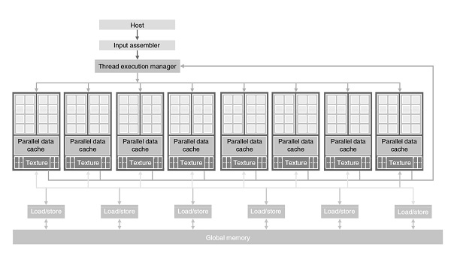
3.1 GPU Design
https://www.tutorialspoint.com/cuda/cuda_introduction.htm
GPU Design
Here is the architecture of a CUDA capable GPU.
1. There are 16 SMs (Streaming Multiprocessors) in the below diagram.
2. Each SM has 8 SPs (Streaming Processors).
1
2

Slide 10
3.1 GPU Design
https://www.tutorialspoint.com/cuda/cuda_introduction.htm
GPU Design
That is, we get a total of 128 SPs (= 8 PM x 16 SP/MP).
Now, each SP has a MAD unit (Multiply and Addition Unit) and an additional MU (Multiply Unit).
The GT 200 has 240 SPs, and exceeds 1 TFLOP of processing power.
Each SP is massively threaded, and can run thousands of threads per application.
The G80 card supports 768 threads per SM (note: not per SP).
Since each SM (Streaming Multiprocessor) has 8 SPs (Stream Processors), each SP supports a maximum of 96 threads.
Total threads that can run: 128 * 96 = 12,228.
This is why these processors are called “massively parallel”.
The G80 chips has a memory bandwidth of 86.4GB/s.
It also has an 8GB/s communication channel with the CPU (4GB/s for uploading to the CPU RAM, and 4GB/s for downloading from the CPU RAM).

Slide 11
3.2 Memory

Slide 12
3.2 Memory
https://www.tutorialspoint.com/cuda/cuda_introduction.htm
Memory
We discuss the difference between different types of memory.
1. DRAM stands for Dynamic RAM.
It is the most common RAM found in systems today, and is also the slowest and the least expensive one.
The RAM is named so because the information stored on it is lost, and the processor has to refresh it several times in a second to preserve data.
DRAM is very slow and need refresh, and require large amount of power consumption. DRAM cannot be used in GPUs.

Slide 13
3.2 Memory
https://www.tutorialspoint.com/cuda/cuda_introduction.htm
Memory
2. SRAM stands for Static RAM.
This RAM does not need to be refreshed like DRAM, and it is significantly faster than DRAM (the difference in speeds comes from the design and the static nature of these RAMs).
It is also called the microprocessor cache RAM.

Slide 14
3.2 Memory
https://www.tutorialspoint.com/cuda/cuda_introduction.htm
Memory
So, if SRAM is faster than DRAM, why are DRAMs even used?
The primary reason for this is that for the same amount of memory, SRAMs cost several times more than DRAMs.
Therefore, CPU processors do not have huge amount of cache memories.
For example, the Intel 486 line microprocessor series has 8KB of internal SRAM cache (on-chip).
This cache is used by the processor to store frequently used data, so that for each request, it does not have to access the much slower DRAM.

Slide 15
3.2 Memory
https://www.tutorialspoint.com/cuda/cuda_introduction.htm
Memory
3. VRAM stands for Video RAM.
It is quite similar to DRAM but with one major difference: it can be written to and read from simultaneously.
This property is essential for better video performance.
Using it, the video card can read data from VRAM and send it to the screen without having to wait for the CPU to finish writing it into the global memory.
This property is of not much use in the rest of the computer, and therefore, VRAM are almost always used in video cards.
Also, VRAMs are more expensive than DRAM, and this is one of the reasons why they have not replaced DRAMs yet.

Slide 16
End

